Slide 1
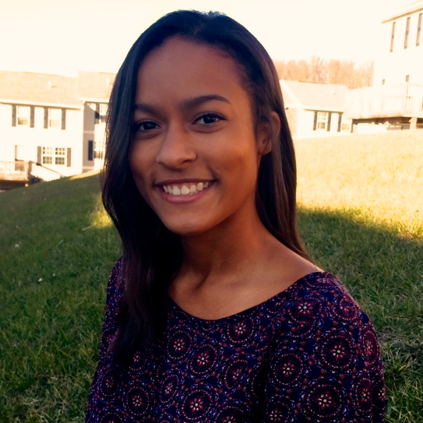
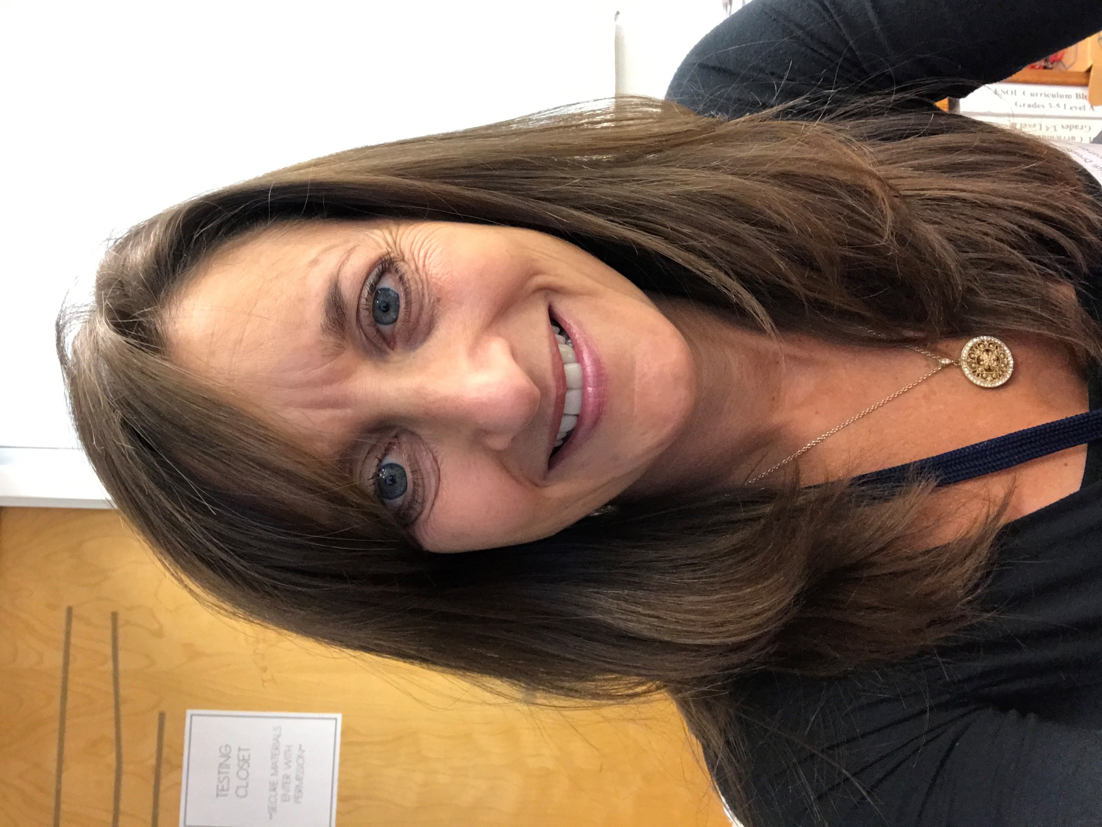
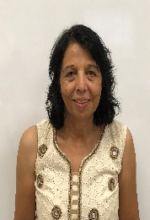
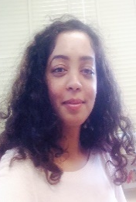
About Ms. Amegashie…
I was born in Bethesda, MD and grew up as a student attending Frederick County Public Schools. I came to Carl Sandburg in 2016 as the school’s new art teacher and have since received my ESOL certification as well. I am looking forward to working one on one with my ESOL students and learning more about each of their cultures.
About Mrs Dross…
I was born in Silver Spring, MD and grew up in Rockville, MD, as a student in MCPS. I began my career as a Special Education teacher in 1993 and I started teaching English for Speakers of Other Languages (ESOL) in 2012. I love being an ESOL teacher and learning about my students and their families!
About Ms. Tahir…
I was born in Pakistan. I immigrated to Canada with my family and went to college in Ontario, Canada. After Canada, I moved to Maryland. I started my career as a Focus Teacher in 2016. This is my first year as an ESOL teacher at Carl Sandburg. I’m really excited and looking forward to working with my students, their families, and my team at Carl Sandburg.
Welcome to Carl Sandburg’s ESOL program!
Carl Sandburg Learning Center
451 Meadowhall Drive
Rockville, MD 20851
About Ms. Arora…
I was born in Punjab, India, earned my M. A. And B. A from Punjab University, Chandigarh, India and began my career as a Lecturer in English at the University. My family moved to Australia and lived in Canberra, Australia for nearly 6 years. We moved to the U. S. in
the fall of 1986. While raising our children, I also earned M. Sc. degree in Special Education and an Advanced Professional Certification in ESOL. In MCPS, I began teaching English for Speakers of Other Languages in 1995. I have worked at Carl Sandburg L.C. as an ESOL teacher since 1995-to date. I love my job and always look forward to my students’ English language development!

Slide 2
What is ESOL?
What will your child learn?
How can you contact us?
English for Speakers of Other Languages (ESOL) is a program in Montgomery County Public Schools (MCPS) which supports students whose first language is not English. ESOL services support students in developing academic language proficiency in reading, writing, listening and speaking in English. ESOL is a support your child receives to help him/her become successful in the classroom and beyond.
Your child will learn many things in ESOL. Depending on your child’s needs he/she will learn vocabulary and ways to become a successful reader and writer in English. The ESOL teacher uses the same curriculum as the classroom teacher, but teaches language skills as well as academic skills.
For more information about the ESOL program please contact the ESOL team or the MCPS website:
www.montgomerycountyschoolsmd.org
You can call the school office:
301-279-8490
You can email us:
Anavi_M_Amegashie@mcpsmd.org
Samanju_B_Arora@mcpsmd.org
Heidi_H_Dross@mcpsmd.org
Ambreen_Tahir@mcpsmd.org
If at anytime you would like to know more about ESOL and what or how your child is doing please let us know.

