Slide 1

Tiered Assignments:
Creating Levels for Student Work

Slide 2
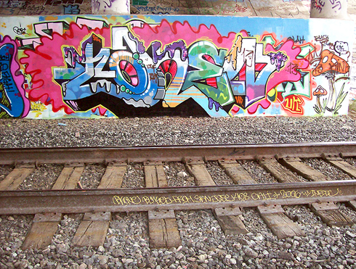
Please visit the graffiti wall. Use a black
marker and write one or two things you know about a particular term or concept.

Slide 3
Outcomes
As a result of this session, participants will be able to…
Define tiering and associated terminology
Identify important aspects and concepts of tiering
Consider options for tiering assignments

Slide 4
What is “Tiering?”
A form of differentiation where:
Two or three levels of the same assignment are presented
Levels differ in depth and complexity
Students have the opportunity to actively learn the SAME concept
Notes:
Discuss with participants different ways we hear about “tiers” outside of school – cakes, auditoriums, stadiums. Ask them to compare a theatre’s tiers with differentiation tiers – everyone sees the same “concept” but from different perspectives or levels.

Slide 5
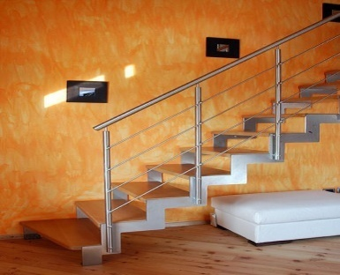

Tiering is…
A form of differentiation
Differentiation according to readiness, MI, or learning styles
Based upon students’ readiness or interest for a particular task
Driven by pre-assessment
NOT the only kind of differentiation, though it is foundational
NOT locking students into “ability boxes” -- groups are flexible and vary according to the task
NOT more work or “better” work for some levels – tasks are equitable

Slide 6
When tiering assignments, a teacher…
Selects learning goals
Pre-assesses students’ grasp of those goals
Designs several equally respectable tasks
    To meet those same learning goals
    With varying degrees of challenge and support
Infuses challenge and support into the task’s…
    Content (What the students learning about?)
    Process (What level of thinking is required?)
    Product (How will the results of the learning be represented and assessed?)

Slide 7
Key Principle:
Tiering relies on information gathered about students’ readiness to deal with specific things they need to know, understand, and be able to do.

Slide 8
To Tier,,,,or ( you know how it goes,,,)
When some students need additional time to master a skill or content
When activities can be matched by resources and readiness
When outcomes can be achieved through basic and advanced work
When outcomes can be demonstrated in more than one way
Start with a task and work your way up,,,,,, What do you want your students to know and be able to do?

Slide 9
Tiered assignments are usually created based on…
Student Readiness for a Skill
  Pre-assessment determines level of readiness
  Tiers reflect differences in critical thinking level or complexity
Multiple Intelligences or Learning Styles
  Tiers reflect differences in interest or learning preference

Slide 10
When tiering, you should be teaching the same objectives to all students, content mastery should take the same amount of time, and, most importantly, each student should be challenged to do his/her best at whatever level he/she is performing.
We all need to have respectful tasks and be challenged!

Slide 11

Respectful Tasks are
Different – not more or less
Equally active
Equally interesting and engaging
Fair in terms of expectations and time

Slide 12
Sample Exit Card: Science
Name:
What is mitosis?
Briefly explain the process of mitosis.
How does the process of mitosis connect with the rest of this unit?

Slide 13
Exit Card Groupings
Group 2
Group 1
Students with
some understanding
of concept or skill
Students who are
struggling with the
concept or
skill
Group 3
Students who
understand the
concept or skill
Readiness Groups

Slide 14
Features of Tiered Lessons
Based on Readiness
Struggling Learners
Less difficult independent reading
Spare text, more graphic aids
Fewer steps to complete
Very concrete
Knowledge and comprehension levels of thinking for independent work
Includes supportive strategies
Converges on “right” answer to solve problem (more closed-ended)

Slide 15
Average Learners
On-grade level reading materials
More steps
Concrete concepts used to transition to more abstract ones
Knowledge, comprehension, and application levels of thinking for independent work, higher levels with help
Assumes more inferencing and drawing conclusions with less teacher support
Mix of “right” and open-ended answers

Slide 16
Advanced Learners
More complex
reading materials
More steps or more
lengthy materials
since can read
faster
Abstract concepts
as much as possible
Analysis, synthesis,
and evaluation
levels of thinking
Requires inferencing
drawing conclusions,
and evaluating
Open-ended questions
almost exclusively

Slide 17
Tiered Lessons Based on Learning Style, Multiple Intelligences
Learning Styles
  Visual
  Auditory
  Kinesthetic/Tactile
Gardiner’s Multiple Intelligences
  Verbal/Linguistic
  Logical/Mathematical
  Visual/Spatial
  Bodily/Kinesthetic
  Musical
  Interpersonal
  Intrapersonal
  Naturalist

Slide 18
Content + Process + Product =
the learning experience
Examine the issues surrounding the use of the atomic bomb during WW II.
Establish your position for or against, and compose a convincing argument to be presented in a point/counter point
dialogue.
Adapted from “Differentiating Instruction in the Regular Classroom” - Heacox

Slide 19
Be consistent. Be sure everyone knows the rules in advance and that they are presented in clear, written form.

Slide 20
From Theory to Practice
English 10
Amon Colburn

Slide 21
Reflection
Think about a lesson or learning activity that you have recently implemented and ask yourself the following:
Did some of my students need more time to achieve mastery?
Could the outcomes been demonstrated by students
in more than one way?
Using the Tiered Lesson Plan Template
Draft one or two learning activities that support the objective. Activities can reflect readiness or learning style.

Slide 22


Next steps…
Think about a unit for next semester where tiered assessments can be incorporated.
Consider collaborating with course alike colleagues to develop tiered learning activities.

Slide 23

Do you….
Have additional questions or concerns that you would like to discuss?
Need help locating additional resources?
Need another pair of hands to get the job done?
Feel free to contact me
and I will be happy to help!!

Slide 24
Now…revisit the graffiti wall, and use a
purple marker to add any new terms, concepts, or
reflections that you have acquired as a result
of this session.

Slide 25
Additional Resources
http://www.learnerslink.com/curriculum.htm
http://www.bertiekingore.com/tieredinstruct.htm
http://www.saskschools.ca/curr_content/bestpractice/tiered/index.html
http://www.manhattan.k12.ca.us/staff/pware/diff/
http://www.doe.state.in.us/exceptional/gt/tiered_curriculum/welcome.
http://www.uhseport.net/published/k/sh/kshaw/collection/1/

