Slide 1
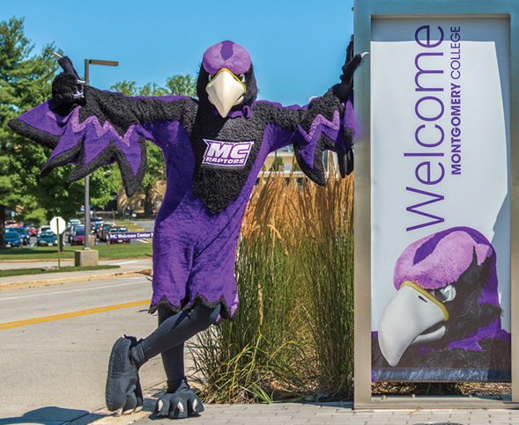
Summer Workshop
Nicholas Boyd
Recruitment & College
Access Specialist

Slide 2
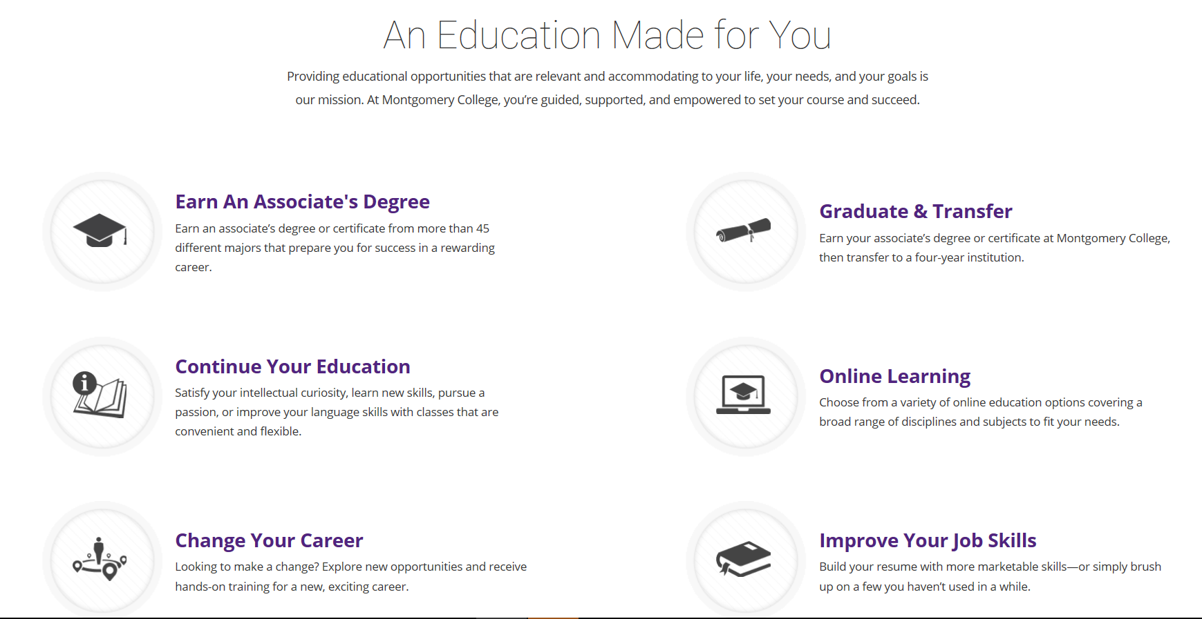
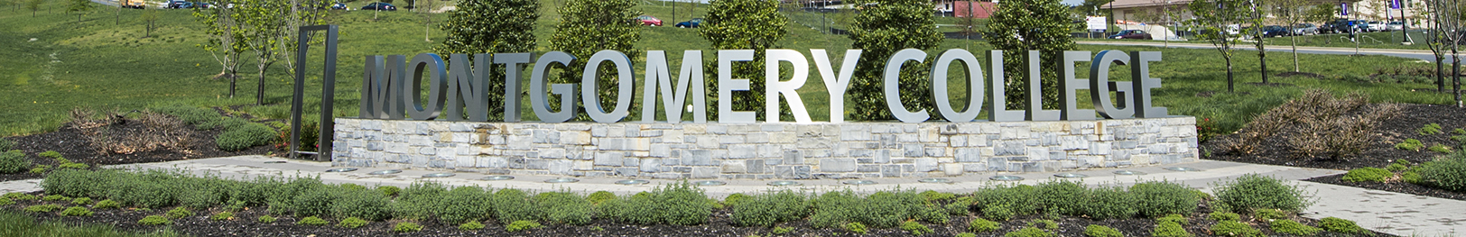
Notes:
Designed to prepare you for transfer to a 4 year school
Courses transferable to most colleges and universities
Get right into the workforce

Slide 3
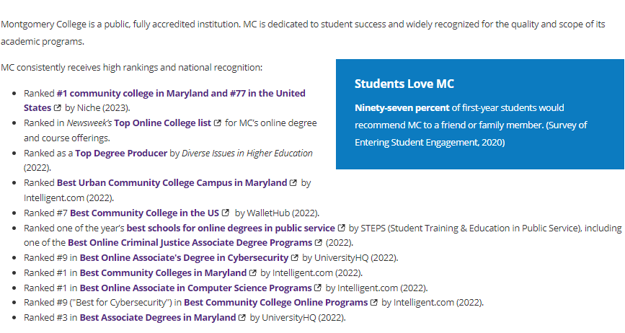
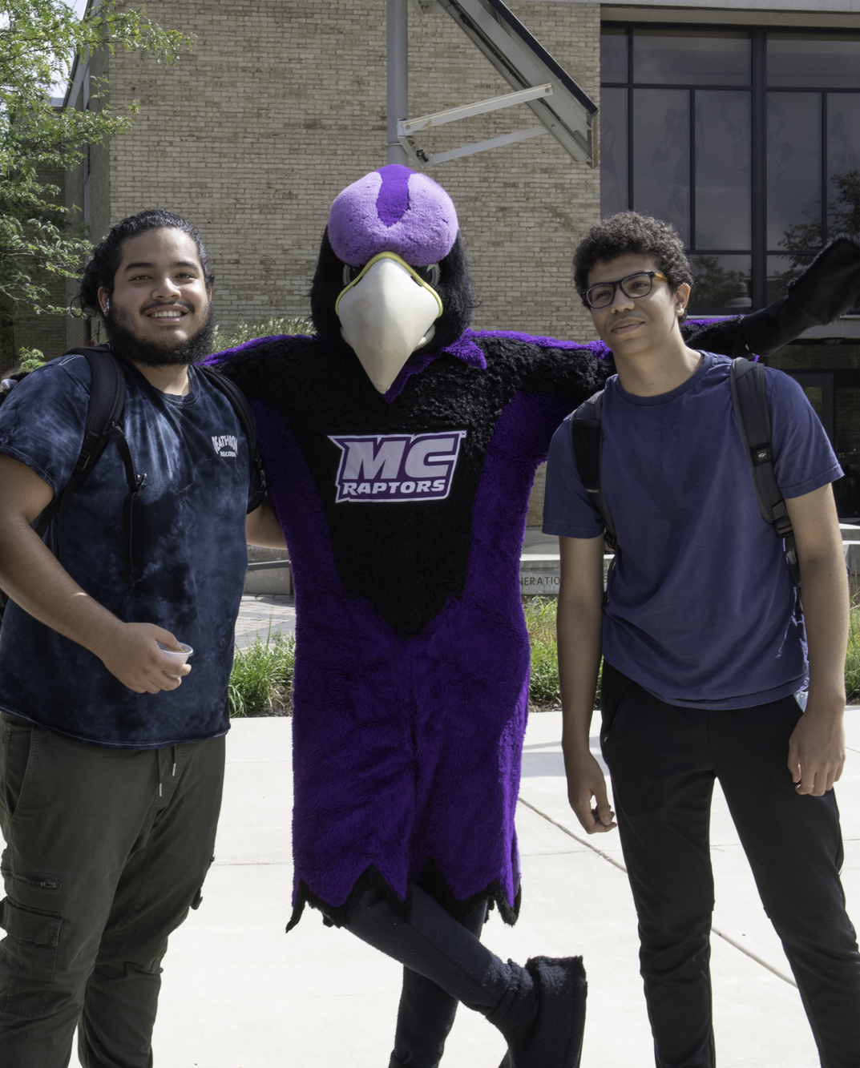
MC is Nationally Ranked

Slide 4
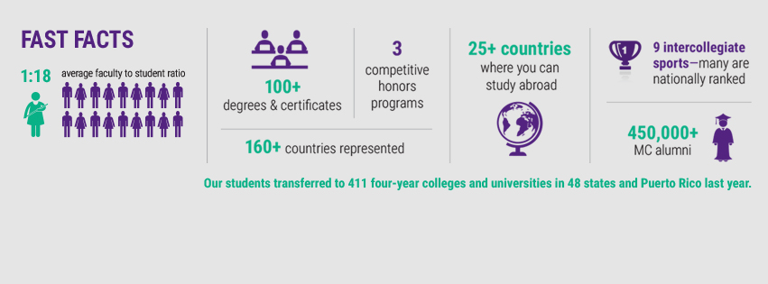
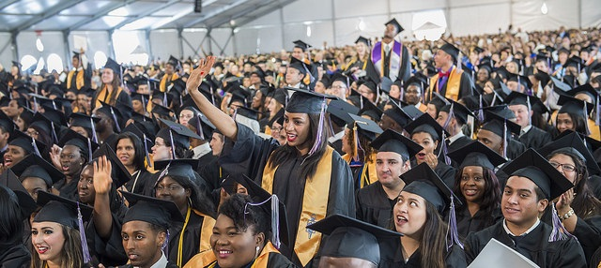
Picture Yourself Here
Notes:
Review fast facts
Diversity
Study Abroad
Alumni
Approx. 60,000 students credit (D.L) & non-credit
Personal story

Slide 5
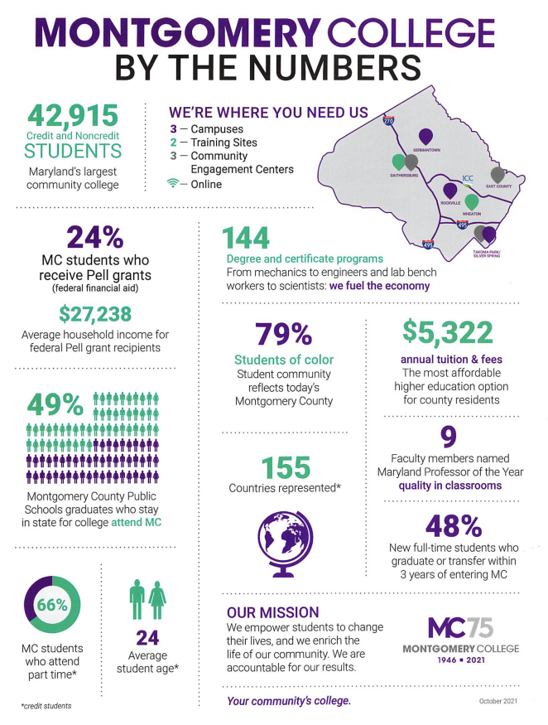

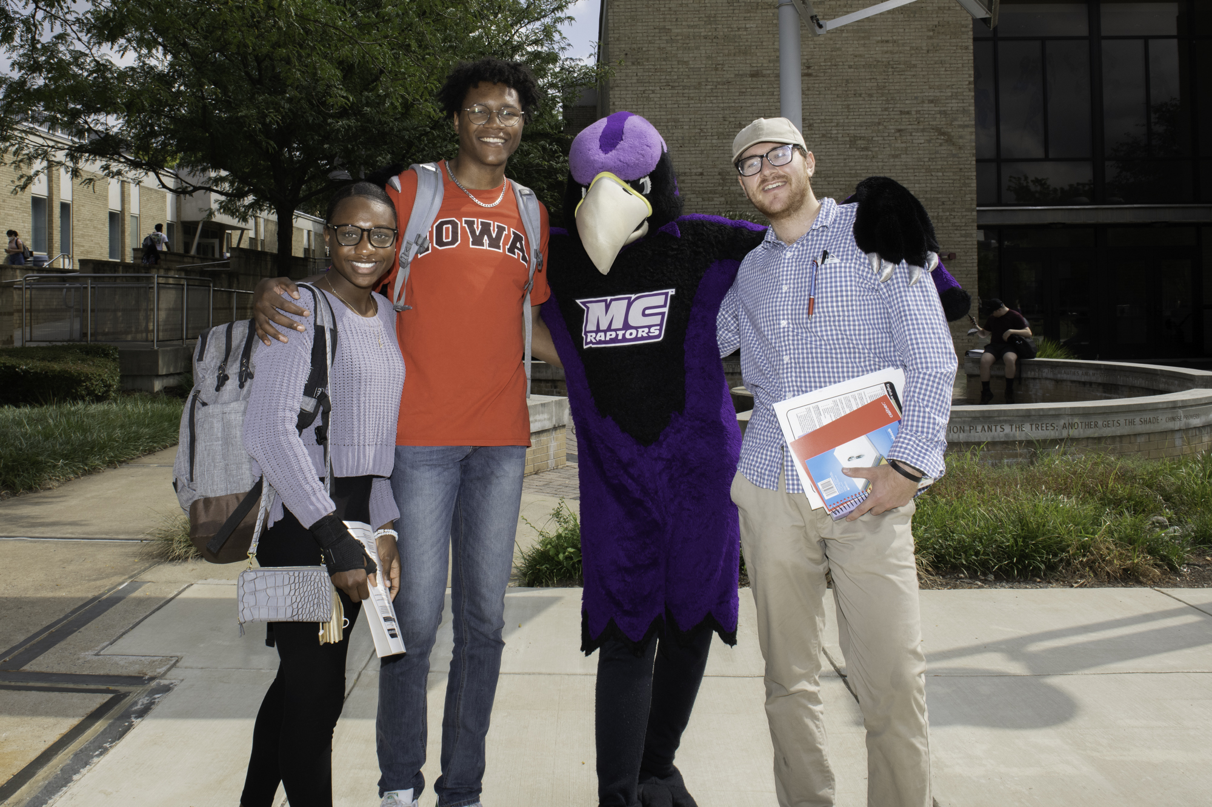
Notes:
Talk about credit and non credit options
Talk about specific programs-Nursing, Engineering, Cyber Security & Gudelsky

Slide 6
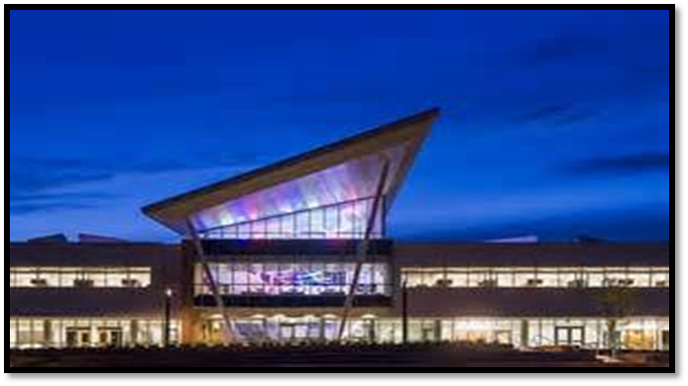
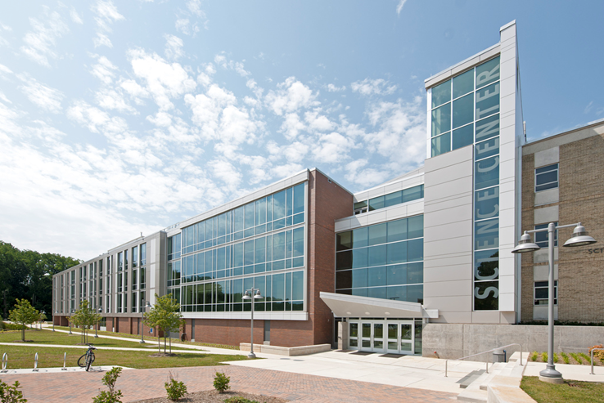
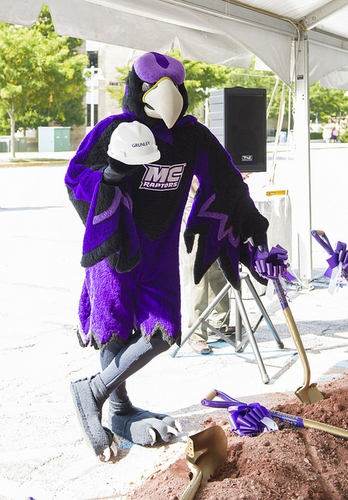
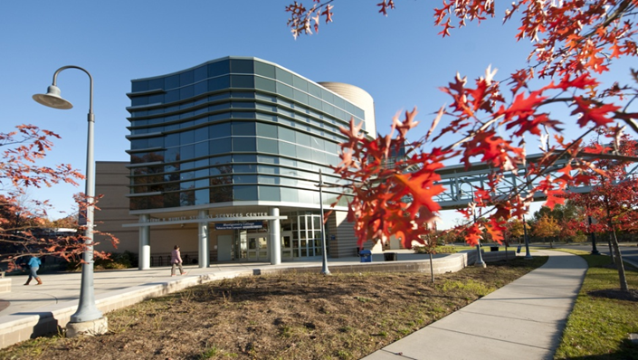

Three Campuses, One College
Notes:
Germantown
Approx. 7,700 students
High Technology and Science Center
State-of-the-art facilities
Bioscience Education center
Globe Hall
High technology programs
Network & Wireless Technologies
Biotechnology
Rockville
Approx. 16,000 students
Programs
Communication
Applied Technologies
Engineering
Computer Gaming
Exercise Science
Building Trades
Automotive
Criminal Justice
STEM
Takoma Park/Silver Spring
Approx. 7,800 students
Students from over 170 countries
Health Science programs
School of Art + Design

Slide 7
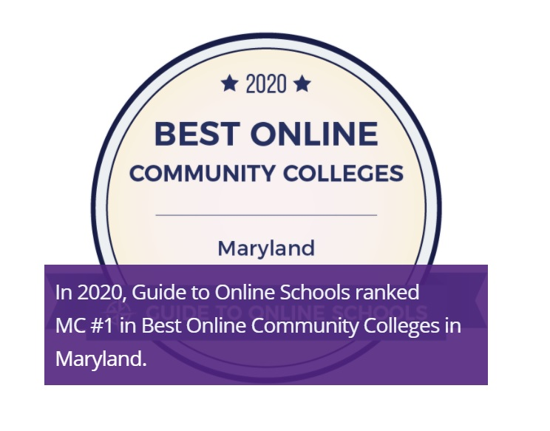
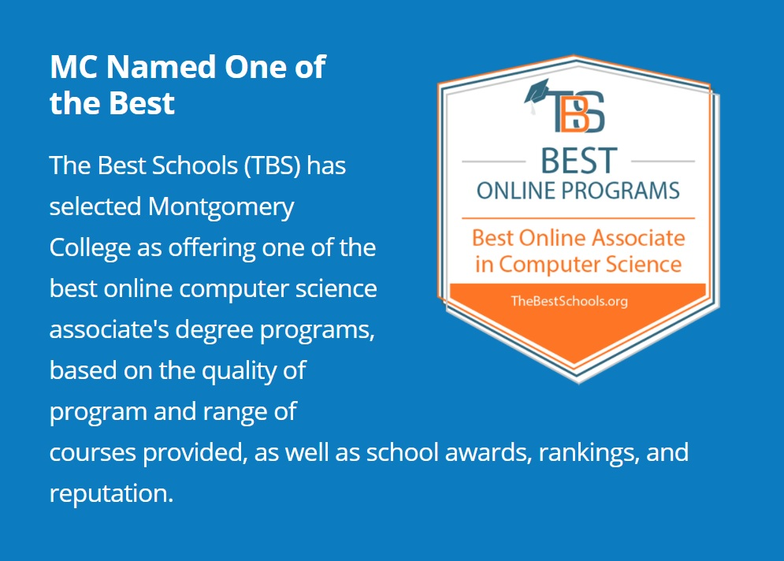
Flexible Options
15, 13, and 7- week courses are available
Many degrees are offered fully online: Business, Computer Science, Criminal Justice, Cybersecurity, Digital Media & Web Technology, General Studies & Early Childhood Technology
Z courses and degrees that require zero textbook purchases
Credit and non-credit course options
Notes:
https://www.montgomerycollege.edu/academics/online-learning/index.html

Slide 8











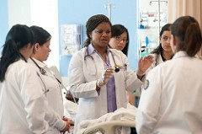







Go Anywhere
Keyword search: Transfer Agreements or
Career Services
Notes:
Designed to prepare you for transfer to a 4 year school
Courses transferable to most colleges and universities
Get right into the workforce

Slide 9
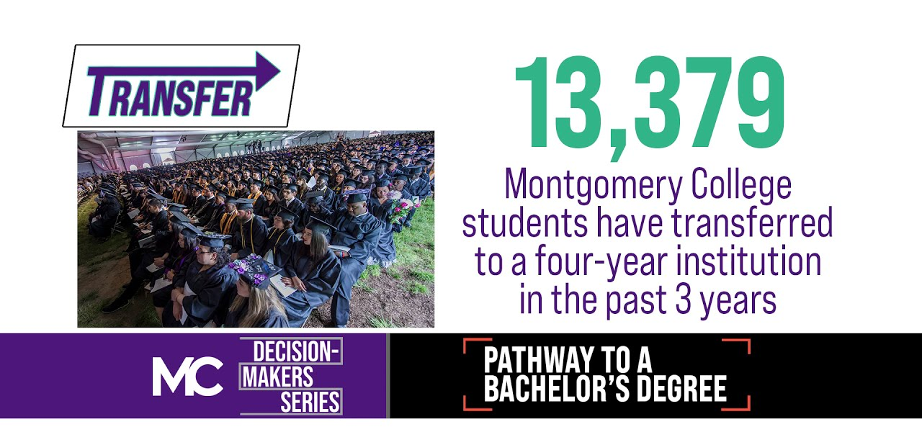
Keyword search: Transfer Agreements
Notes:
Designed to prepare you for transfer to a 4 year school
Courses transferable to most colleges and universities
Get right into the workforce

Slide 10
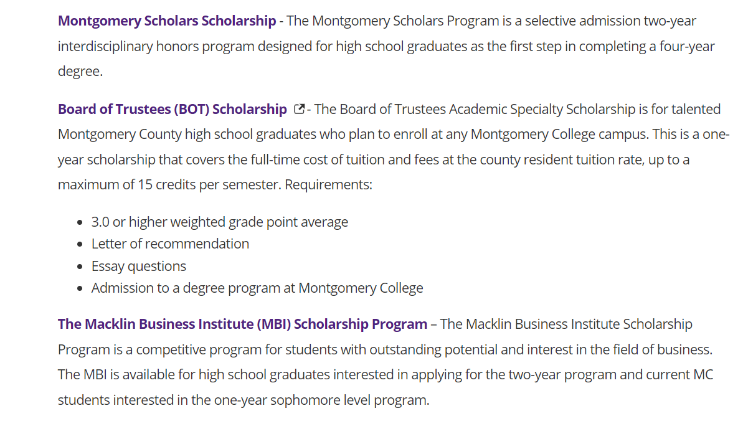
Montgomery College
Scholarships
www.montgomerycollege.edu/scholarships

Slide 11

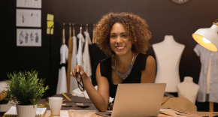
Earn a Certification
Careers in Technical Specialties are in Extremely High Demand
In 2020, 65% of all jobs in our economy required post-secondary education (Georgetown). 90% by year 2025.
Careers in welding, home improvement, and many others need specialists such as HVAC Tech, Electrician, IT, Plumbing, Nursing, Carpentry, etc.
At MC, many programs will give you the options to transition to Associates Degrees
https://www.montgomerycollege.edu/workforce-development-continuing-education/index.html
Keyword search: Workforce Development
Notes:
Designed to prepare you for transfer to a 4 year school
Courses transferable to most colleges and universities
Get right into the workforce

Slide 12
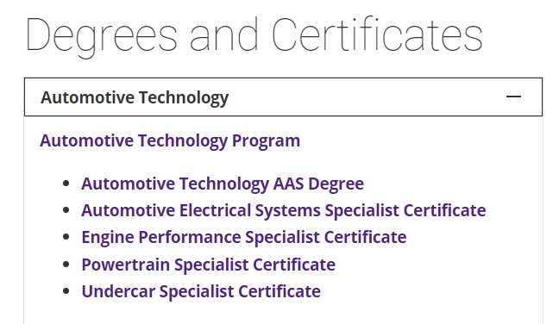
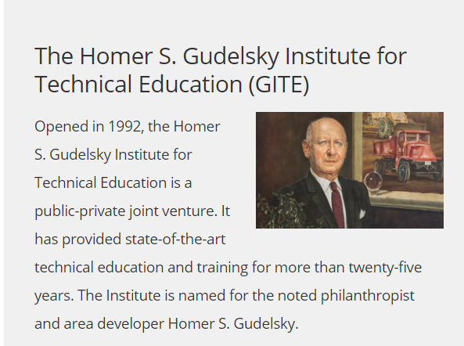
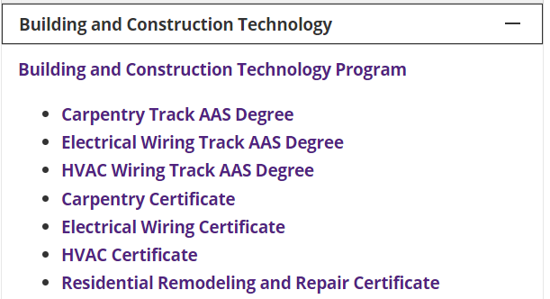
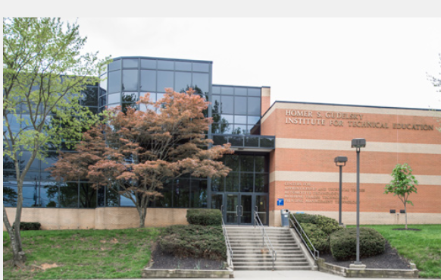
Gudelsky Institute
For Technical Education
Keyword search: Gudelsky Institute

Slide 13

Notes:
Designed to prepare you for transfer to a 4 year school
Courses transferable to most colleges and universities
Get right into the workforce

Slide 14

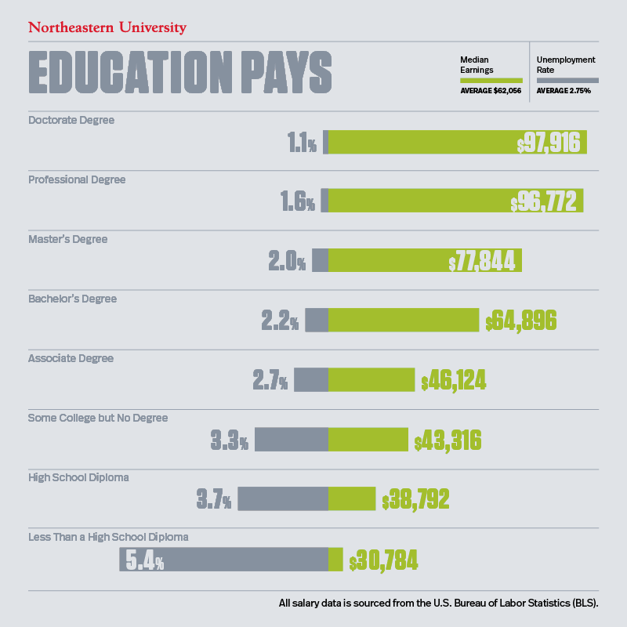
Earning Potential by Education Level

Slide 15

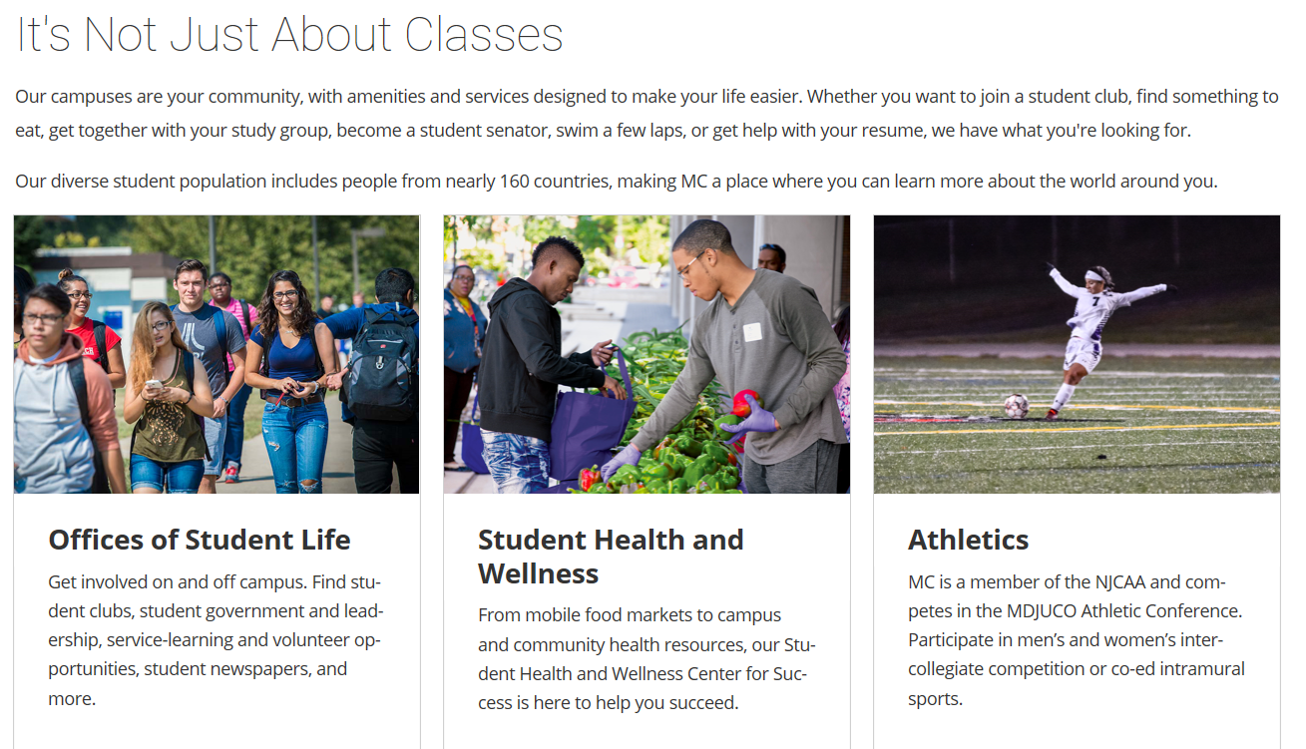

Slide 16
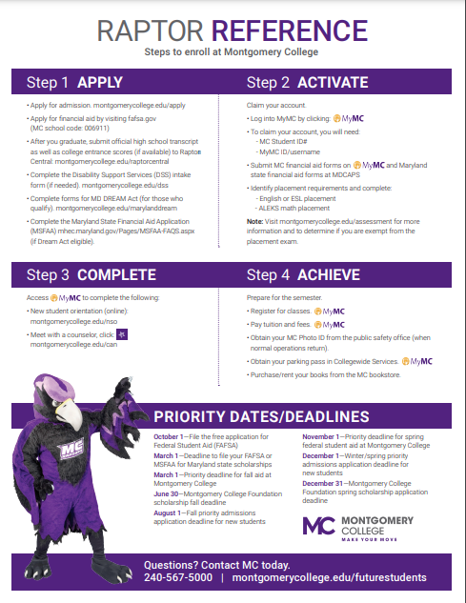

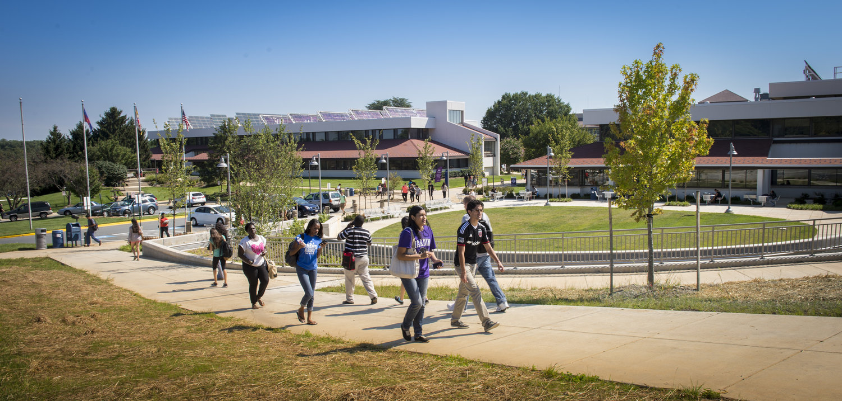

Slide 17
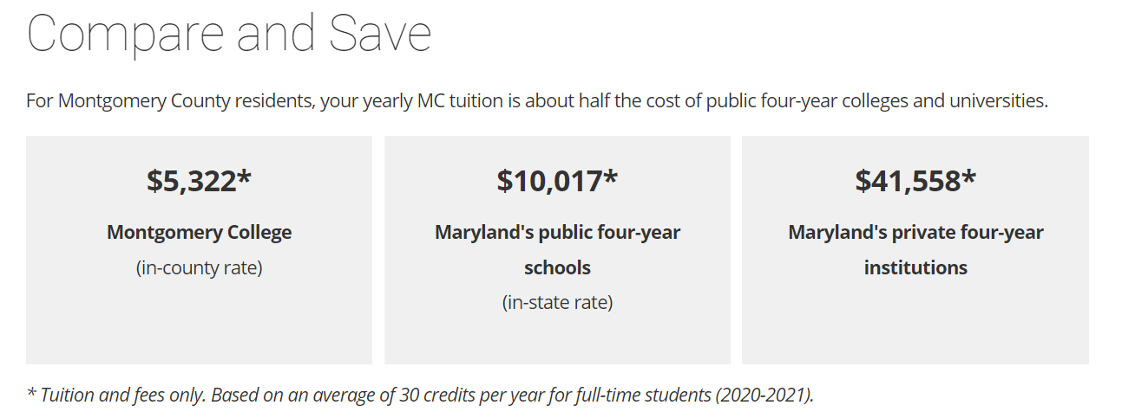
Notes:
Designed to prepare you for transfer to a 4 year school
Courses transferable to most colleges and universities
Get right into the workforce

Slide 18
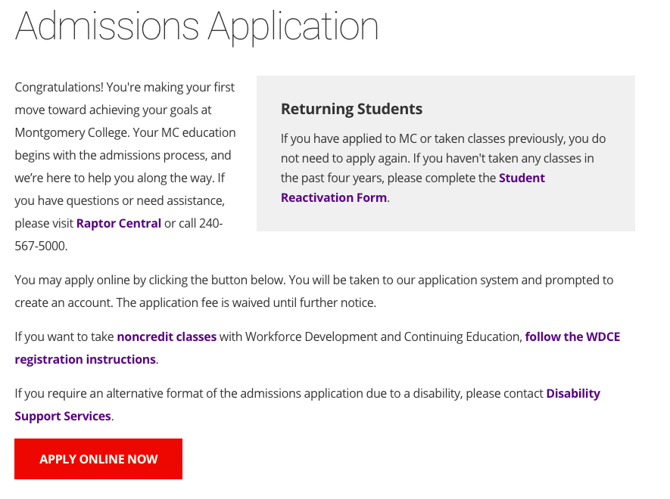
www.montgomerycollege.edu/apply
Fall 2023 Application opens on October 1, 2023. No application fee!

Slide 19
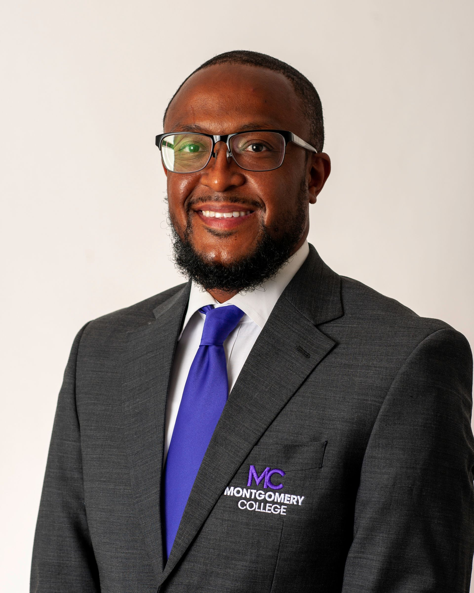
Thank you!
Nicholas Boyd
Nicholas.Boyd@montgomerycollege.edu
(240)567-4451
Explore the MC Future Student webpage by visiting www.montgomerycollege.edu/futurestudents

