Slide 1
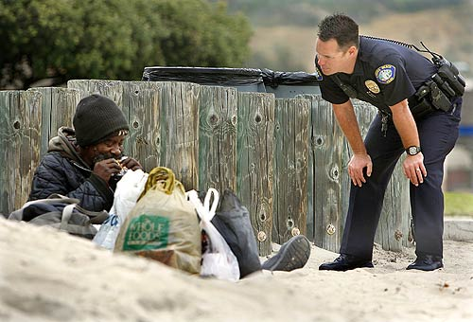
Helping the Homeless
By Susana, Isabella, David, Gaby and Melissa

Slide 2
Homeless Americans
Before 1980 the word homeless was almost unknown in the U.S. Many hardworking people had jobs that paid little and offered no health insurance. Often, if they became sick or disabled, they were fired.

Slide 3
Homeless Kids
Not many homeless teens have the typical high school experience, 50 percent of homeless children ages 16 or older drop out of school to go to work to get money instead. 4,775 people under the age of 21 and including 706 children under the age 18 were turned away from homeless shelters in Chicago.

Slide 4
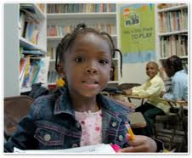
Home Away From Home
Did you know that homeless teens may be sitting next to you in class? People think that homeless people live under a bridge or in a car or on a bench. But there were about 15,027 homeless students enrolled in Chicago public schools alone during the 2009-2010 school year.

Slide 5
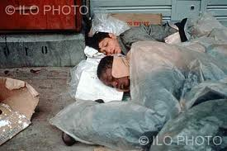
The homeless
Homeless children are not to blame for their situation. It is not their fault. Many homeless children enter new schools with dirty clothes , and pain in their hearts. Classmates sometimes make fun of them.

Slide 6
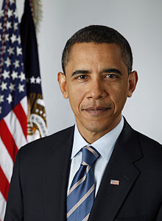
President Barack Obama’s Note
"I'm heartbroken that any child in America is homeless. Part of the change in attitudes that I want to see here in Washington and all across the country is a belief that it is not acceptable for children and families to be without a roof over their heads in a country as wealthy as ours. President Barack Obama, March 24, 2009

Slide 7
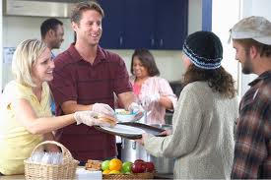
How to help the homeless
Donating clothing
Donate toys
Volunteer at a soup kitchen
Play with children
Respect the homeless
Give recyclables
Donate a bag of groceries

Slide 8
The End
And that’s why you should help the homeless.
We can help the homeless and you can too!

