Slide 1
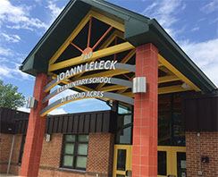
Who are the school counselors?
Mr. Fernando Moreno (Room 400) will be primarily supporting students in Pre-Kindergarten-2nd grade.
Ms. Rachel Margulies (Room 401) will be primarily supporting students in 3rd-5th grade.
The BARK Promise:
“I am a part of JoAnn Leleck Elementary School at Broad Acres.
I promise to…
Be respectful
Act responsible
Remain ready and
Keep safe.”
Contact Us:
JoAnn Leleck Elementary School at Broad Acres 710 Beacon Road Silver Spring MD 20903
Phone: (240) 740-1900
Mr. Fernando Moreno (Pre-K to 2)
Fernando_Moreno@mcpsmd.org
Ms. Rachel Margulies (3-5)
Rachel_H_Margulies@mcpsmd.org
School Counseling Program
(2017-2018)
Our Mission is to help children be healthy and successful through culturally appropriate and family oriented social emotional interventions.
Our Vision is to develop the whole child by taking into consideration cultural, familial and socioeconomic needs, developing their self-awareness, and cultivating their social, emotional, and academic skills.
JoAnn Leleck Elementary School at Broad Acres
*Support from the school counselors can be referred by parent, JLES staff member, or by student self-referral*

Slide 2
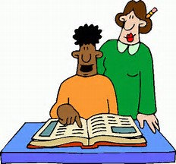
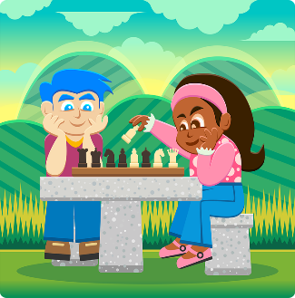
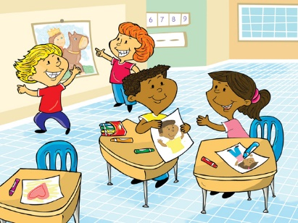
We provide the following counseling services:
Counseling Small Groups:
Groups will meet weekly for 6-8 weeks and work with students on topics such as:
Social Skills
Anxiety
Self-Esteem
Anger
Grief and Loss
Acculturation and Integration
Separation from Families
Classroom Lessons:
Monthly classroom lessons will take place this school year on a variety of topics based on grade level. Lessons are based on the main counseling standard areas of development: Academic, Personal, Interpersonal, Career, and Healthy Development.
TOPICS INCLUDE:
Study and Learning Skills
Career Awareness
Personal Safety
Friendship
Anti-bullying Behaviors
Goal Setting
Empathy
Decision Making
Diversity/Respecting Differences
Social Emotional Learning with Chess
Individual Support:
Individual, short-term, counseling support will be provided on an as-needed basis. Individual meetings are intended to help children solve difficult problems, make good choices, and do their best!
~We use chess as a metaphor for life to develop social emotional skills~

