Slide 1
C.H.E.S.S.
“Chess Helps Every Student Succeed”
Developing Socio-Emotional Skills for All Students
Fernando Moreno
NCC, NCSC, LCADC
Elementary School Counselor
JoAnn Leleck ES at Broad Acres
Montgomery County Public Schools, MD, US
Fernando_Moreno@mcpsmd.org
International “Chess in School” Conference
Yerevan, Armenia 16 - 18 October 2014

Slide 2
Media clip students playing
http://youtu.be/Pd-1MrAZkO4

Slide 3
A Description of JoAnn Leleck Elementary school
JoAnn Leleck ES is part of the Montgomery County Public Schools (MCPS 2014) school district, a large suburban district located in the state of Maryland in the United States.
MCPS | JoAnn Leleck ES at Broad Acres
Contains more than 150,000 students (PK-12th grade) | Contains approximately 780 students (PK-5th grade)
35% of students receive Free and Reduced Meals (FARM) | 95% of students receive FARMS
14% of students are classified Language Limited English | 75% of students are ELL
 | Students display disproportionate levels of major health problems

Slide 4
What Students see and experience in the neighborhood surrounding joann leleck elementary school:
Alcohol and other drug use
Domestic and family violence
Truancy from school
High risk of gang involvement and teenage pregnancy
Lower rates of achieving higher education (college degrees)

Slide 5
Abstract
C.H.E.S.S. is a chess counseling program conducted in a Title I Elementary School called JoAnn Leleck ES at Broad Acres in Silver Spring, Maryland. “Chess Helps Every Student Succeed” is an integral part of the school culture¹.
C.H.E.S.S. was initiated in 2007 with a grant from the MD State Department of Education. Since 2007, the program has secured grants through other non-profit organizations.
This program implements the conclusions already published by Ramon Aciego (2012) about the benefits of playing chess regularly. C.H.E.S.S. facilitates the development of socio-emotional and problem-solving skills and improves the integration of ELL learners into the school community.
Surveys of upper grade students suggest that the C.H.E.S.S. program benefits all students, not just those who participate in the after-school chess program.
1. Students receive counseling services through chess, socialize over chess and expect it to be present, receive recognition through chess, expand background knowledge through chess, and take chess home with them.

Slide 6
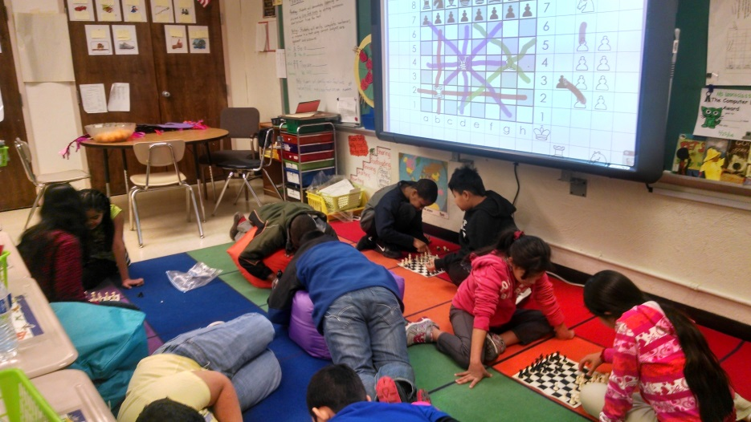
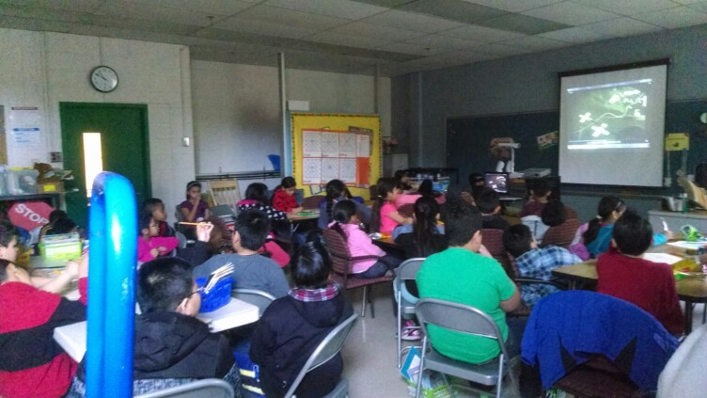
Purpose of c.h.e.s.s.
To facilitate the development of social-emotional, problem-solving, and thinking skills
To improve the integration of English Language Learners
C.H.E.S.S achieves these goals by using chess as a metaphor for life in the classroom, in small groups and through individual instruction.

Slide 7
Chess skills are correlated with socio-emotional skills
What are socio-emotional skills²?
  Recognizing and managing emotions
  Developing caring and concern for others
  Establishing positive relationships
  Making responsible decisions
2. These are skills that allow children to calm themselves when angry,
to make friends, to resolve conflicts respectfully, and to make ethical and safe choices (Collaborative for Academic, Social and Emotional Learning, CASEL 2014).

Slide 8
The Central Premise of C.H.E.S.S.
The chess board represents the life of a student
Each student identifies with different chess pieces
The way students move the pieces leads to success or failure in the game
The skills they learn along the way equip them to lead better lives

Slide 9
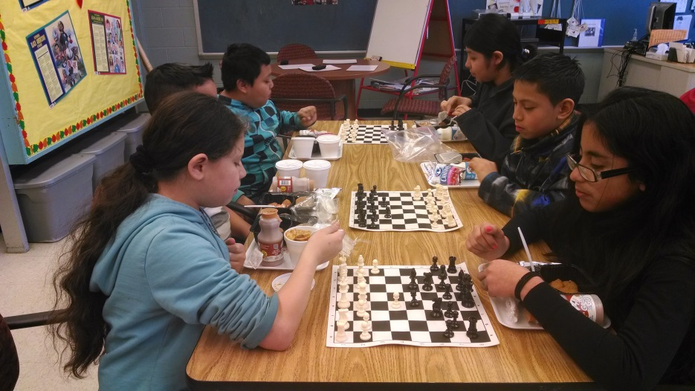
The three Components of C.H.E.S.S.
Using Chess to Counsel Children
Creating an After-School Chess Program
Participating in Chess Tournaments

Slide 10
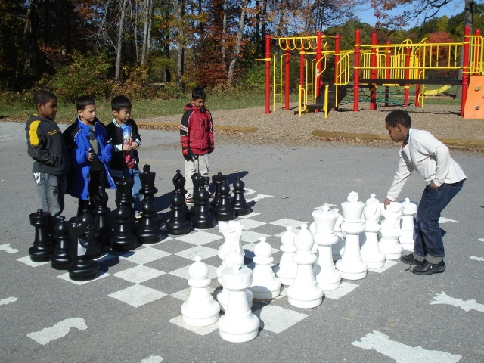
Counseling with Chess
A chess curriculum is presented to all students in the upper grades, integrating socio-emotional skills through chess (Moreno 2002).
Whole classroom instruction occurs once a month
Individual counseling sessions reinforce the use of chess as a metaphor for life
Supportive lunch groups use chess as a tool to discuss these issues

Slide 11
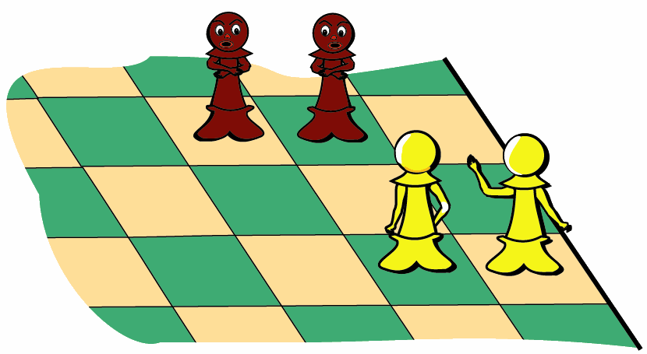
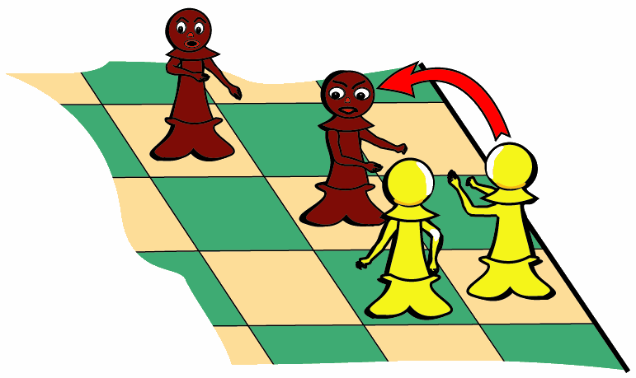
Using Chess to Discuss Real Life Situations
What should I do?
What’s the best thing to do?
Should I now fight back?
Two Pawns meet
two Pawns,
then a Pawn moves
to attack.
Poem and graphics by M. P. Kusen

Slide 12
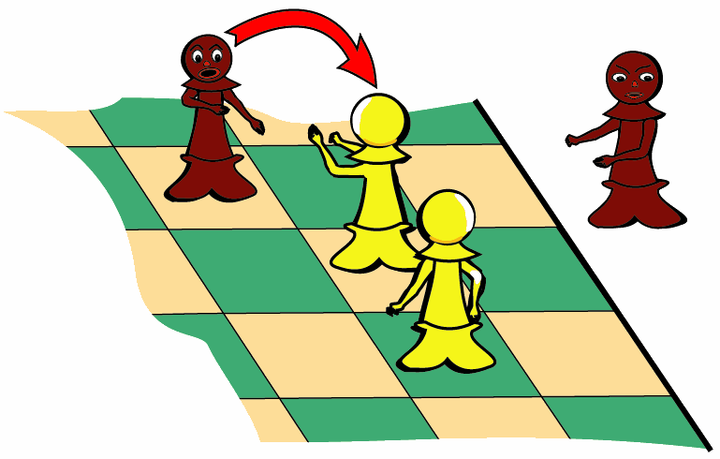
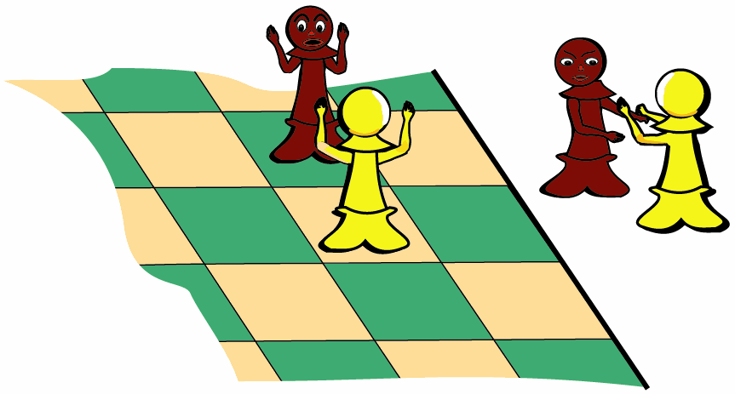
If I fight
and
capture . . .
I’ll be
captured too!
Then my pal
will be blocked,
is that the best
thing I can do?
Poem and graphics by M. P. Kusen

Slide 13
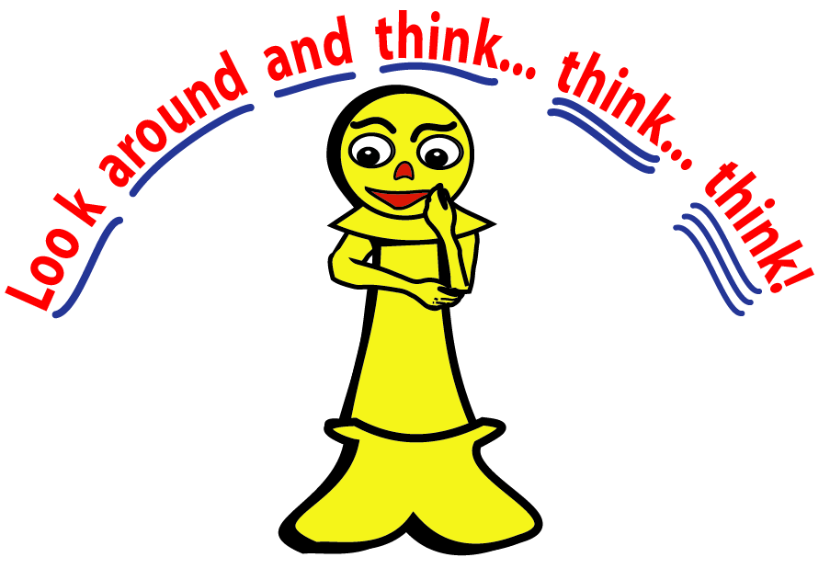
But suppose I think of other moves,
instead of just reacting.
Let’s look around… and think a bit,
before we go attacking.
Poem and graphics by M. P. Kusen

Slide 14
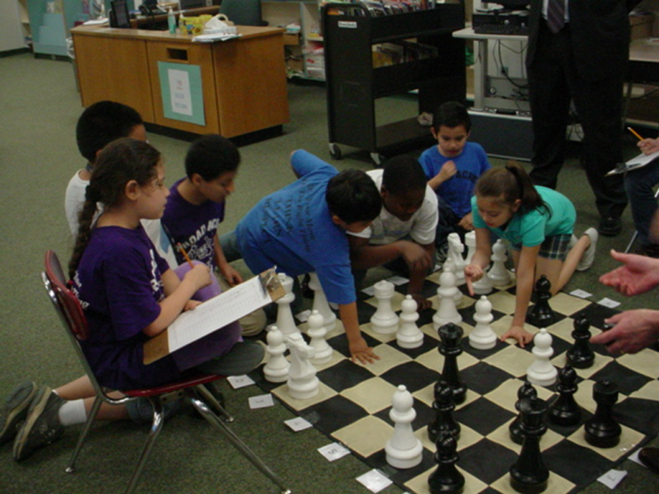
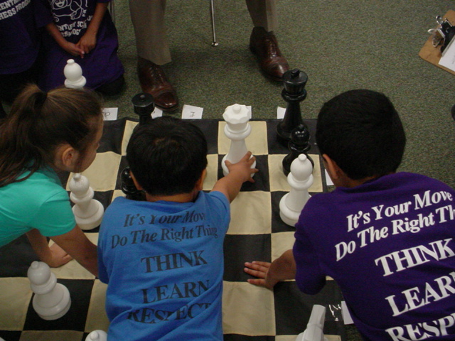
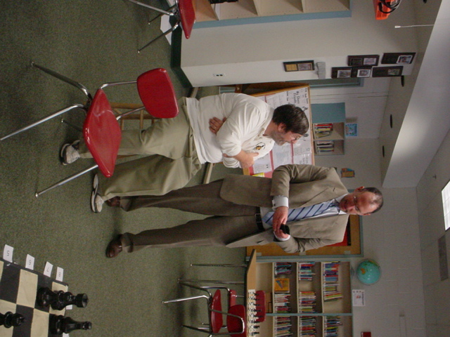
Joshua Starr ‏ @mcpssuper
“I'm about to play chess against 6 Broad Acres students. Wish me luck!!”
My opponents are talking to each other about their next move. Critical thinking and collaboration skills.
“I lost miserably!! Fernando Moreno has taught them well.”

Slide 15
Survey Results from 2007-2008 to 2012-2013
 | 07-08 Only Club | 11-12 Only Club | 07-08 All students |  | 11-12 All students
Likes chess | 98% | 97% | 79% | 85%
Tournaments | 88% | 94% | 58% | 55%
Knows How To Play | 98% | 99% | 42% | 65%
Life Issues | 70% | 80% | 58% | 67%
Life decisions | 77% | 82% | 62% | 69%
School work | 75% | 83% | 55% | 63%

Slide 16
Interpreting survey Results
Students demonstrate that the implementation of C.H.E.S.S. over this period benefited them in meaningful ways.
Students in the after-school chess club AND the overall student body believe that chess helps them significantly with their school work and their ability to make good decisions.

Slide 17
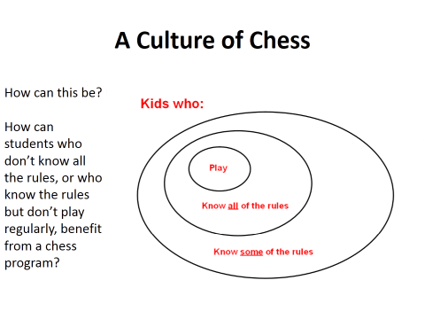
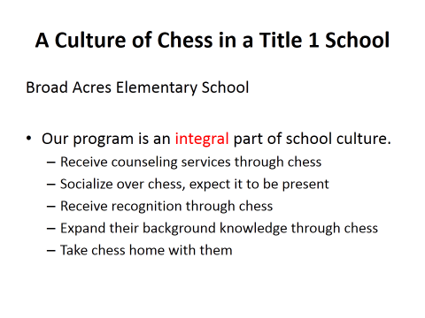
Conclusion
“Chess Helps Every Student Succeed” has proven that it is possible to create a chess program that benefits the overall culture of the school, independent of the students’ socio-economic status, language abilities, and previous knowledge of the game.
Part of the program can naturally be used to create tournament players, but this should not be the primary goal of the program.

Slide 18
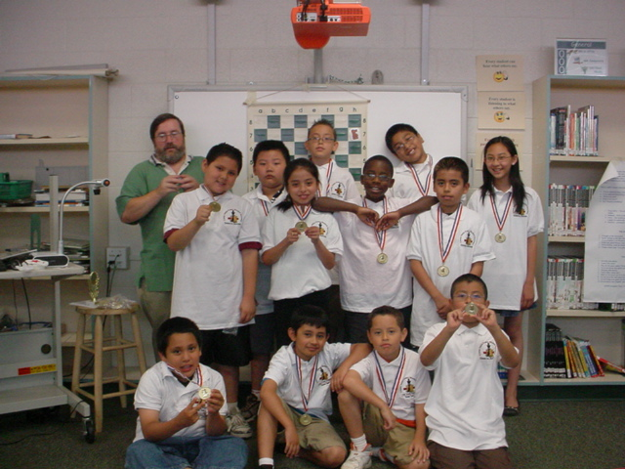
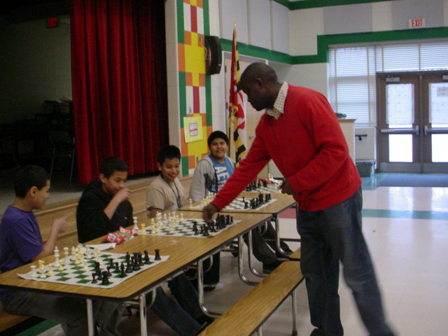
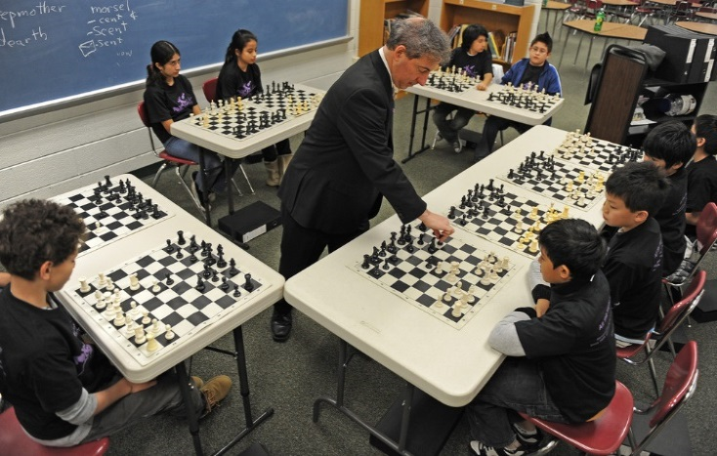
The After-School Chess Club
The after-school chess club is for students in the upper grades. Around 100 students signed up last year.
Former students from the program who are in middle school and high school help teach chess during the after-school sessions (Moreno 2014).
Special features include guest appearances and simultaneous exhibitions with players from the community
Chess Camps

Slide 19
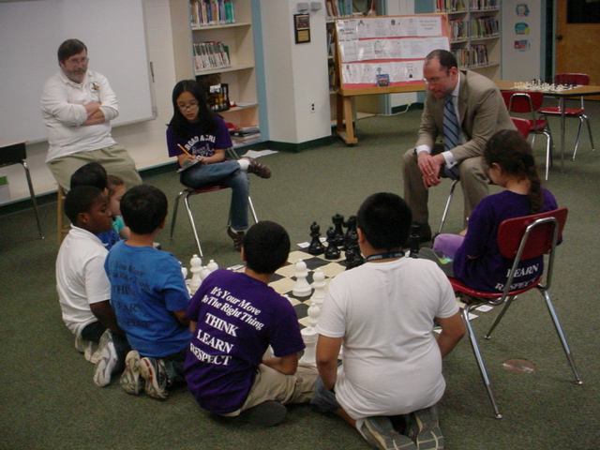
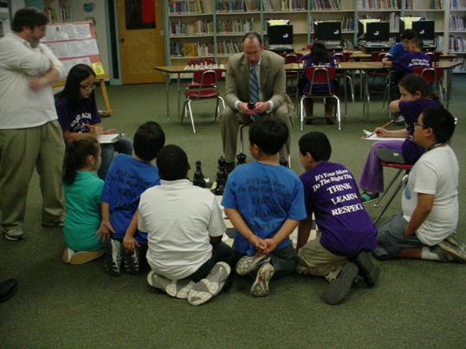
Special Guest: district Superintendent
The school district superintendent, Dr. Starr, visited the school, played chess with our students, and tweeted positively about the skills the students were learning (Broad Acres 2012).

Slide 20
Next
Need for future studies (not only self-reporting from students).
Need to have studies with more than one school and one counselor delivering services.
Future studies to evaluate school engagement, perceived stress, grit, and literacy with chess participation as a variable (University Maryland).

Slide 21
Preliminary results
Grit, Emotion and Literacy Study
O’Neal, C & Perlow B. (UMD 2014)
The students in chess club and not in chess club had very similar school engagement, perceived stress, grit, and literacy scores.
Of the students who participated in chess club, the students who went to the most events tended to have higher grit than the students in chess club who did not participate in many events.
In this sample, the students who are in chess club and also have high grit tended to have the highest literacy scores by the end of the year

Slide 22
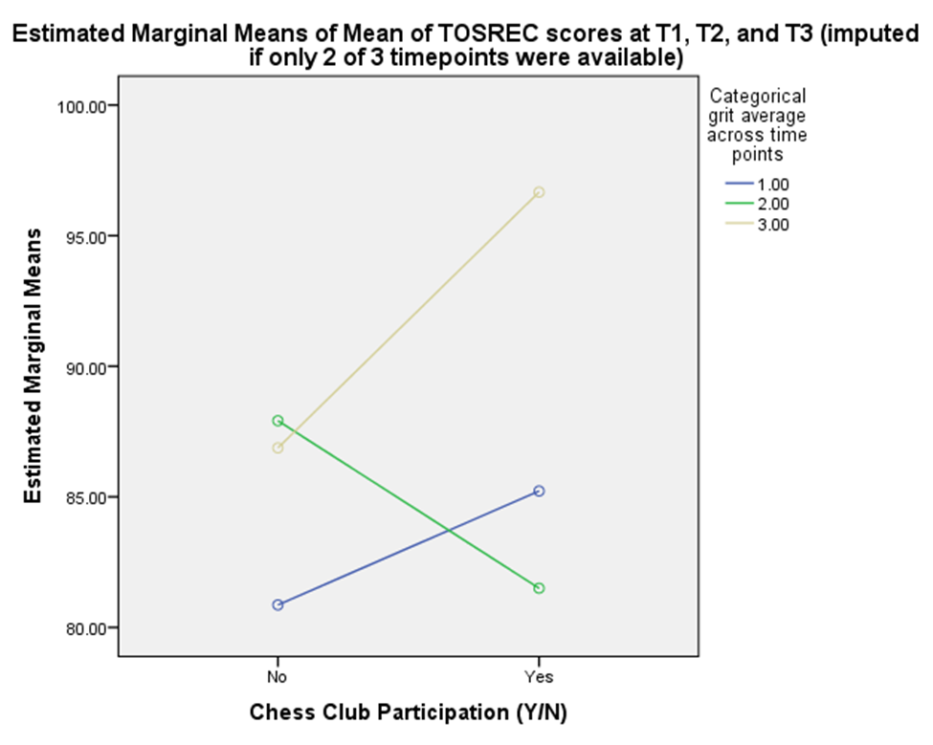
Preliminary results
Grit, Emotion and Literacy Study
O’Neal, C & Perlow B. (UMD 2014)
Interpretation: While the results are not significant, in this sample, students who participate in Chess Club and have high grit are the most likely to get high TOSREC (literacy) scores. Students with low grit and do not participate in chess club are the least likely to have high TOSREC (literacy) scores.

Slide 23
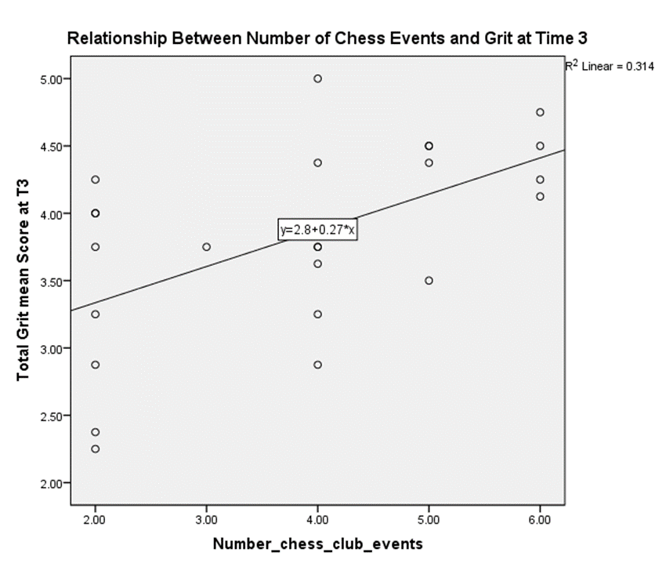
Preliminary results
Grit, Emotion and Literacy Study
O’Neal, C & Perlow B. (UMD 2014)
The relationship between number of chess club events and grit at time 3 is significant meaning that the participants in chess club who went to the most events tended to have higher grit at the end of the year than other students in chess club.

Slide 24
Acknowledgements
Parts of this presentation have been taken from:
Collaborative for Academic, Social and Emotional Learning (CASEL) http://casel.org/
Chess for teacher by M. P. Kusen http://www.chessforteachers.com/
Teaching Life Skills Through Chess by Fernando Moreno
Eric Henderson’s presentation “A Culture of Chess in a Title 1 School”
O’Neal, C & Perlon B. Grit, Emotion and Literacy Study(UMD 2014)
US Chess Center, Washington DC
Thanks for the editing and suggestion from Cristina Moreno, Yale student.

Slide 25
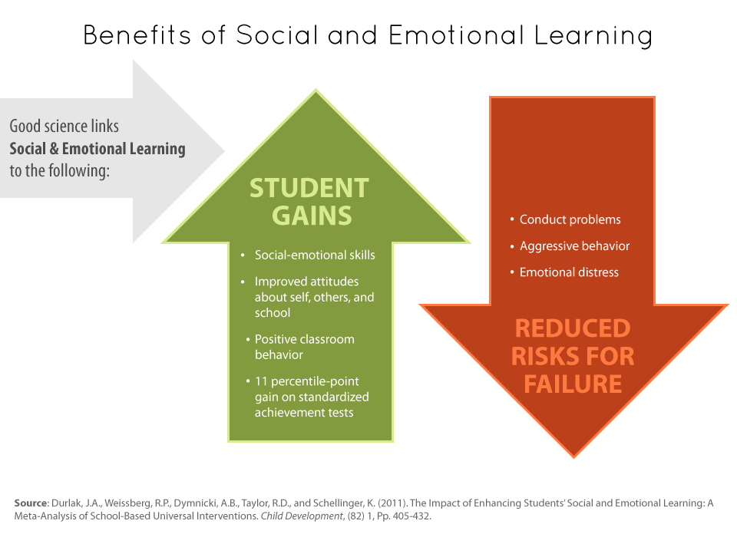

Slide 26
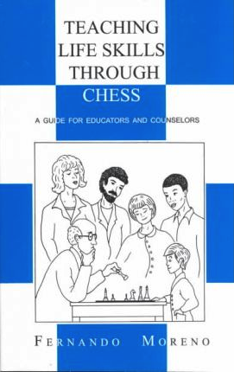
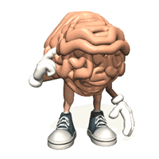

By:
Fernando Moreno
Montgomery County, Maryland School Counselor
US Chess Federation Education Board Member
“Think
Before You
Move Lesson”

