Slide 1


Montgomery County Public Schools
School-Wide Positive Behavioral Interventions & Supports
Mike Muempfer
PBIS Specialist
Montgomery County Public Schools
michael_j_muempfer@mcpsmd.org
Notes:
Since we began to implement PBIS in Maryland in 1999, we have been working with Dr. George Sugai, then at the Univ. of Oregon, but just recently relocated to Connecticut.
I am ________, co coordinator for PBIS in Maryland.
I will be presenting an overview of PBIS – some big ideas and themes - this type of presentation has the potential to last more than 2 hours, we plan to be done in __ minutes and allow time for Q&A.
It will work best if you ask questions as we proceed, if we will be covering the topic later, we will let you know.
And, if in fact we get bogged down in a one on one conversation, not material to the rest of the audience, please allow me to defer further conversation onto the end of the presentation - I can remain for _______

Slide 2
Mike Muempfer
(background information)
Father and Husband
  Children: 3 boys: Max (11), Zach (11), Troy (6)
  Wife: Ericka (Cultural Anthropologist at Johns Hopkins University)
Work Experience
  PBIS Specialist MCPS
  6 years School Climate Specialist at Johns Hopkins University
    Partnership with MSDE and Sheppard Pratt
    PBIS Implementation throughout MD
    Other various EBP interventions throughout MD
    National PAX GBG Trainer (Classroom management)
  10 years as a classroom teacher in Baltimore City
    Classroom/Behavior Management Coach in Baltimore City

Slide 3
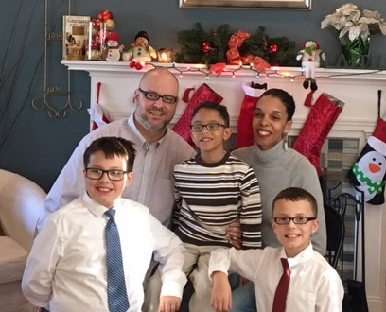
My Family

Slide 4
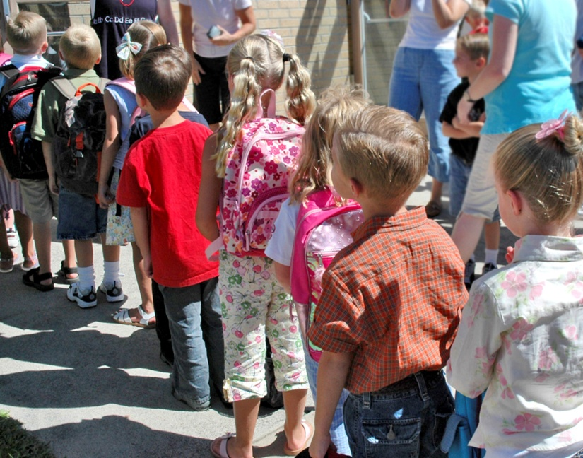
Goals for the workshop
  Understand the philosophy of the PBIS system and the PAX Good Behavior Game
  Learn how PBIS and PAX are implemented in schools
  Collect and implement strategies on how to use PBIS in the home and community

Slide 5
I Believe
I believe that parents are the child’s first and most important teacher.
I believe that the schools cannot do it alone.
I believe that we must work as a team.

Slide 6
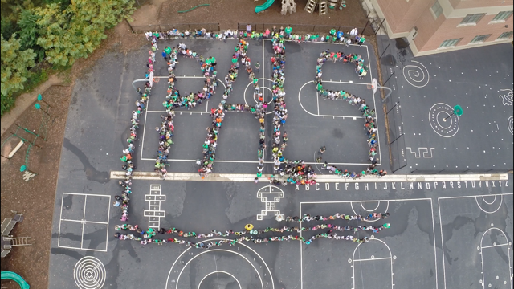
What is PBIS?
Positive Behavior Interventions and Supports (PBIS) is a framework for a school that supports a positive school climate and positive behavior in school.
  Implemented in 109 MCPS Schools

Slide 7
What is PBIS ?
PBIS is a pro-active reinforcement based system rather than a reactive consequence based system.
The focus is teaching behaviors that lead to academic success.
Praise is a powerful strategy that supports generalization
Praise is vital for effective PBIS implementation.

Slide 8
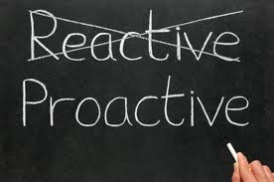
Proactive towards student success!
PBIS works on creating a proactive approach teaching students the expectations through:
  Modeling expected behavior
  Matrixes
  Direct Social Skills Instruction
  “Teachable Moments”

Slide 9
Can we MAKE students behave?
We can’t make kids learn or behave, but we have the power to increase the likelihood by creating a positive environment and teaching. In other words, PBIS aims to improve school climate.

Slide 10
The Basics
Behavior is learned
Do not assume children know your rules, expectations, or social skills
Every social interaction you have with a child teaches him/her something

Slide 11
The Basics
Behavior communicates need:
Children engage in behavior(s) to "get" what they find reinforcing or to "avoid" what they find aversive

Slide 12
Behavior = Communication
Every behavior has a function:
Escape
Attention
Tangible Desires (food, item, activity)
Control

Slide 13
We have the Power
Our reaction to a particular situation can escalate or de-escalate behavior
Control Environmental Factors
Control Task Presentation
Eliminate Emotional Cues
Avoid a Spiral of Conflict

Slide 14
teach.
  “If a child doesn’t know how to read, we
  If a child doesn’t know how to swim, we
teach.
  If a child doesn’t know how to multiply, we
teach.
  If a child doesn’t know how to drive, we
teach.
  If a child doesn’t know how to behave, we...
teach? punish?
  Why can’t we finish the last sentence as automatically as we do the others?”
  The bottom line: Teaching
  Teach Expectations
  Teach Routines and Procedures
Notes:
The following quote by Tom Herner expresses our difficulties with dealing with challenging behavior. Read quote. Do we regard behavior as a skill deficit that needs to be taught or do we perceive it as something that needs to be punished? If we perceive it as something to be punished then it is very clear that we regard it differently than any of the other behaviors or skills that we address at school. As a result, we tend to approach it in less-effective and less-professional ways. Appropriate behavior should be taught just like reading, swimming or driving.

Slide 15
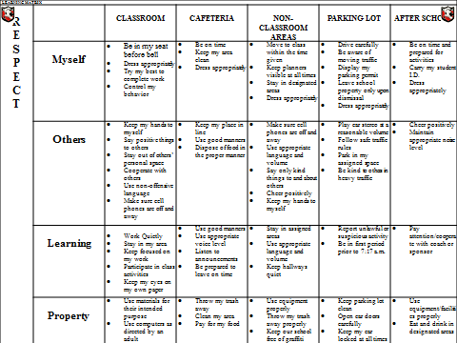
PBIS Matrix at School
Provide initial lesson plans and/or lesson plan format to teach specific behaviors identified on the Matrix
CAFETERIA
Be on time Keep my area clean Dress appropriately
Keep my place in line Use good manners Dispose of food in the proper manner
Use good manners Use appropriate voice level Listen to announcements Be prepared to leave on time
Throw my trash away Clean my area Pay for my food
Notes:
Social skill lessons are based on school data
Behavioral instruction is infused into all instruction
Procedures are understood and practiced by administrators, staff, students, and families

Slide 16
Why Develop a System for
Teaching Behavior?
Behaviors are prerequisites for academics.
Procedures and routines create structure.
Repetition is key to learning new skills.
  For a child to learn something new, it needs to be repeated on average of ? Times (Joyce and Showers, 2006)
  Adults average ? (Joyce and Showers, 2006)
  For a child to unlearn an old behavior and replace with a new behavior, the new behavior must be repeated on average ? times (Harry Wong)
8
25
28
Notes:
We can’t assume:
that students know the expectations/rules and appropriate ways to behave
That students will learn appropriate behaviors quickly and effectively without consistent practice and modeling
We must assume:
Students will require different curricula, instructional modalities supports, etc., to learn appropriate behavior
We need to teach expectations/rules and appropriate behaviors as effectively as we teach academic skills

Slide 17
Biggest misconception of PBIS is the recognition system
Difference between bribery and recognition
Tickets are not designed to change student behavior
Tickets are designed to change adult behavior
Ticket designed to prompt conversation (relationship building)
Conversation/relationship changes the behavior
What matters is the positive social engagement (know your students)
Not used as general praise

Slide 18
PBIS at Home
Helps to build a school and home connection
Teaching and re-teaching behavioral expectations
Positive acknowledgment
Improved behavioral outcomes

Slide 19

The importance of the home, school, community connection
PBIS can be implemented in the home and community settings.
By connecting PBIS at home and school your child gets:
  Consistency
  Common language
  Additional applications of important social/behavioral skills

Slide 20

PBIS at Home Breakdown
To implement PBIS in the home and community, follow these four steps:
1. Set expectations in advance
2.Communicate/teach the expectations
3.Positively reinforce when expectations are met
4. Have a plan to give additional support when expectations are not met

Slide 21
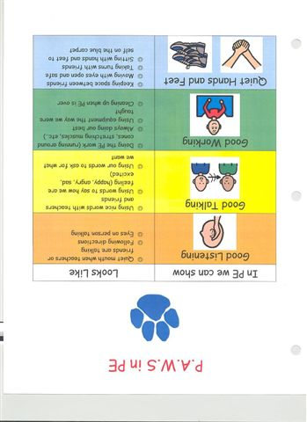
Set Your Expectations in Advance
Simply put, ask yourself, “what is it I want my child to be able to do during dinner or at the movie theatre?”
Knowing your child, set your expectations in a way that is visible and other people could understand if they read it
A home/community matrix is a tool to use when completing this step

Slide 22
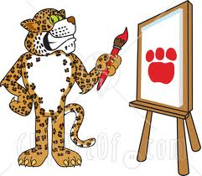
Communicate/Teach the Expectations
Just like any other skill, we must teach our expectations to our children
The most effective and usually easiest way to teach expectations is through modeling them ourselves
Some other methods to use are:
  Social stories or books
  You Tube or other videos
  Siblings/other children modeling
  Use the additional community resources for help with this step

Slide 23
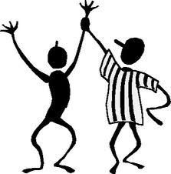
Positive Reinforcement when Expectations are Met
We want to hear when we did a good job and so do our children
Two big areas to plan and practice are:
  What reinforcers should you use
  How often should you reinforce (frequency)

Slide 24
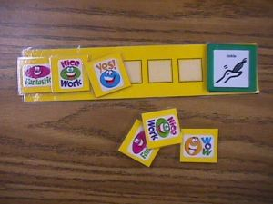
Selecting a Reinforcer
Using a reinforcement inventory is one way to identify reinforcers for your child
It is important to identify both small and large reinforcers for your child
  Example of small: token board
  Example of large: TV time

Slide 25
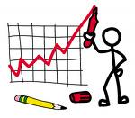
Frequency of Reinforcement
This is the trickiest part of the whole process
Through knowing your child and some trial and error a plan will be created on how often a child needs to be positively reinforced
The goal is for independence so the less you can reinforce the better
Usually when starting the process you will need to reinforce often and in time can lessen the amount
The home/community PBIS chart is a way to give reinforcement

Slide 26
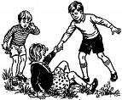
Additional Support
What is the plan if the expectations are not met?
  Re-teach the expectation
  Give additional prompting or support for success
  Time for consequences for their actions
    Not receiving the reinforcer until expectations are met

Slide 27

PBIS is not 100% effective
It would be great if it was but the PBIS system data shows it is effective about 80-85% of the time
The school PBIS team is looking to work together with you in learning from each other in specific workshops designed address specific behavior topics such as:
  Accepting No
  Transitions
  Prompting
  Task Analysis

Slide 28
My Family’s Matrix
Muempfer Family Matrix | Respect Ourselves | Respect Family Members | Respect Property
At Home… | Listen to Parents Be Honest Use manners | Share Be Kind Help Each Other Golden Rule | Clean-Up When Finished Use Equipment Properly Ask for Help
Morning… | Wake-Up at Appropriate Time Brush Teeth After Breakfast | Say Good Morning Use Kind Words Help Each Other Keep Hands to Self | Make Bed Use Equipment Properly Clean-Up (room, dishes, bathroom, etc.)
Homework… | Quiet Space Get Materials Ask for Help Read Carefully Take My Time | Do Not Disturb Others Be Kind Help Each Other | Get Rid of Distractions Use Equipment Properly Clean-up
Meals… | Make Healthy Choices Take My Time Use Manners | Use Manners Set Table Appropriate Conversations Use Inside Voice | Use Utensils Properly Clean-up When Finished
In Car… | Wear Seatbelt ALWAYS!! Do Not Distract Driver | Use Inside Voice Keep Hands to Self Share | Keep Car Clean No Throwing Items Use Equipment Properly
Play… | Limit Screen Time Go Outside Be Active Be Safe | Share Sportsmanship Be a Role Model Help Each Other | Use Equipment Properly Be Safe
Bedtime… | 8+ Hours of Sleep Go to Bed On-Time | Do Not Disturb Others Shower | No Electronics No Rough-Housing Clean-Up

Slide 29
Family Teaching Matrix |  | SETTING
 |  | At home | Morning Routine | Homework | Meal Times | In Car | Play | Bedtime
 | Respect Ourselves
 | Respect Others
 | Respect Property
Expectations

Slide 30
PAX Good Behavior Game
Evidence Based Classroom Practice
PAXIS Institute (goodbehaviorgame.org)
www.PubMed.gov
My testimonial:
  “Most effective behavior management tool I’ve ever used in my classroom.”
  “Easiest behavior management tool I’ve ever used in my classroom.”

Slide 31
Impulsive Behavior/Self-Regulation
The ability to self-regulate (self-control) is a more accurate predictor to future academic success than a reading level
The PAX Good Behavior Game is a classroom strategy that helps kids learn how to self-regulate while they are participating in their daily lessons

Slide 32

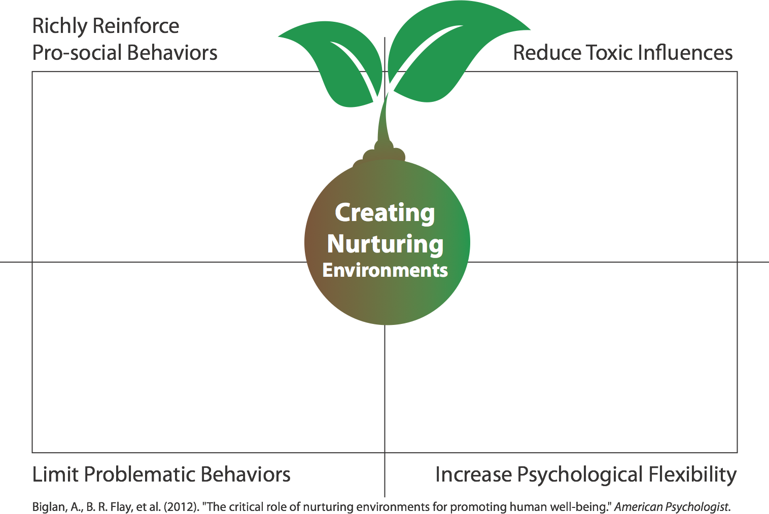
How does PAX create self-regulation?
Daily group intrinsic, activity rewards for prosocial behavior
Written “Tootles” from peers & adults
Lower rates exposure to exclusion & tattling
Lower exposure to bullying & trauma
Lower exposure to harsh adult actions
75% to 85% reduction in disturbing, disruptive, aggressive peer behaviors every day.
Low rates of negative peer reinforcement.
Increased ability to change the social environment
More ability to treat upsets lightly
Notes:
Powerful self-regulation emerges under certain environmental conditions It’s not magic; it’s quite logical. First, the social environment has to have high levels of reinforce for prosocial behaviors—especially by peers to peers. Too often peers reinforce each other today for anit-social behavior, because it accrues status. PAX changes the environment to mimic our ancestral conditions so that peers are noticing and thanking each other for prosociality. And they group earns simple fun things to do as a result of being prosocial as a group, which means the kids work together not against each other.
If there is lots of antisocial behavior from peers (often not seen by adults), this evokes fear and trauma responses from students—which can trigger more aggression. The shear structure of PAX evidence-based kernels and the Game itself drop exposure to problematic behaviors by 50% to 85% rapidly.
Toxic influences can happen by tattling, harsh commands, etc. Those trigger cortisol. These in turn cause freezing or fighting or agitation. PAX GBG (both the PAX part from PeaceBuilders and the GBG part from Johns Hopkins) was the first experimentally proven student in the United States to reduce such toxic influences in 1997 and 1999. Neither PeaceBuilders and GBG ever talked about those things, but created an environment where they did not happen.
PAX GBG increases both behavioral and psychological flexibility in adults and children. Both adults and children actually learn to see that they CAN change things, because of the scoreboard. The use of the language of PAX helps increase mental flexibility because the adults don’t get locked into treating all behavioral and emotional issues as some form medical or genetic determinism.

Slide 33
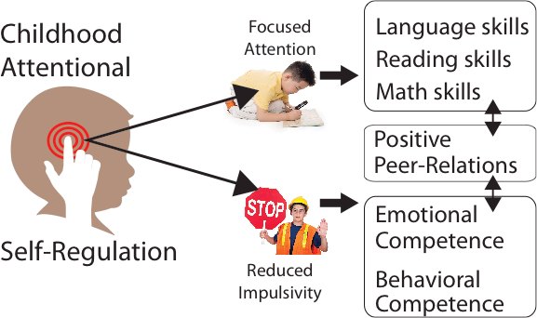

How Do Teachers Create These?
How do all these
skills change a
child’s future?
Razza, R. A., Martin, A., & Brooks-Gunn, J. (2012). The Implications of Early Attentional Regulation for School Success among Low-Income Children. J Appl Dev Psychol, 33(6), 311-319
Notes:
How many of you here have children in the class who cannot pay attention to a task, such as stay focused on their reading, math or other lessons?
How many of you have children who go up and down in behavior or go up and down emotionally? How many of you have children who cannot pay attention and are not regulated emotionally or in behavior?
How many of you have students who get locked down and can’t shift their focus or emotion?
Both too little attention and self-regulation and TOO much self-regulation can be a problem academically, socially and for physical/emotional wellbeing for life. Balanced skill in attention and self-regulation are key predictors for academic success, emotional competence, behavioral competence and positive peer relations. In the school of education in your course, somebody probably taught you theories about the importance of these skills. But they did not actually teach you a way to help children acquire these meta-strategies for successful development. PAX is such a practical strategy. By the way, all of the normal activities of children’s play, socialization before the advent of TV, fear of neighborhood crime, fear of strangers, etc. out door play, children’s mixed age play, meaningful roles helping in the family and community provided the scaffold for those skills. PAX makes use of what we know about those everyday experiences and finds a way to build some of them into your daily routine to help children develop those essential skills.

Slide 34
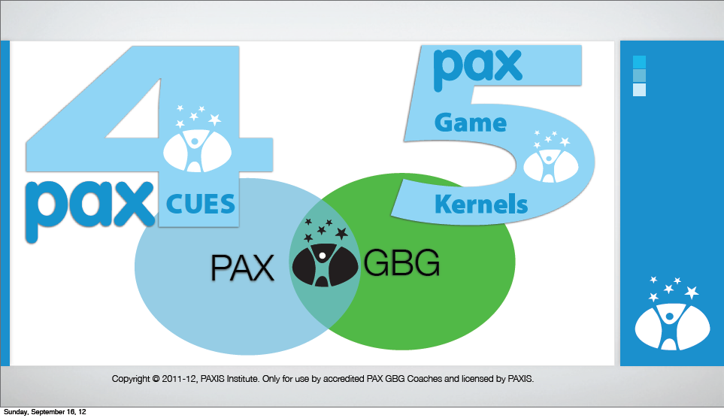

Slide 35

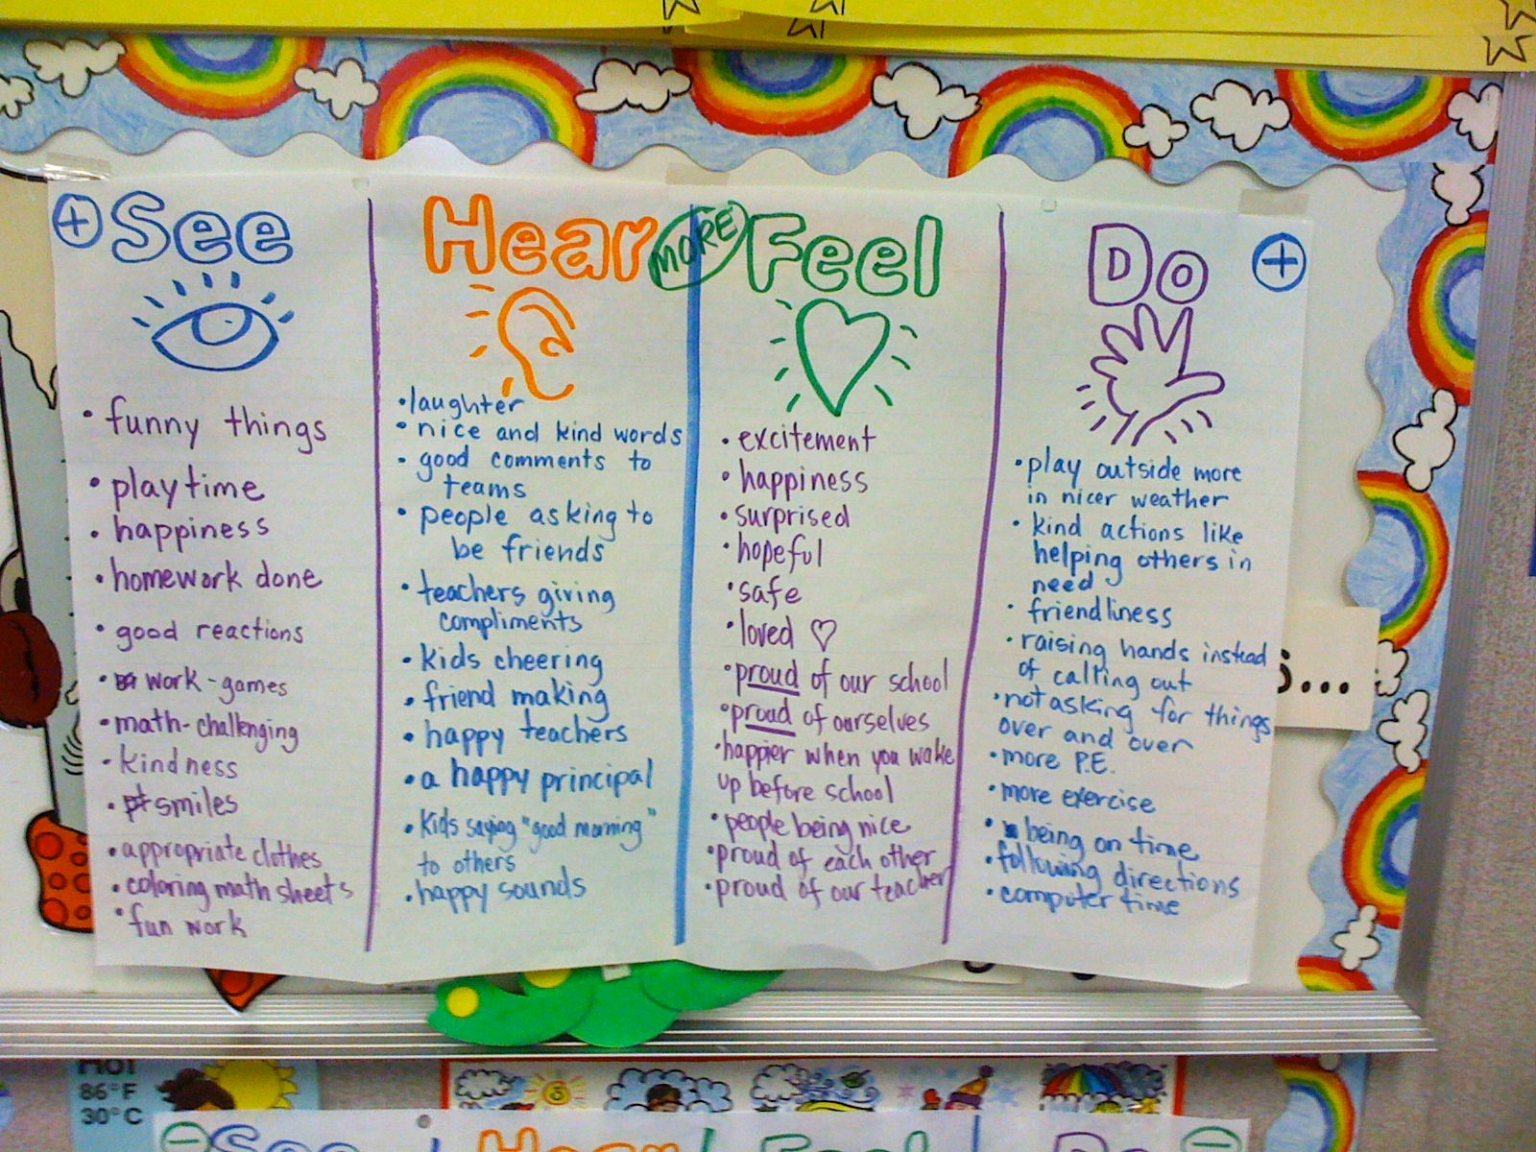
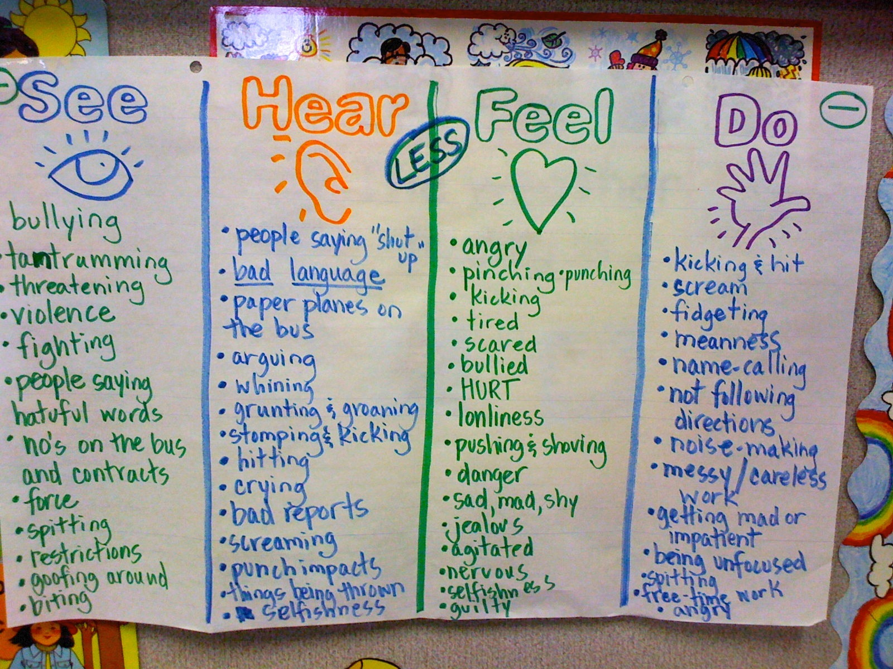
Create a Wonderful School Vision with your students from Chapter 8
Prep
Step 7
Page
41
Copyright © 2011-13, PAXIS Institute. Only for use by accredited PAX GBG Coaches and licensed by PAXIS.
Notes:
Note: Tell the audience that this activity is one of the single most important one they will do for prepping their class for PAX GBG.
Tell them the chapter explains what to do with the class, NOW ACT it out by asking the audience to imagine their classroom, their school is the most wonderful in the community, the state, the country and maybe the whole world.
As for some helpers from the audience to write the charts for PAX and spleems. Do the MORE chart first, but wait to tell them that is is PAX. After you have a good MORE chart from the audience. change slides to the next.

Slide 36
PAX & SPLEEMS
Pax: Peace, productivity, health, and happiness. Actual word.
Spleem: Anything that prevents PAX. Completely made up word.
    No negative connotation
    No labeling/defining the behavior
    Easier for students to generalize
    Reduces negative visual stimulation

Slide 37
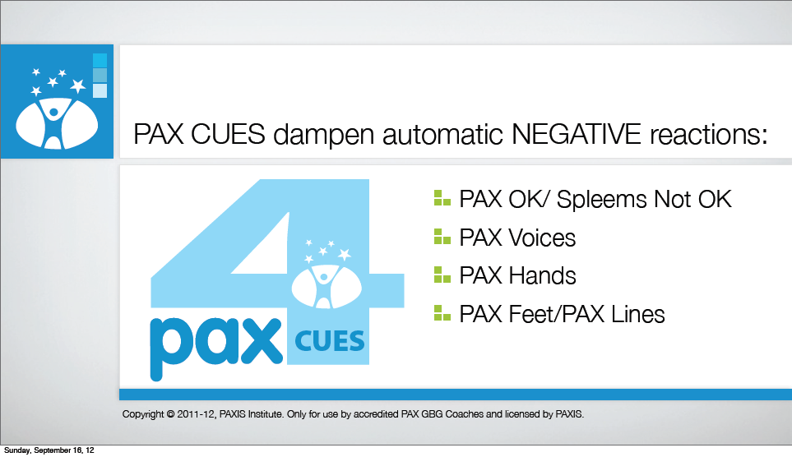

Slide 38
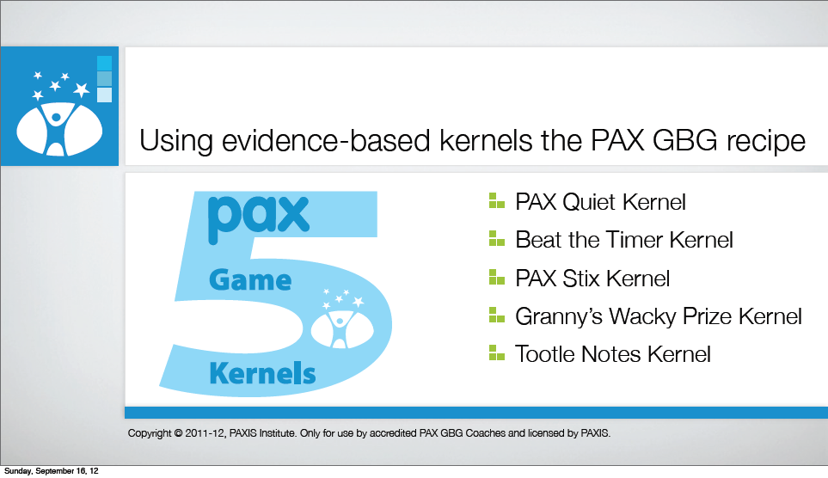

Slide 39

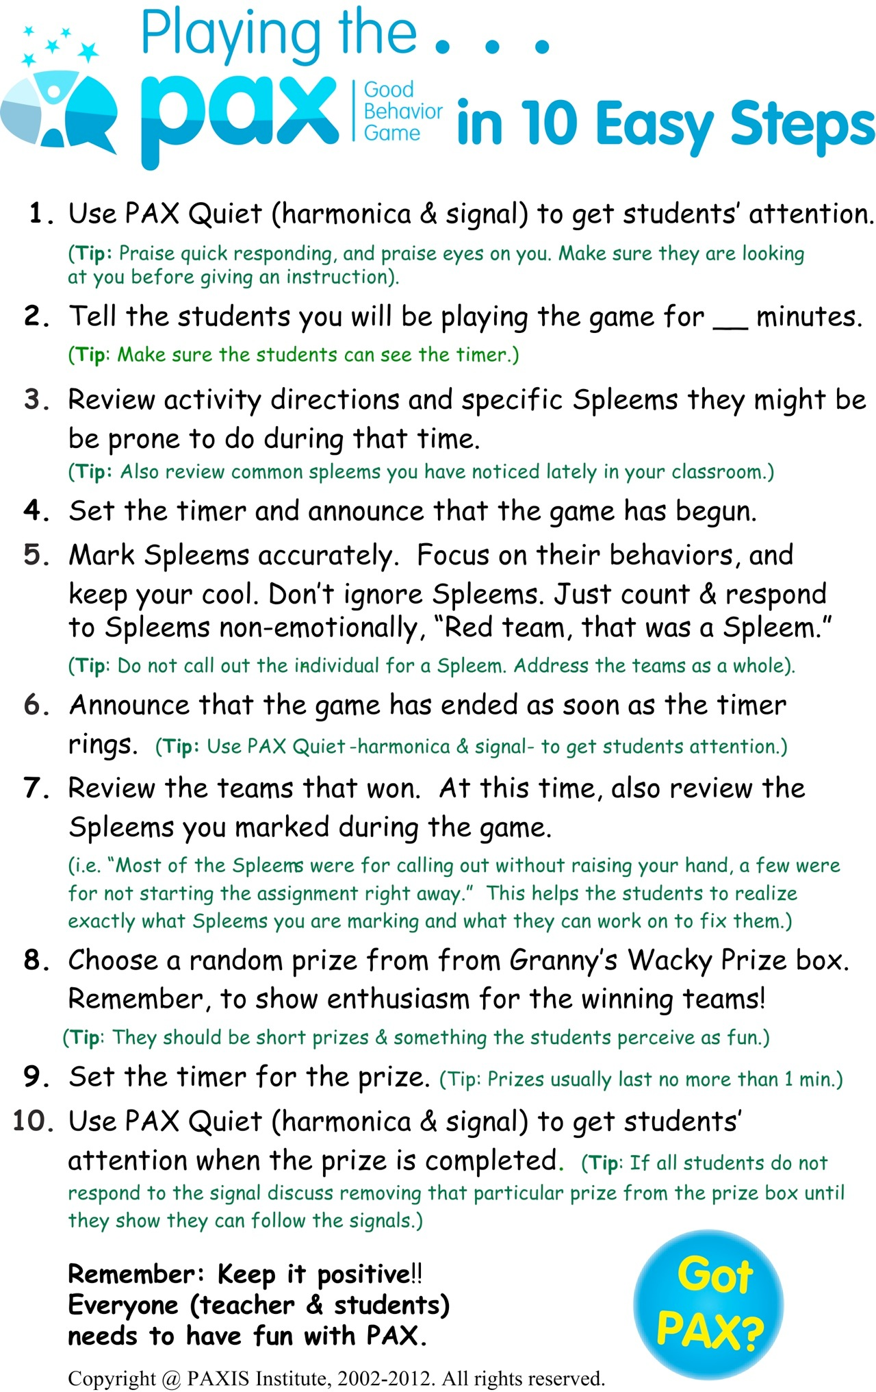
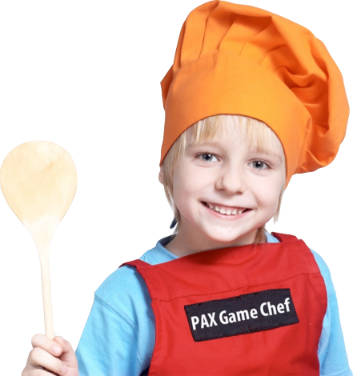
Page 101
Now you know the
PAX ingredients. Now make the recipe. Please open the
book to this page.
Copyright © 2011-13, PAXIS Institute. Only for use by accredited PAX GBG Coaches and licensed by PAXIS.
Notes:
The PAX game is a recipe composed of evidence-based kernels (like the ingredients in a cooking show). The ingredients or kernels need to be used in a certain order to produce reasonable and reliable effects.

Slide 40
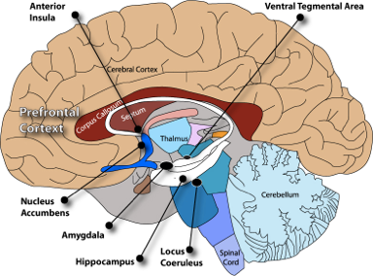

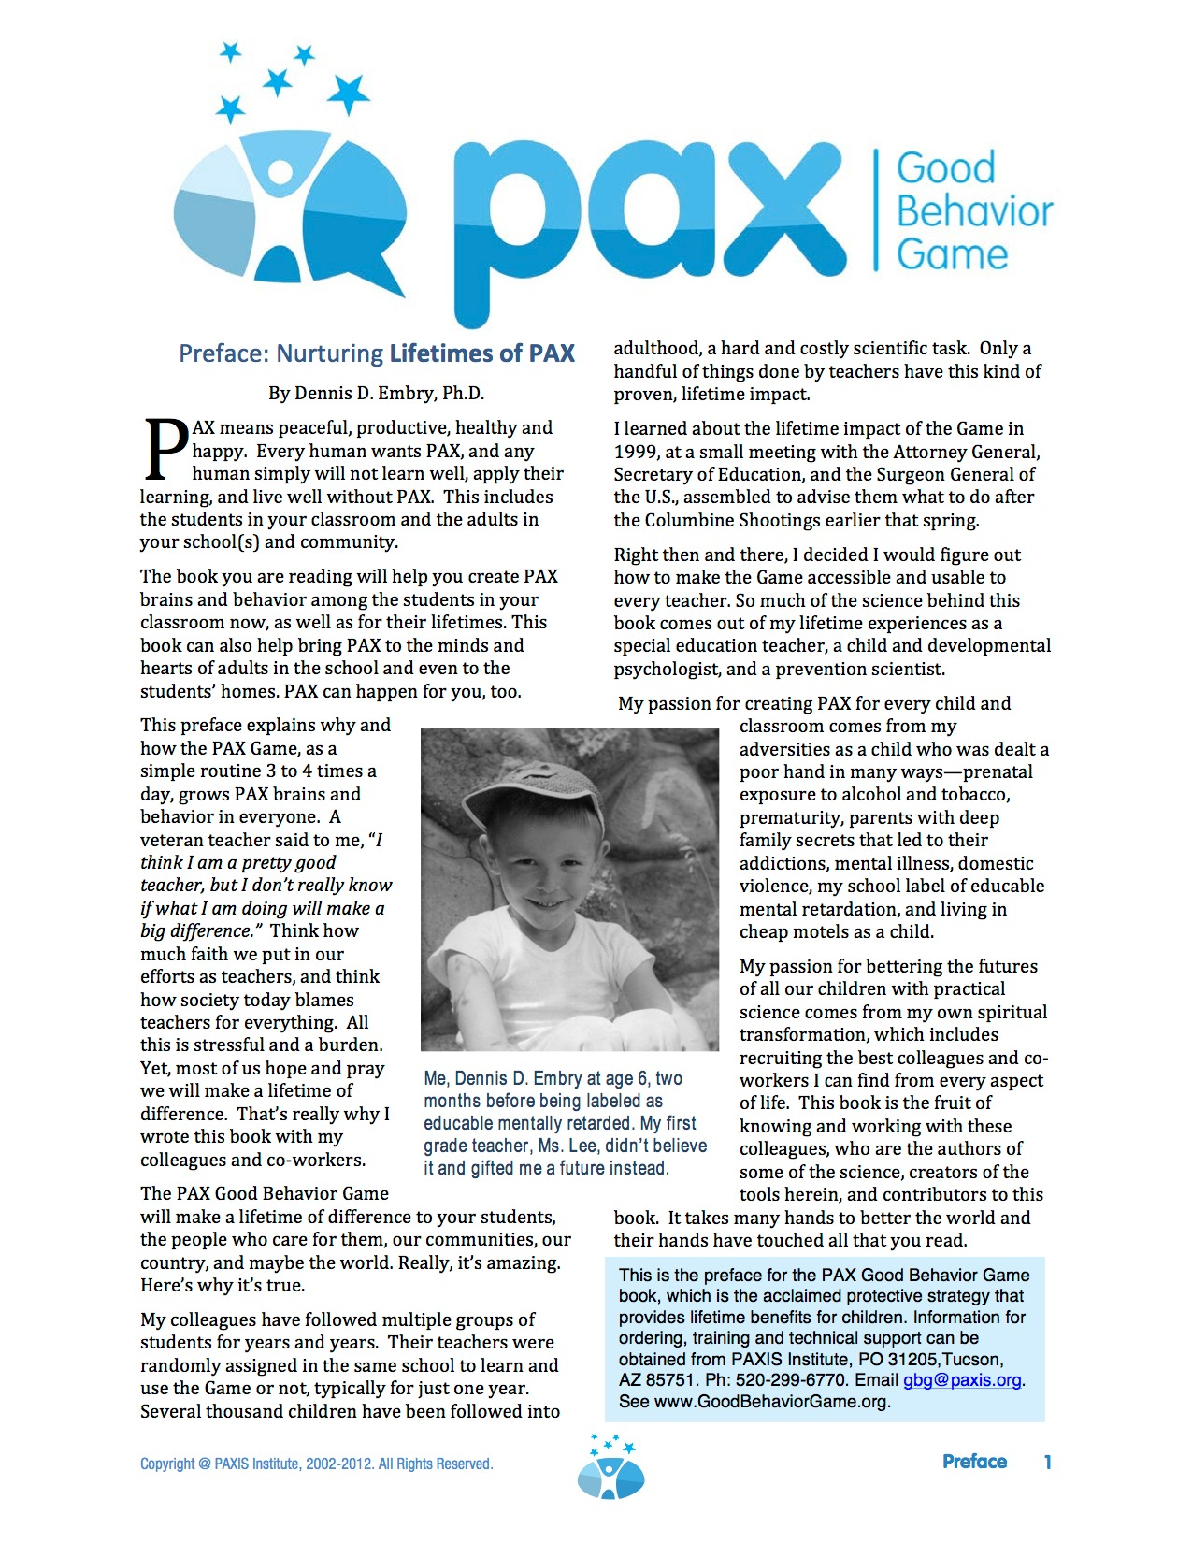
A PAX Brain…
Dopamine synthesized in VTA
associated with PAX & Self-Regulation
The Game and Cues
dampen fear and anxiety reactions
Peer expectations of PAX create goal setting in Prefrontal Cortex
Read the
Preface in the manual for info on the brain
and PAX.
Granny’s Wacky Prizes pair self-control with PAX
in reward center
PAX Signals safety to
the Amygdala
Daily repetition of Game & Cues encode memory of self-control & self-regulation
Alarm circuits dampened in Locus Coeruleus by PAX cues, kernels & game
Copyright © 2011-13, PAXIS Institute. Only for use by accredited PAX GBG Coaches and licensed by PAXIS.
Notes:
The PAX Game and its various tools affect the brain dramatically. You can read more about that in the manual’s preface.
(Coaching note: If you have some experience implementing the Game, you can chime in your own experience here of the effects you see on cognitive and behavioral skills).

Slide 41
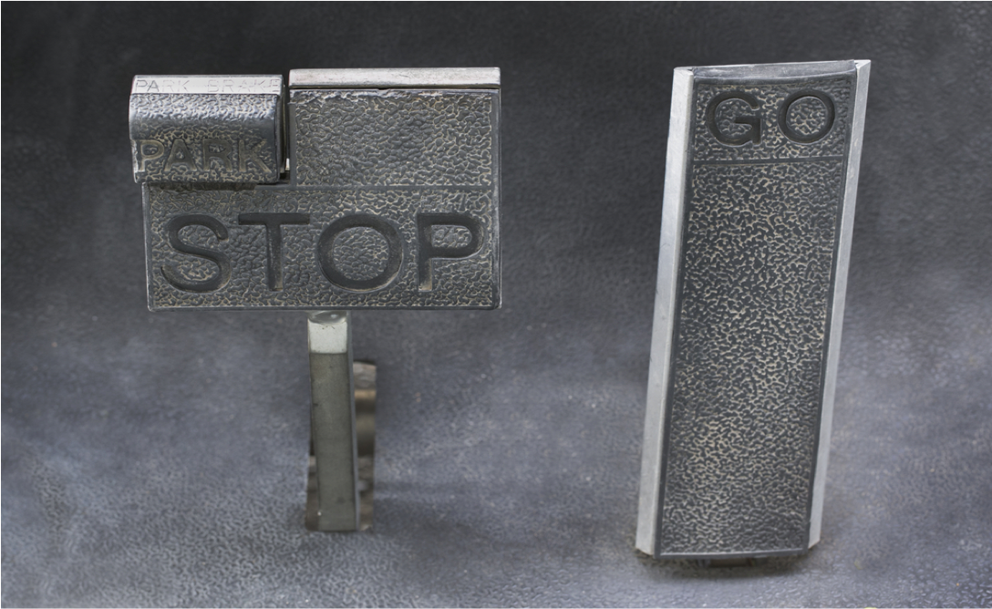
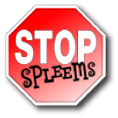

Notes:
PAX teaches children how to use their GO or gas pedal. And PAX teaches children how to use their brake pedal. You cannot SUCCESSFULLY teach children how to use their brain’s brake by frequent consequences or punishing them for going to fast or not stopping. Children have to have positive, encouragement from peers and adults for using both their BRAKE and Gas Pedal.

Slide 42
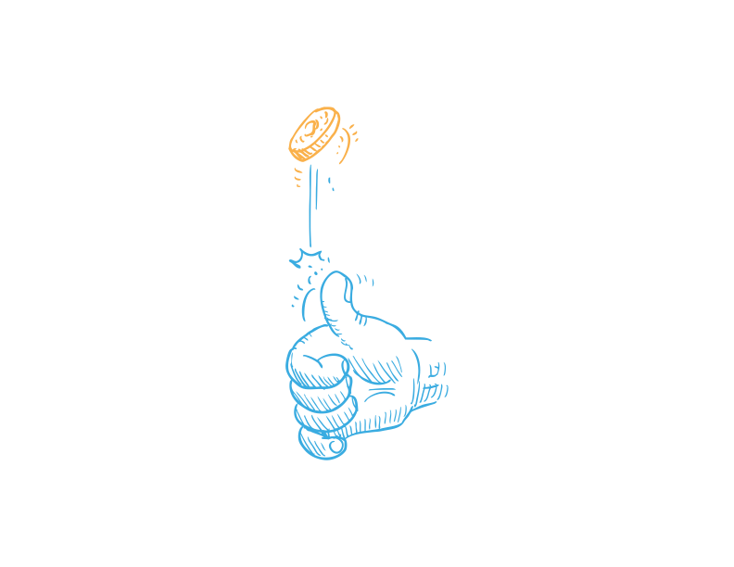
Longitudinal Johns Hopkins Studies of GBG
Kindergarden
First Grade
Grades 2 thru 12
Follow Up
Young Adulthood
Follow Up
Every child rated by teachers
GBG
Age 19-21
Age 26
Age 30
No More GBG
NO GBG
Age 19-21
Age 26
Age 30
No GBG
Purpose: To find out if GBG affected their adolescent lives.
Purpose: To find out if GBG affected their adult lives.
Tested in 41 first- grade classrooms within 19 elementary schools with two consecutive groups of first graders.
Note: Some kids got GBG in 1st Grade only, and some in both 1st & 2nd grade,
Notes:
So imagine you are first grade teachers in the same school. Children’s kindergarten teachers in your school have rated children on clinical and behavioral scales for mental, emotional, and behavioral problems. Are teachers good raters of those problems? Yes they are more reliable than parent ratings because they see more kids in their lifetimes. The children are matched as kids without any early problems and kids with early problems (ADHD, anxiety, aggression, shyness, etc.). The children are then randomly assigned to your classroom or another teachers classroom. Then, a coin is flipped to determine if you or the other teacher learns to use PAX GBG. Thus you or the other teacher learn and use PAX GBG for a year with those kids. Thus, kids in the same school get or don’t get PAX GBG. Neither group of students gets PAX ever again, but both the kids who NEVER got PAX GBG or DID are followed for decades to see what if any last effects there are—regardless of their families, where they live, etc. That is a classic, gold-standard randomized control group study with longitudinal follow up. It’s very time intensive and costly to do this. Presently, it’s been done five times with this strategy, more than any other school based strategy in the world.

Slide 43

Timeline of Benefits…
First Month
More time for teaching and learning
Less stress for Staff & Students
First Year
Better Attendance
Fewer Referrals
Fewer Service Needs
Less Illness
Happier Families
Less Vandalism
Better Academics
2nd & 3rd Years
ADHD Reduction
Oppositional
Defiance Reduction
Special Education Decrease
5-15 Years
No Tobacco
Less Alcohol
Less Conduct Disorders
Less Depression
Less Crime, Violence, Suicide
High School Grad & University
Copyright © 2011-13, PAXIS Institute. Only for use by accredited PAX GBG Coaches and licensed by PAXIS.
Notes:
While the Game makes life a lot better in the short term, it makes a big difference over time. these are the monitored changes of children who got GBG—JUST in First grade (not after that). They have been followed now up to the 30th year of life as adults. These are major findings.
Again, the children either got the Game or didn’t in 1st grade only. This is a sample of hundreds of diverse children from the city of Baltimore in the late 1980s. Since the students were matched and randomized to grade one classrooms in the same schools, and their teachers in the SAME SCHOOL were were randomly assigned to learn to play the Game, these are the changes over time.

Slide 44
Beliefs and Facts
Parent values are instilled in our youth – tell your children everyday to say “I can do anything!”
7,200 students dropout daily in the US
A 4 year college graduate makes 1 million dollars more in their lifetime than a high school graduate.
Teach your child to develop goals
Children laugh 400 times a day
Adults laugh 15 times per day

Slide 45
Some things we know but often forget:
Our role is to teach, not criticize.
They are our children, put them first.
Mood affects learning, keep it positive.
The power of praise can affect our children’s futures.
Make a difference in the life of our children by teaching them to look for the good in all.
Praise (specifically) often and build a positive future for our children.

Slide 46
A Final Thought…
“People often say that motivation doesn’t last. Well, neither does bathing. That’s why we recommend it daily.”
Zig Zigler

Slide 47

Questions

Slide 48
Resources
www.pbis.org
www.pbismaryland.org
www. goodbehaviorgame.org
www.PubMed.gov
www.montgomeryschoolsmd.org
Michael_J_Muempfer@mcpsmd.org

Slide 49
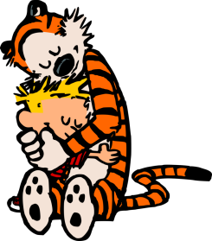
Thank you!

