Slide 1
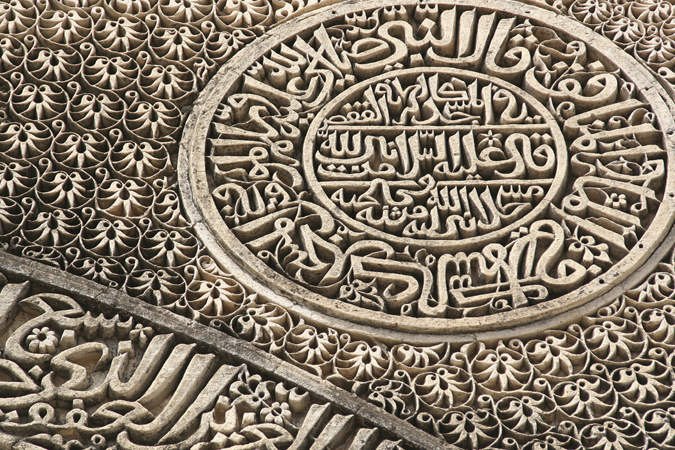
Young Geographers Project
India

Slide 2
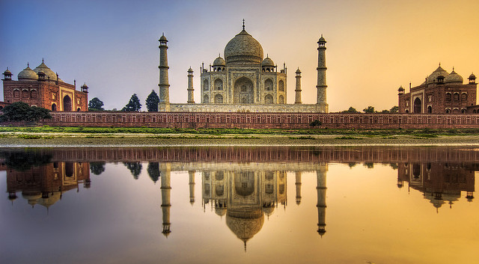
Human-made features Taj Mahal
http://www.flickr.com/photos/stuckincustoms/2035748576/

Slide 3
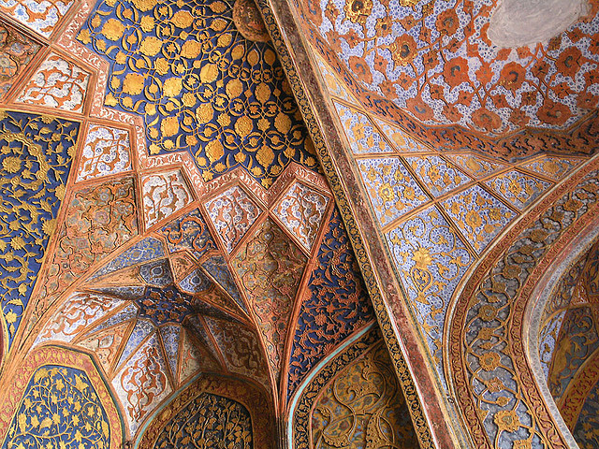
Human-made features Architecture

Slide 4
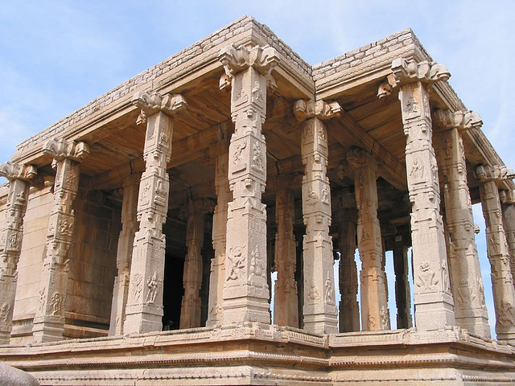
Human-made features Architecture, Hampi
http://www.flickr.com/photos/dey/2864026/

Slide 5
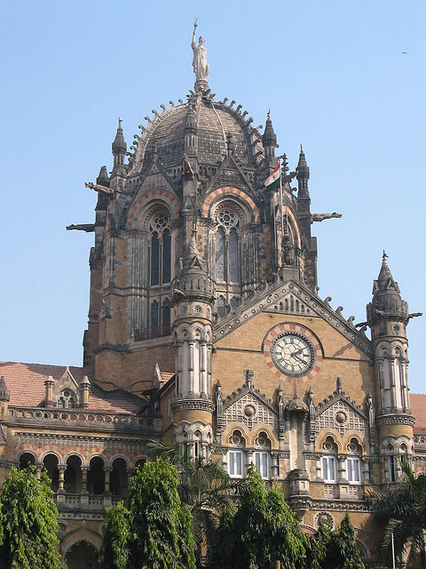
Human-made features Architecture
http://www.flickr.com/photos/dey/3136325/

Slide 6
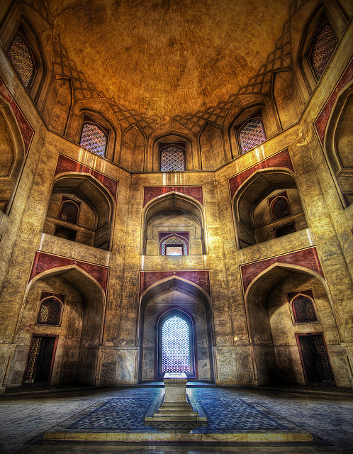
Human-made features Architecture – Humayun’s Tomb

Slide 7
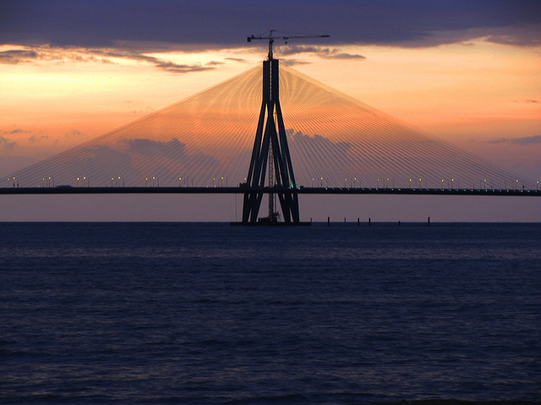
Human-made features Bridge
http://www.flickr.com/photos/kaushal/4990531140/

Slide 8
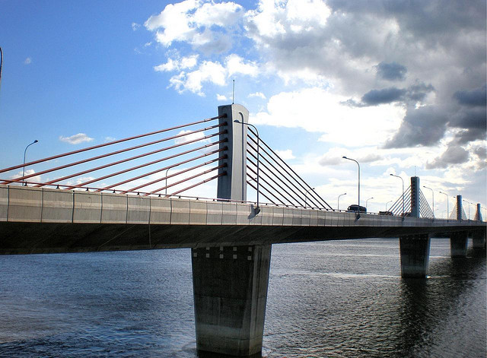
Human-made features Bridge - Nivedita Setu, Kolkata
http://www.flickr.com/photos/85296574@N00/2716236677/

Slide 9
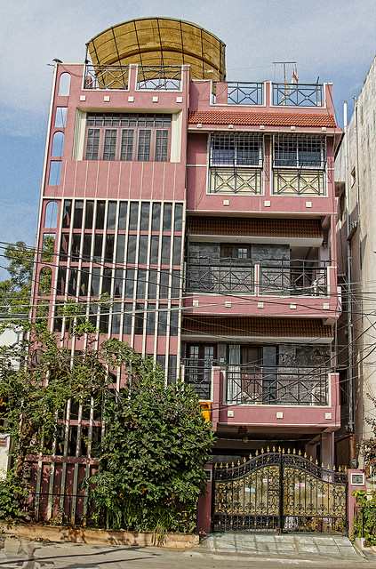
Human-made features Housing
http://www.flickr.com/photos/adityakolli/4205907794/

Slide 10
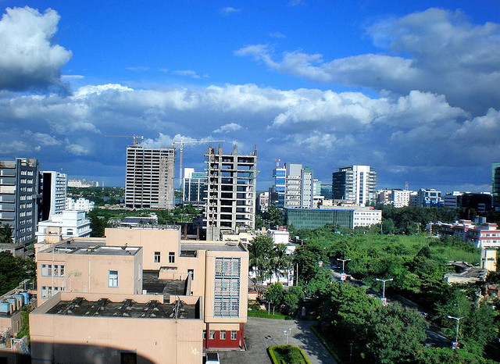
Human-made features Nabadiganta skyline, Kolkata
http://www.flickr.com/photos/85296574@N00/3736756827/

Slide 11
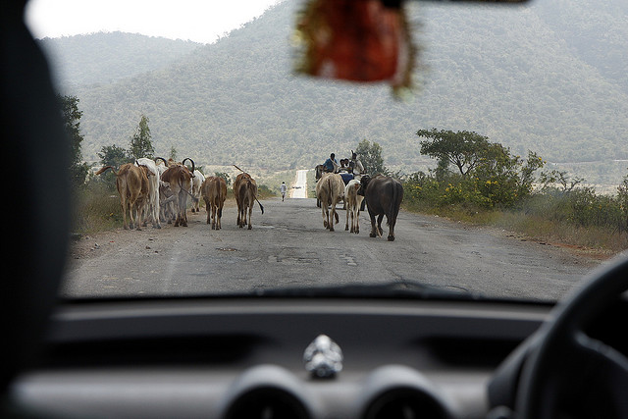
Human-made features Road
http://www.flickr.com/photos/83762626@N00/3547990466/

Slide 12
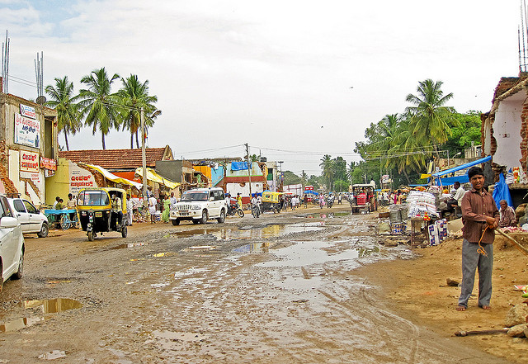
Human-made features Road - Kanakapura, Karnataka
http://www.flickr.com/photos/natarajam/3669021655/

Slide 13
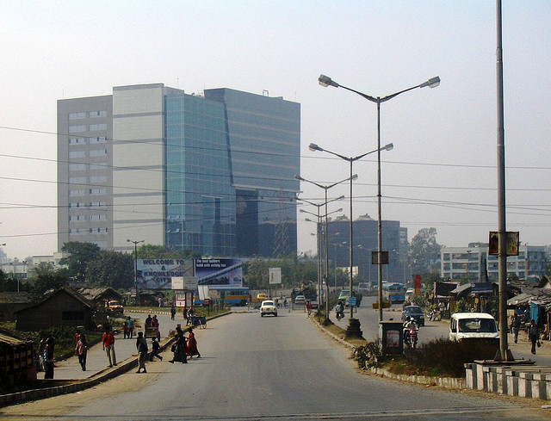
Human-made features Road, Buildings

Slide 14
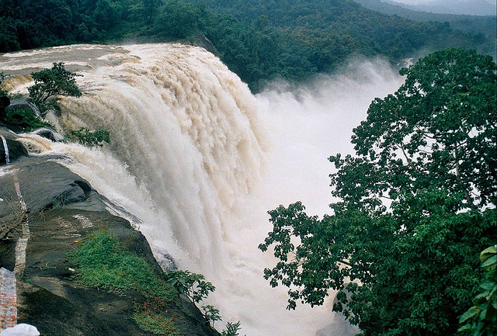
Natural features Athirappilly Waterfall in Kerala
http://www.flickr.com/photos/internationalrivers/3854359222/

Slide 15
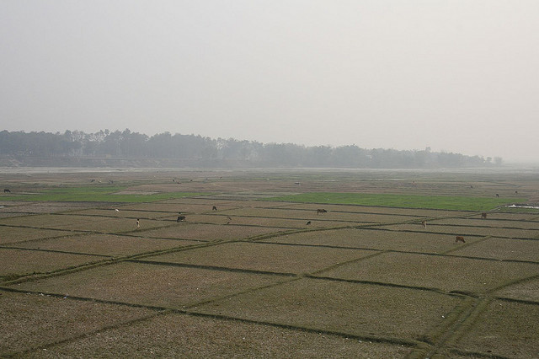
Natural features Border plains
http://www.flickr.com/photos/marcs-album/2214322993/

Slide 16
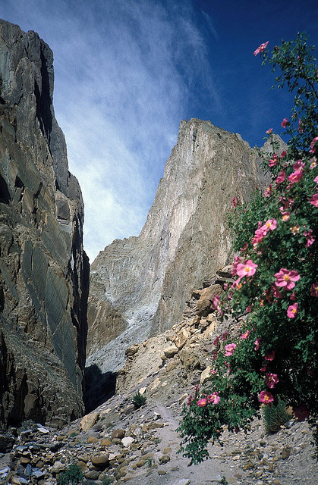
Natural features Spangtang Canyon
http://www.flickr.com/photos/sabamonin/3484314224/

Slide 17
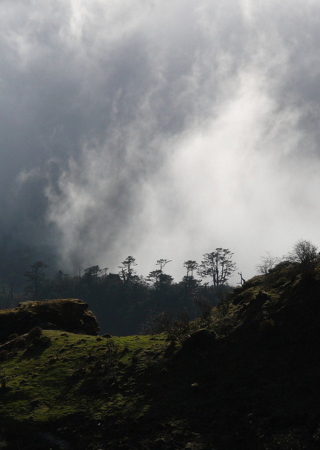
Natural features - forest Kangchenjunga National Park in Sikkim
http://www.flickr.com/photos/petitnic/4448268381/

Slide 18
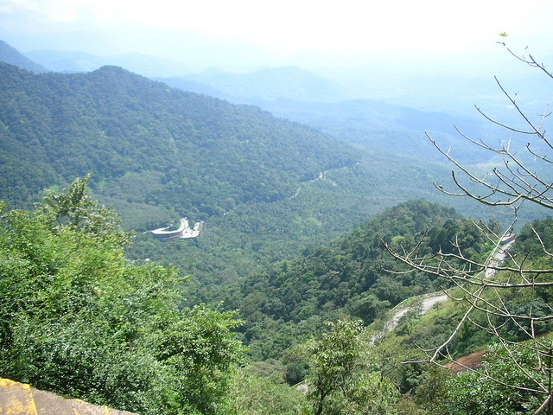
Natural features Hills

Slide 19
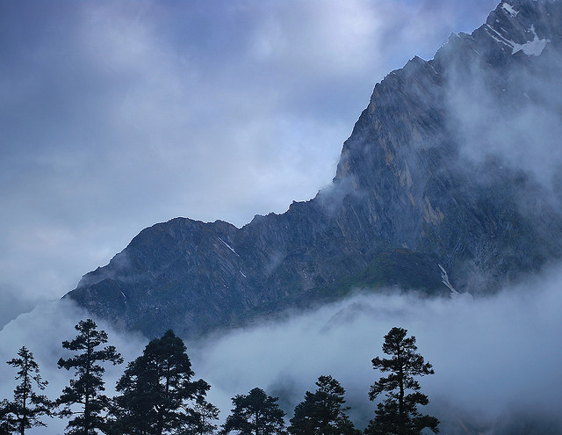
Natural features Himalayan Mountains
http://www.flickr.com/photos/himalayan-trails/3990203670/

Slide 20
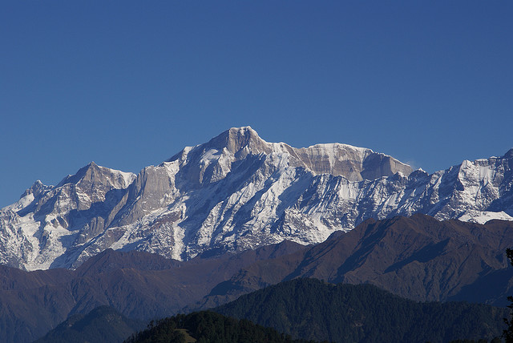
Natural features Mountains

Slide 21
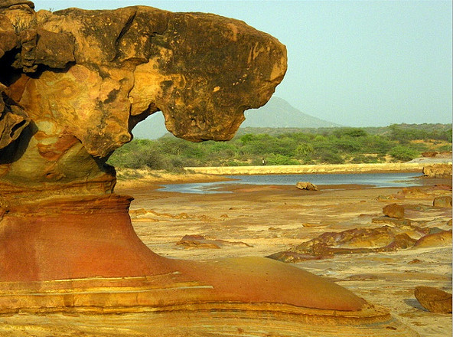
Natural features Rock formations
http://www.flickr.com/photos/jvblogger/3694603654/

Slide 22
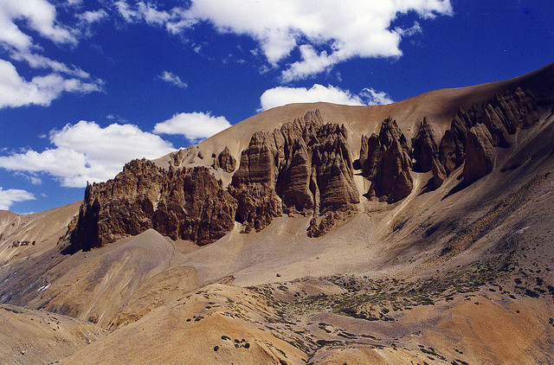
Natural features Himalayan rock formations
http://www.flickr.com/photos/dey/3864780/

Slide 23
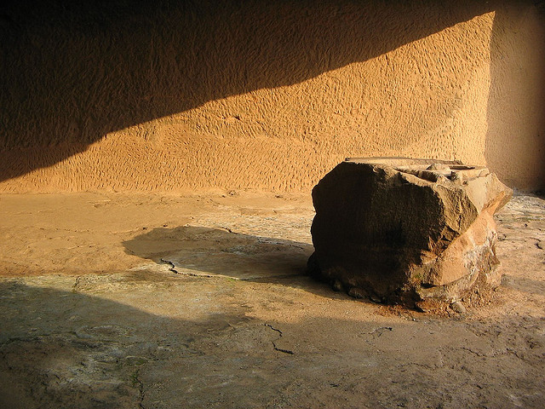
Natural features Lonavala Buddhist caves
http://www.flickr.com/photos/penny7b/1524007412/

Slide 24
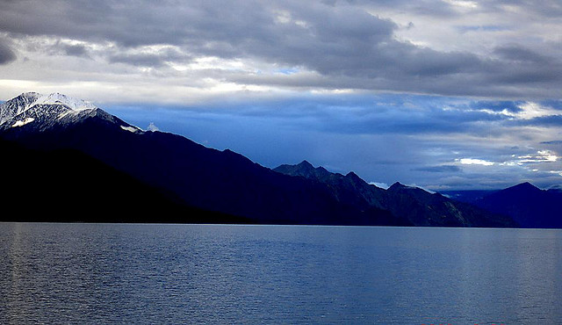
Natural features Pangong Lake
http://www.flickr.com/photos/himalayan-trails/322156167/

Slide 25
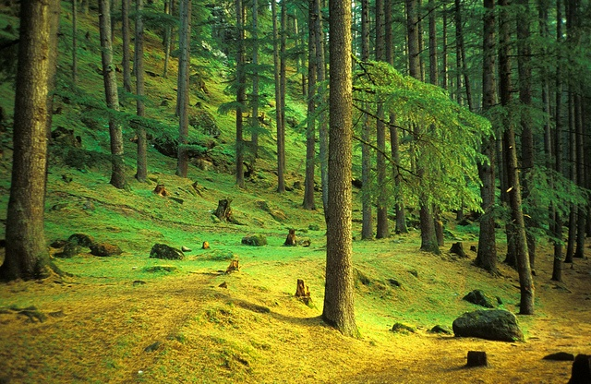
Natural features Parvati Valley
http://www.flickr.com/photos/sabamonin/4987336577/

Slide 26
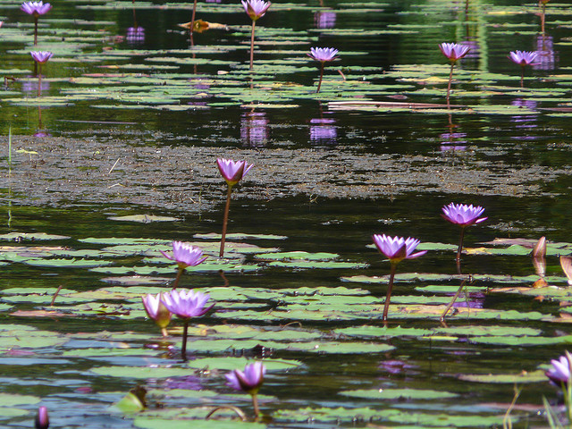
Natural features Pookode Lake
http://www.flickr.com/photos/christianbaudet/4404008199/

Slide 27
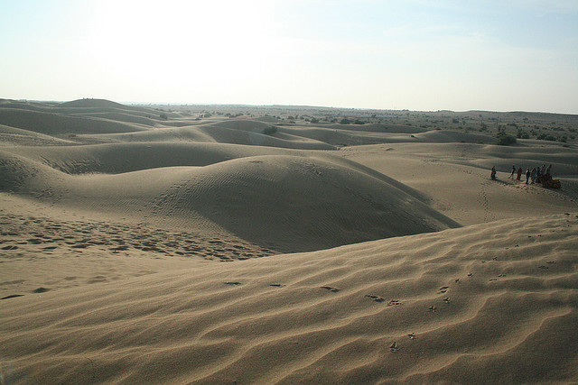
Natural features Sand dunes
http://www.flickr.com/photos/kumarasastry/576786956/

Slide 28
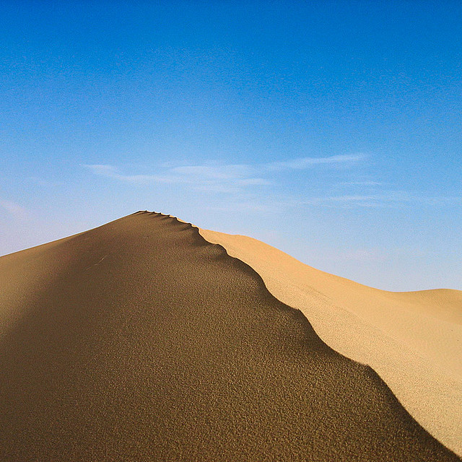
Natural features Sand dune - Thar desert
http://www.flickr.com/photos/burnblue/104767702/

Slide 29
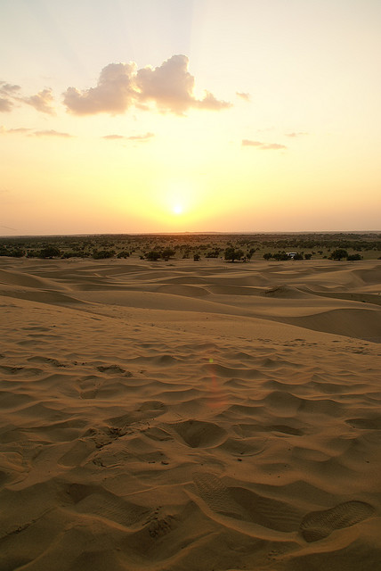
Natural features Thar desert
http://www.flickr.com/photos/clara/2120269800/

Slide 30
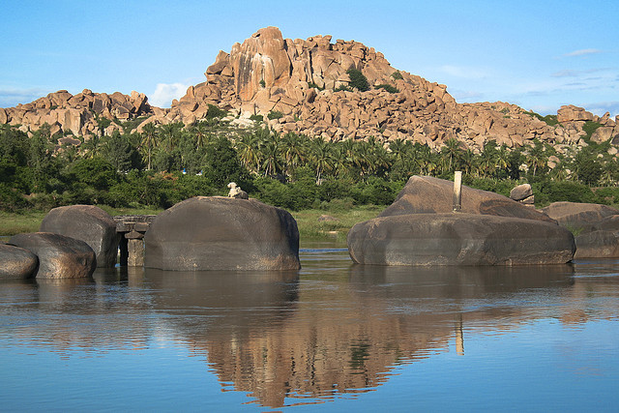
Natural features Tungabhadra River
http://www.flickr.com/photos/diegowyllie/537796189/

Slide 31
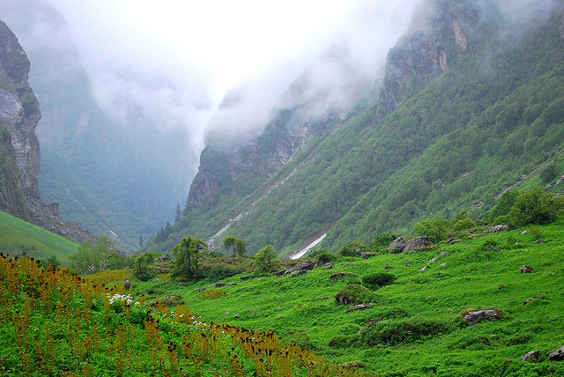
Natural features Valley of Flowers National Park in Uttranchal
http://www.flickr.com/photos/himalayan-trails/3417360067/

Slide 32
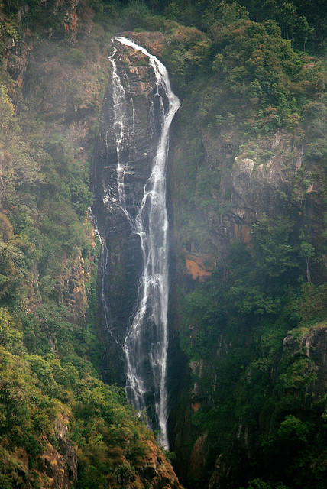
Natural features Waterfalls
http://www.flickr.com/photos/ravages/2703542712/

Slide 33
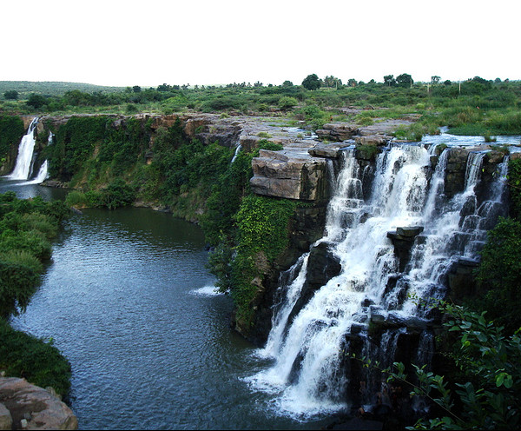
Natural features Waterfalls
http://www.flickr.com/photos/suneelmadhekar/2934853050/

