Slide 1
The Watsons Go to Birmingham - 1963
By Christopher Paul Curtis
A Virtual Tour
Presented by
Emily Fear, Lauren Millikan, & Ellie Ratliff

Slide 2
We’re taking a road trip!

Slide 3
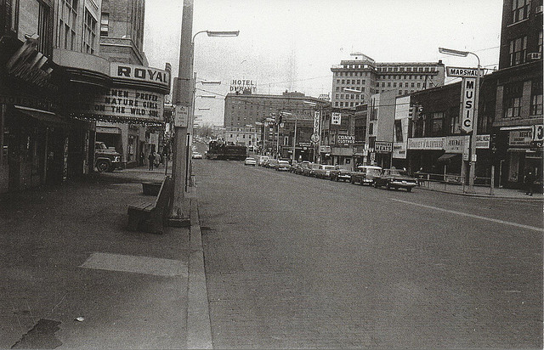
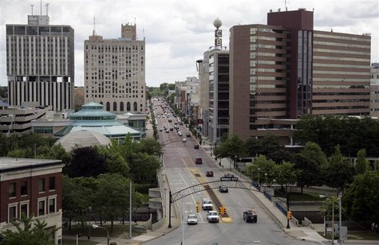
Welcome to Flint, Michigan!
Then
Now

Slide 4
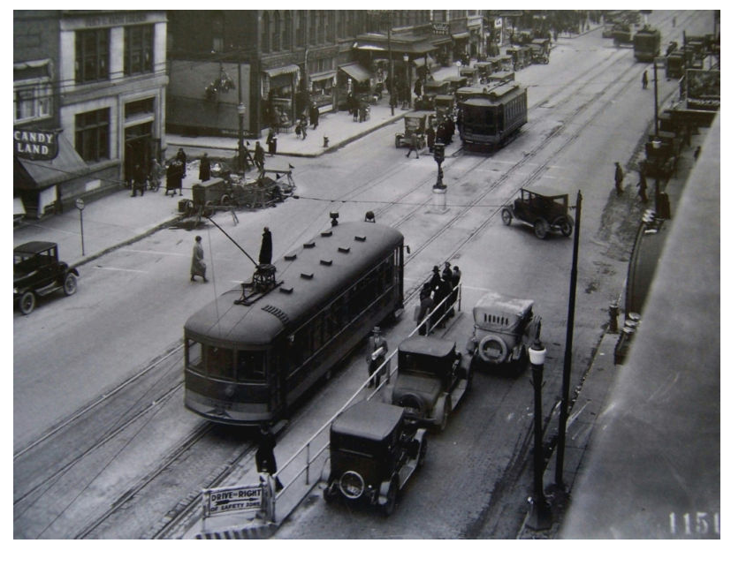
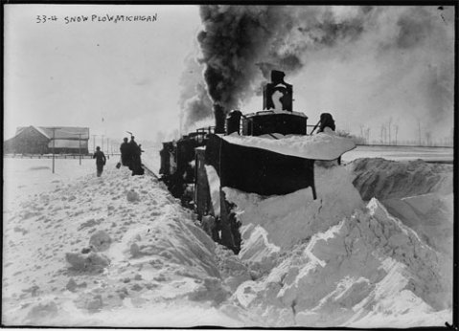
Winter in Flint
“Wilona, I heard tell about the weather up that far north in Flint, Mitch-again, heard it’s colder than inside a icebox. See a movie about it, think it was made in Flint. Movie called Nanook of the North.” - Daniel Watson, imitating Hambone Henderson (p.5).
Contrary to Hambone’s opinion, it was filmed in Port Harrison, Northern Quebec instead of Flint, Michigan.
In January 1963, the maximum temperature was 39°F and the minimum temperature was -14°F.

Slide 5
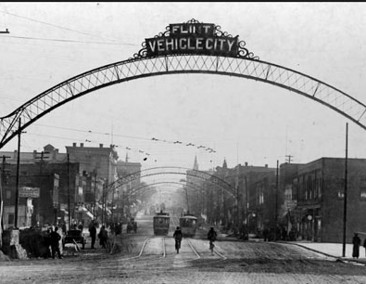
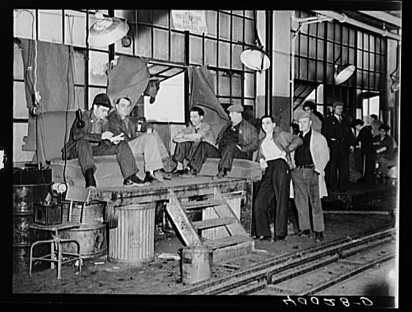
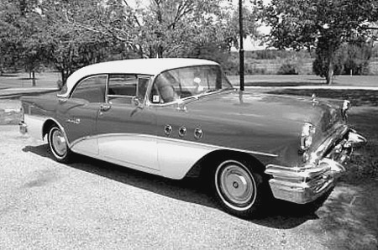
“Vehicle City”
“Dad was in the United Auto Workers at work so seniority was real important in our house.” - Kenny Watson (p.136)
Known as “Vehicle City,” by the 1950s, Flint was the site of the largest single manufacturing complex of General Motors and second only to Detroit in US auto manufacturing.
Things you can do:
Visit the Buick Automotive Gallery, featuring over 25 classic and concept Buick's, Chevrolet's and other locally built automobiles.
The gallery is part of the Flint Cultural Center ; other parts of it would also be fun to visit.

Slide 6
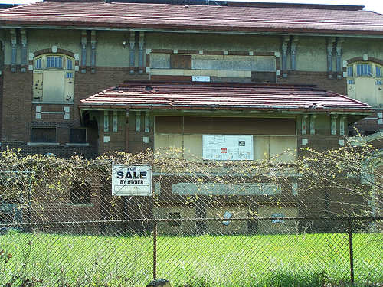
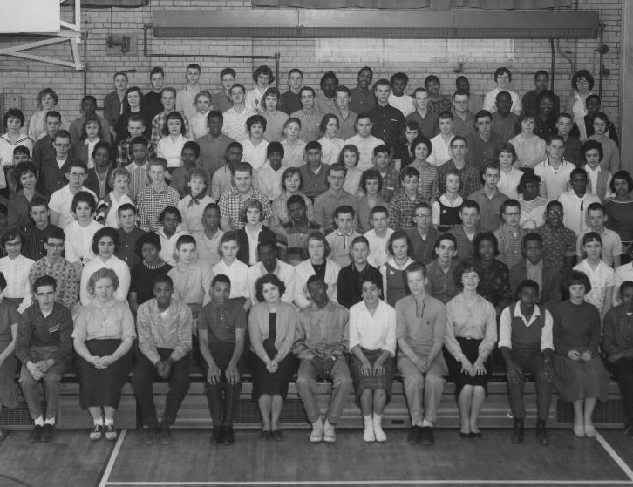
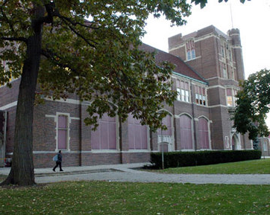
Schools in Flint
Clark Elementary Now
“Even though my older brother was Clark Elementary School’s god that didn’t mean I never got teased or beat up at all. “ - Kenny Watson (p.26).
Clark Elementary (closed due to construction of I-475)
Corner of Harrison and S. Eighth St.
“Let me put it this way, do you remember the line Big Daddy used to give every girl at Central High School? … ‘I can show you better than i can tell you’ “ - Wilona Watson when referring to Byron’s butter (p.93-94).
Central High (closed in 2009 due to declining enrollment and maintenance costs)
601 Crapo St
The oldest school in the city (until it closed)
These were both a part of Flint Community Schools
Things you can do:
Visit the old Clark Elementary building.
Visit the old Central High building
Watch the movie To Touch a Child (1962), a look into Community Schools.
Central High 9th Grade Class - 1963
Central High Now

Slide 7
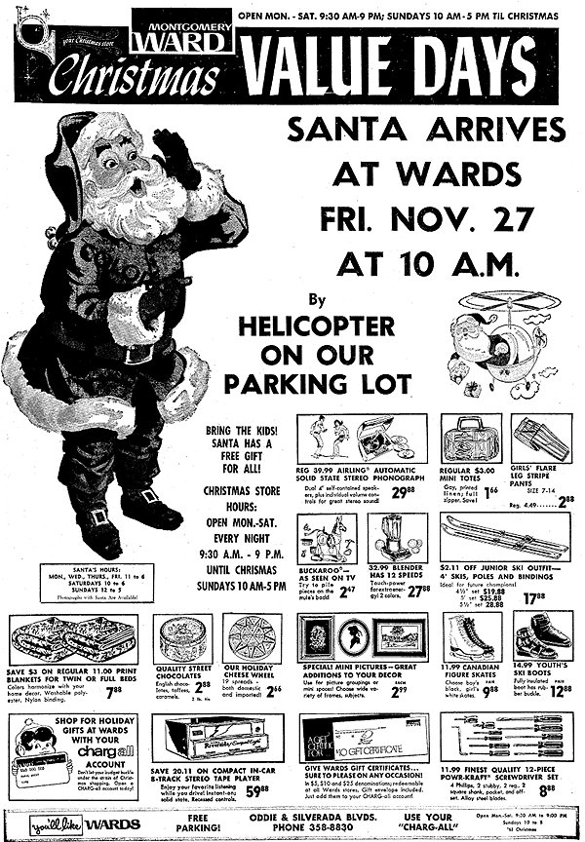
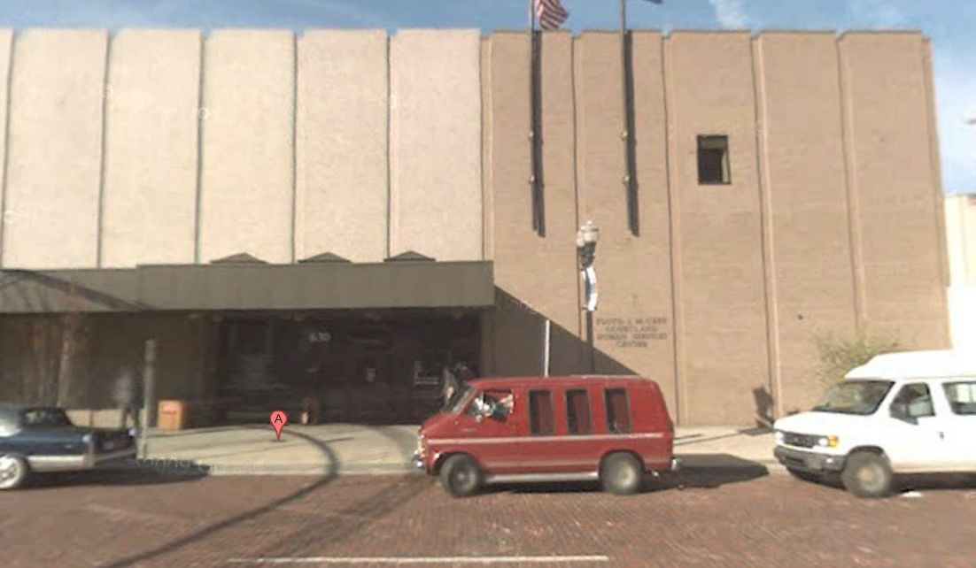
Montgomery Ward’s
“At the end of every winter Momma and Dad would go downtown to Montgomery Ward’s when gloves were going on sale and buy six pairs for us kids.” - Kenny (p.55).
Montgomery Ward’s (or where it used to be)
630 S. Saginaw Street
Opened in 1965 (slight discrepancy from book) in downtown Flint; Closed in 1980.
Ward’s became the Floyd J. McCree Building
Things you can do:
Visit the Floyd J. McCree Building
Floyd J. McCree Building Now

Slide 8
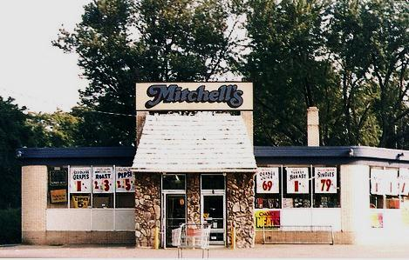
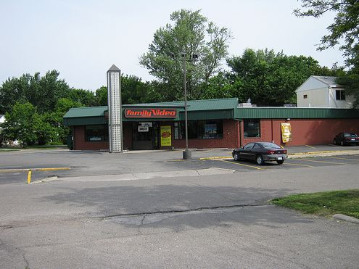
Mitchell’s Supermarket
Mitchell’s Supermarket as of 1992
“Byron, I want you and Kenny to go up to Mitchell’s and get some milk, a loaf of bread and a can of tomato paste for dinner.” - Wilona Watson (p.75).
Mitchell’s became East Village Family Video in 1999.
1835 E. Court St.
Things you can do:
Visit East Village Family Video
East Village Family Video Now

Slide 9
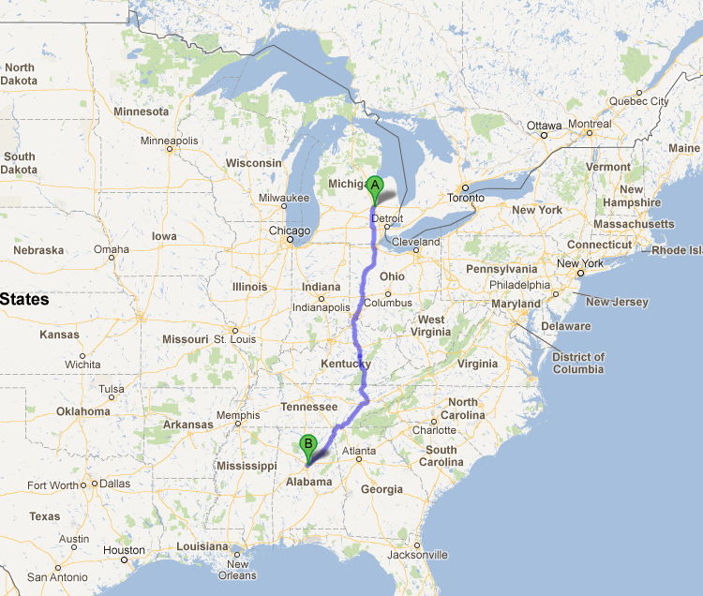
Time to hit the road!

Slide 10
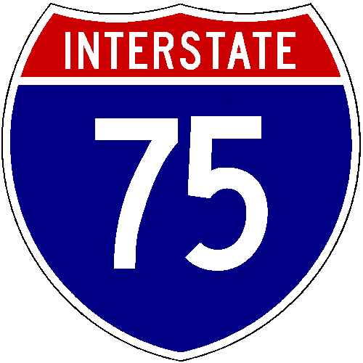
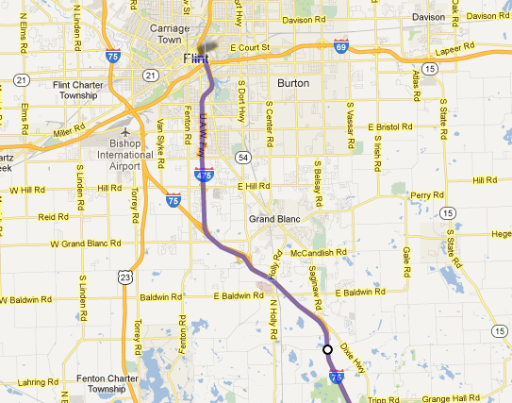
I-75
“We heard a bunch of boring stuff about the expressway - how many years it took to finish it, how many miles long it was, how much it cost to build it, how it ran all the way from the Upper Peninsula in Michigan to Florida, all kinds of thrilling news. The only thing that was a little bit interesting was how many people got killed and hurt making the road.” - Kenny Watson (p.133).
The earliest section of I-75 opened in August 1951 (the section in Atlanta, Georgia, that overlaps I-85) before the Interstate numbers were applied to the network in September 1957.
I-75 was completed at a cost of $3.5 billion from Sault Ste. Marie, Michigan, to Tampa, Florida, on December 21, 1977, with the opening of a segment four miles north of Marietta, Georgia.

Slide 11
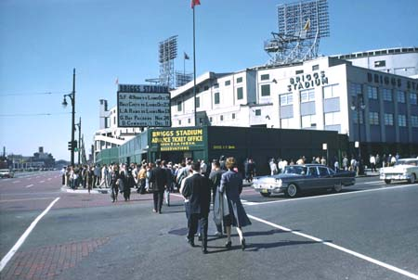
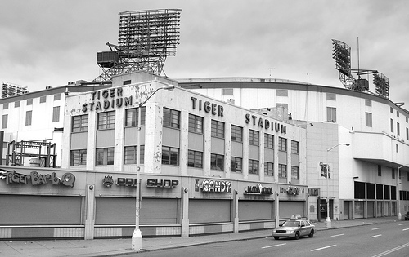
Detroit, Michigan – Tiger Stadium
Tiger Stadium
1960
“On the left, kids, is Tiger Stadium!” - Wilona Watson (p.136).
On September 27, 1999, the final Detroit Tigers game was held at Tiger Stadium, an 8-2 victory over the Kansas City Royals.
The last remaining part of the stadium was demolished at approximately 9:24 am, Monday, September 21, 2009.
From 1963-1968, the seating capacity for baseball was 53,089.
From 1937-1970, the seating capacity for football was 58,210.
Things you can do
Visit the Detroit Historical Museum
Tiger Stadium
2007

Slide 12
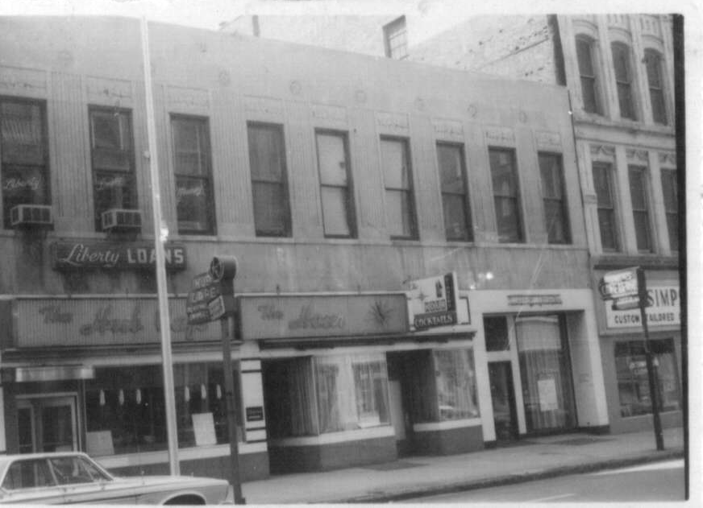
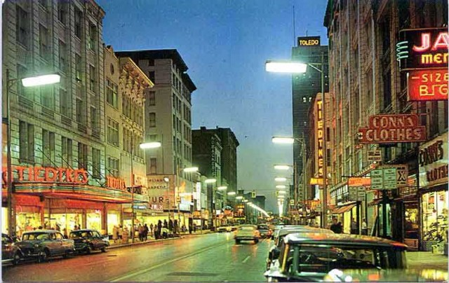
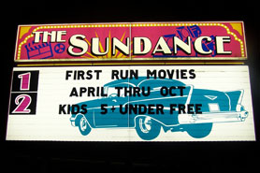
Toledo, Ohio
“Just outside of Toledo we pulled over at a rest stop... The Ohio rest stop was really cool! It was chopped right out of the forest and had picnic tables made out of giant logs.” - Kenny Watson (p. 138).
Toledo is known as the Glass City because of its long history of innovation in all aspects of the glass industry: windows, bottles, windshields, construction materials, and glass art.
Before the industrial revolution, Toledo was a port city on the Great Lakes. With the advent of the automobile, the city became known for industrial manufacturing.
Things you can do
Visit the Toledo Museum of Art, which has a large collection of glass art
Ride a mule-drawn canal boat through the Miami & Erie Canal.
Spend an evening under the stars at the Sundance Kid Drive-In, a 50's style drive-in movie theater.

Slide 13
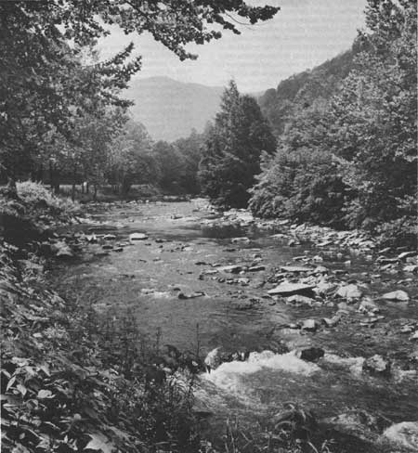
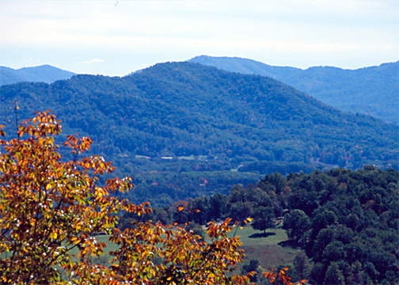
Tennessee - Appalachia
“This is the Appalachia Mountains. We’re over six thousand feet above sea level, this is higher than we’ve ever been before.” - Wilona Watson (p.144)
The Scopes Trial—the nation's most publicized debate over the teaching of the theory of evolution—took place in Dayton, Tennessee in southern Appalachia in 1925.
Appalachian music is one of the most well-known manifestations of Appalachian culture.
Commercial recordings of Appalachian musicians in the 1920s would have a significant impact on the development of country music, bluegrass, and old-time music.
“Dad was looking real, real bad... the worst thing, though, was that he had turned the radio on and was listening to country and western music!” - Kenny Watson (p.151)
Things you can do:
Visit the Museum of Appalachia

Slide 14
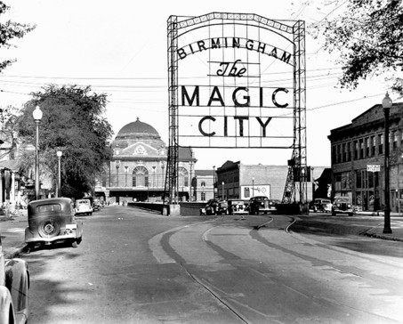
Welcome to Birmingham!
Click here for a video on Birmingham, Alabama in 1963

Slide 15
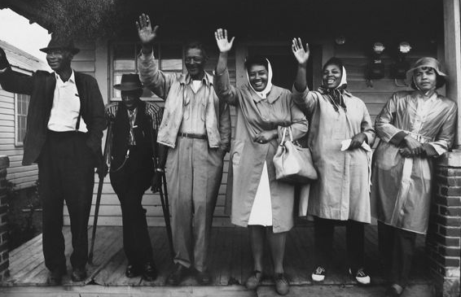
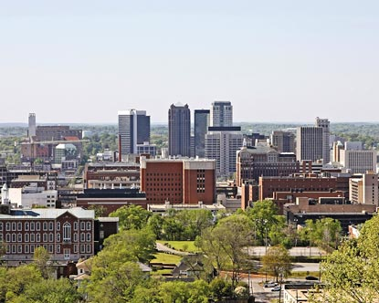
Birmingham, Alabama
“Birmingham was like an oven. That first night I couldn’t sleep at all, me and By had to share a bed and we both were sweating like two pigs.” Kenny Watson (p.162)
In January 1963, the max temperature was 70°F and the min temperature was 0°F.
In September 1963, the max temperature was 93°F and the min temperature was 53°F.
Birmingham, Alabama was, in 1960, one of the most racially segregated cities in the U.S. At that time, its population was 60% white and 40% black.
On May 10, 1963, Fred Shuttlesworth and Martin Luther King told reporters that they had an agreement from the City of Birmingham to desegregate lunch counters, restrooms, drinking fountains and fitting rooms within 90 days.
Birmingham's public schools were integrated in September 1963.
Things you can do:
Visit the Birmingham Civil Rights Institute, which showcases the journey through Birmingham's contributions to the Civil Rights Movement and human rights struggles.
Black citizens of Birmingham
1960
Birmingham, Alabama
Now

Slide 16
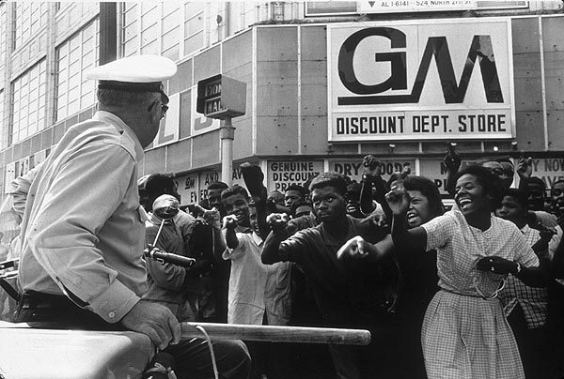
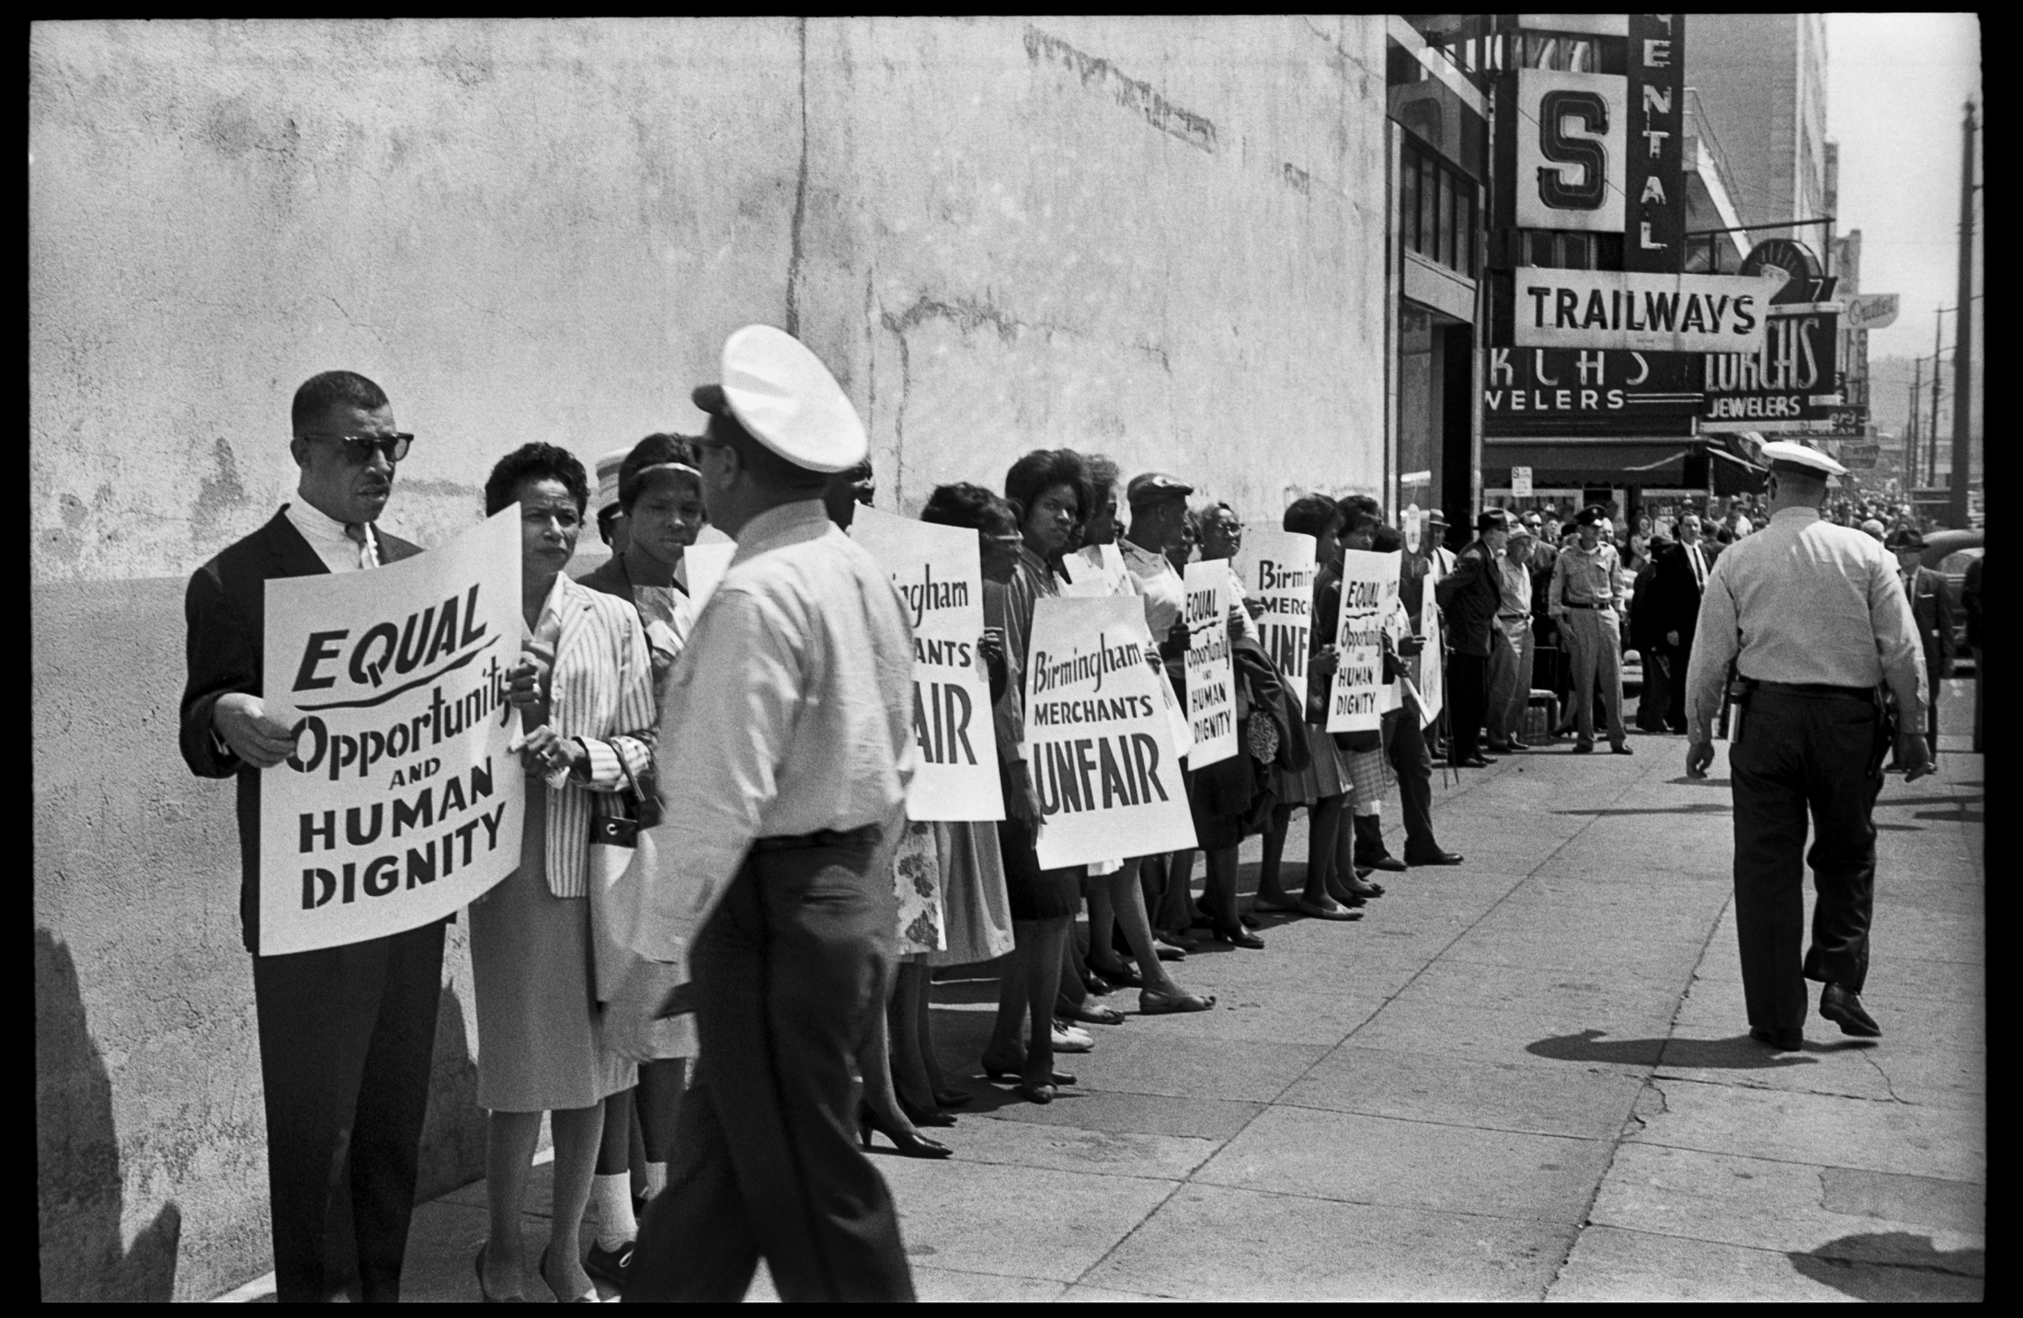
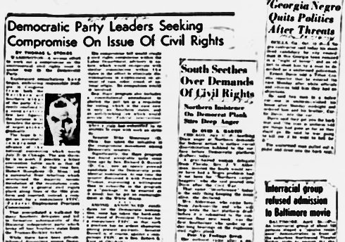
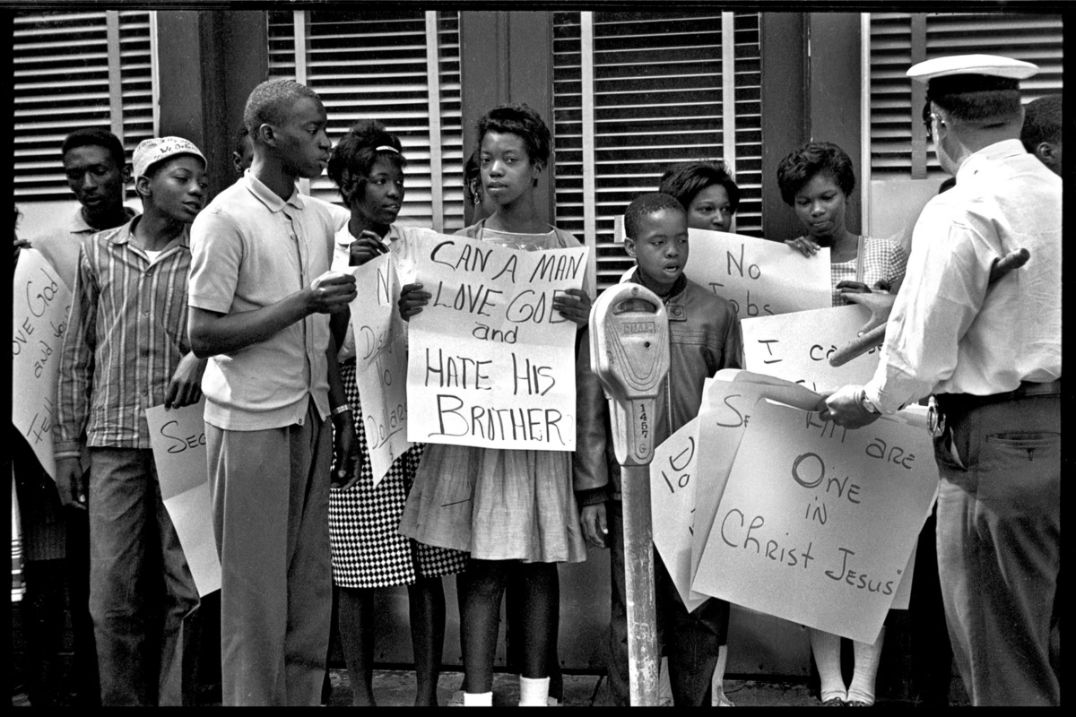
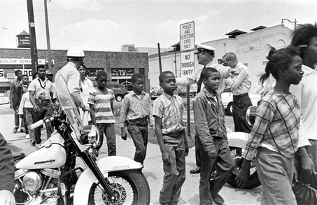
The fight for civil rights in Birmingham

Slide 17
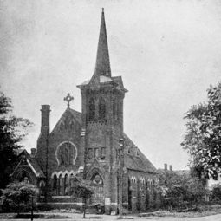
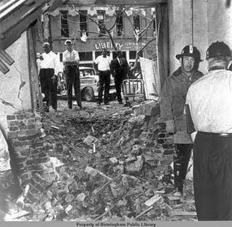
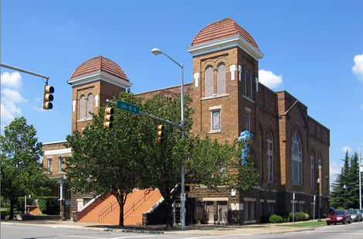
Sixteenth Street Baptist Church
16th St. Baptist Church
Before bombing
“I know it was Sunday because I heard Joetta getting ready for Sunday school.” - Kenny Watson (p.180)
Organized in 1873 as the First Colored Baptist Church of Birmingham, Alabama., it was the first black church in Birmingham.
The church served as headquarters for the civil rights mass meetings and rallies in the early 1960’s.
On Sunday, September 15, 1963, at 10:22 a.m., four young girls were killed when a bomb went off during Sunday school.
The church was reopened for services Sunday, June 7, 1964. A special memorial gift--a large stained glass window of the image of a black crucified Christ--was given by the people of Wales.
Things you can do:
Tour the church.
Watch the 1997 Spike Lee documentary
4 Little Girls, about the bombing.
16th St. Baptist Church
After bombing
Click for video documentary
16th St. Baptist Church
Now

Slide 18
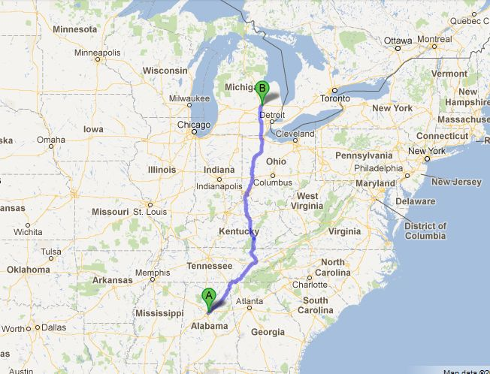
Buckle up!
We’re going home!

Slide 19
References
Flint, MI weather in January 1963 http://www.wunderground.com/history/airport/KFNT/1963/1/1/MonthlyHistory.html Nanook of the North: where was it filmed? http://topdocumentaryfilms.com/nanook-of-the-north/ General Motors in Flint http://www.britannica.com/EBchecked/topic/210279/Flint Address of Clark Elementary Flint Board of education. (1898). City schools...Flint, Michigan, 1897-98. Flint, Michigan: The Board. Photos of the current inside of Clark Elementary http://scotthovind.com/2012/04/07/clark-school-in-flint-michigan-part-2/ Central High closing announcement http://www.mlive.com/news/flint/index.ssf/2009/03/eight_flint_schools_on_choppin.html Central High information http://en.wikipedia.org/wiki/Flint_Central_High_School Site with pictures from Central High 1963 http://www.flintcentral1963.org/FCHS%20News.htm Wikipedia entry: look under ‘Movies’ http://en.wikipedia.org/wiki/Flint,_Michigan

Slide 20
History of Montgomery Ward’s in Flint http://www.mlive.com/opinion/flint/index.ssf/2008/11/remember_when_crowds_flocked_t.html Montgomery Ward’s is now the Floyd J. McCree Building http://www.flickr.com/photos/jhdennis/6527738551/ Photo of Mitchell’s before and after http://www.flickr.com/photos/jhdennis/3864676048/ Address of East Village Family Video http://www.eastvillagemagazine.org/features2/12590.html Facts on Interstate 75 http://www.fhwa.dot.gov/interstate/previousfacts.cfm Toledo, Ohio wikipedia entry http://en.wikipedia.org/wiki/Toledo,_Ohio Toledo, Ohio Sundance Kid Drive in http://www.dotoledo.org/Explore-Toledo/Attractions/Sundance-Kid-Drive-In-Theatre Appalachia wikipedia entry http://en.wikipedia.org/wiki/Appalachia Birmingham, AL weather in January 1963 and September 1963 http://www.wunderground.com/history/airport/KBHM/1963/1/1/MonthlyHistory.html http://www.wunderground.com/history/airport/KBHM/1963/9/1/MonthlyHistory.html Birmingham, AL wikipedia http://en.wikipedia.org/wiki/Birmingham_campaign Birmingham Civil Rights Institute http://en.wikipedia.org/wiki/Birmingham_Civil_Rights_Institute FAQ on Sixteenth St Church http://www.16thstreetbaptist.org/History

Slide 21
Photo Resources
http://www.flickr.com/photos/bradffordallan/4242185498/
http://wtaq.com/news/articles/2011/nov/29/michigan-governor-approves-state-takeover-of-flint/
http://michpics.wordpress.com/2006/12/19/snow-plow-in-field-in-michigan/
http://www.flintexpats.com/2011_08_01_archive.html
http://rustbeltroadtrip.wordpress.com/flint/
http://laborsouth.blogspot.com/2012/06/uaw-targets-nissan-plant-in-canton-miss.html
http://www.princeofpetworth.com/2008/11/clark-elementary-school-in-petworth-to-get-developed/
http://www.mlive.com/news/flint/index.ssf/2009/03/eight_flint_schools_on_choppin.html
http://www.flintcentral1963.org/FCHS%20News.htm
http://mallsofamerica.blogspot.com/2006/12/flying-mall-santas.html
http://www.flickr.com/photos/jhdennis/3861886660/sizes/m/in/photostream/
http://radiospikeblog.blogspot.com/2007_09_01_archive.html
http://atdetroit.net/forum/messages/6790/146721.html?1217509629
http://www.cyburbia.org/gallery/showphoto.php/photo/6705/title/toledosummit-street-at-night/cat/528
http://www.greateasterntheatres.com/sundancehome.asp
http://remetteresearch.blogspot.com/
http://www.foresthistory.org/ASPNET/Publications/region/8/history/chap6.aspx
http://thecollaboratory.wikidot.com/world-regional-geography
http://deadspin.com/5120694/let-me-tell-you-something-about-birmingham-alabama
http://bpldigital.blogspot.com/2010/04/united-states-civil-rights-1947-1969.html
http://blog.al.com/live/2009/08/civil_rights_figures_son_will.html
http://blog.al.com/spotnews/2009/08/birmingham_mayor_langford_to_o.html
http://www.latimes.com/news/obituaries/la-me-moore_08_kzegwync.jpg,0,306325.photo
http://articles.boston.com/2012-02-26/books/31098389_1_book-lovers-bus-trip-first-book
http://blog.sfgate.com/ontheblock/category/national-news/
http://en.wikipedia.org/wiki/16th_Street_Baptist_Church
http://usslave.blogspot.com/2011/05/4-little-girls-1997-there-are-many.html
http://en.wikipedia.org/wiki/16th_Street_Baptist_Church_bombing

Slide 22
Music Resources
“What a Difference a Day Makes” – Hazel Miller
“Yakety Yak” – The Coasters
“Freedom Medley: Freedom Chant; On Freedom: This Little Light” – Various Artists, Smithsonian Folkways

