Slide 1
Intro To 9th Ward

Slide 2
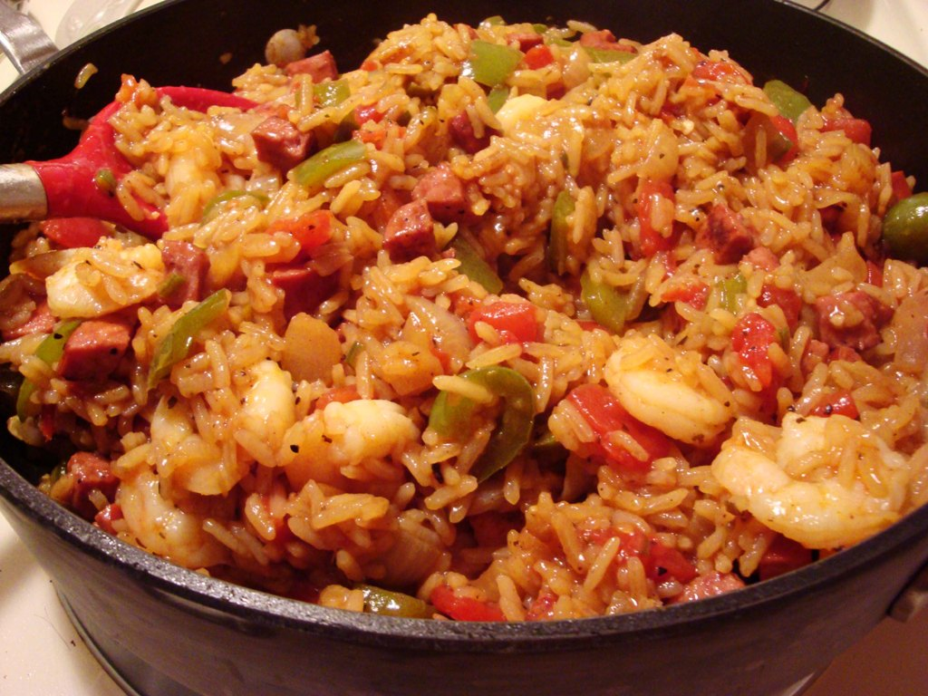

Slide 3
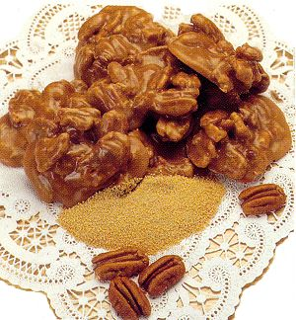

Slide 4
Romeo + Juliet (page 6)

Slide 5


Slide 6
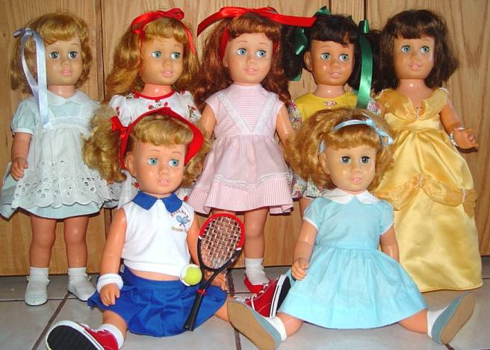

Slide 7


Slide 8

An American non-profit organization that wants to stop educational unfairness by asking high-achieving recent college graduates and professionals to teach for two or more years in low-income communities throughout the United States.

Slide 9
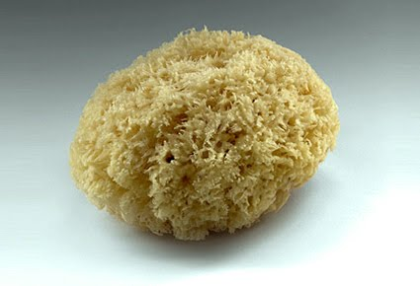
Why is a brain like a sponge?

Slide 10
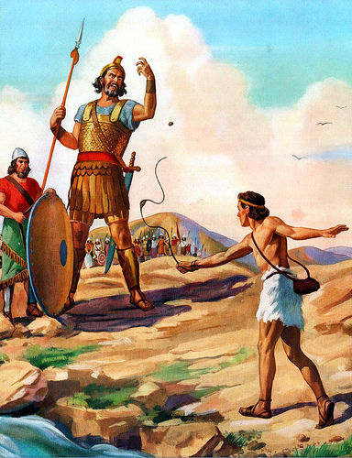
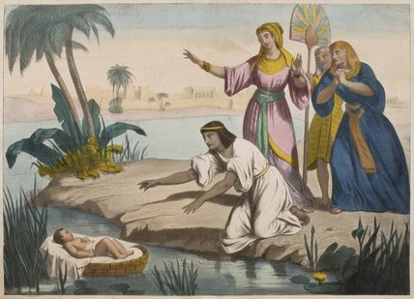

Slide 11
The Philistine army gathered for war against Israel. A Philistine giant measuring over nine feet tall and wearing full armor came out each day for forty days, challenging the Israelites to fight. His name was Goliath. Saul, the King of Israel, and the whole army were terrified of Goliath. One day, David was sent to the battle lines to bring back news of his brothers. David heard Goliath shouting his daily challenge and he saw the great fear in the army of Israel. David volunteered to fight Goliath. Dressed in his simple tunic, carrying his shepherd's staff, slingshot, and a pouch full of stones, David approached Goliath. The giant cursed at him, hurling threats and insults. As Goliath moved in for the kill, David reached into his bag and slung one of his stones at Goliath's head. Finding a hole in the armor, the stone sank into the giant's forehead and he fell face down on the ground. When the Philistines saw that their hero was dead, they turned and ran.

Slide 12
The Jews were in Egypt for 400 years. Pharaoh, the ruler in Egypt, was afraid of the Jews because there were so many of them. He was afraid they would join another army against the Egyptians or start a rebellion. He ordered all male Hebrew babies to be killed. When the Jewish woman, Jochebed, gave birth to a son, she took a basket and coated the bottom with tar, to make it waterproof. Then she put the baby in it and set it among the reeds on the bank of the Nile River. At that same time, Pharaoh's daughter was bathing in the river. One of her maidservants saw the basket and brought it to her. Miriam, the baby's sister, watched to see what would happen. Miriam fetched her mother, Jochebed and brought her to nurse and care for the boy, her own son, until he grew. Then Miriam brought him back to Pharaoh's daughter, who raised him as her own. Pharoah’s daughter named him Moses.

Slide 13


Slide 14
NaRLins Music!
Colinda
Zydeco

