Slide 1
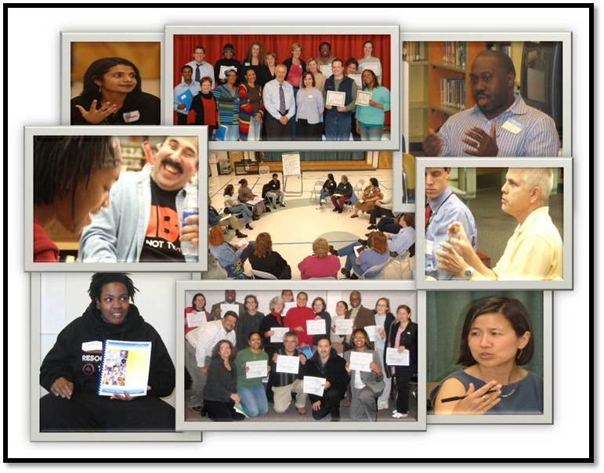
Building Leadership Capacity to Remove Racial Barriers to Student Achievement

Slide 2
Study Circles Mission
The mission of the Study Circles Program is to identify, examine, and eliminate institutional barriers to African American and Latino student achievement in Montgomery County Public Schools.

Slide 3
The next 6 slides include questions and responses from members of 9 different leadership teams. Answer the questions for your leadership team and compare to the others.
Notes:
Whenever we work with leadership teams, we ask them a series of questions. We will take you through 6 questions. For each, stand up if you agree with the statement for this school. (someone needs to keep track of agrees and disagrees). There is no right or wrong answer.
After we see how this ILT responds, we will show you how other ILTs have responded. The answers are based on 9 ILTS in the past year.

Slide 4
1. Racial, ethnic, and cultural differences among staff, students, and parents affect student achievement and parent involvement at this school.
96% of leadership team members agreed with this statement for their school.
Notes:
Click to see the question. Ask everyone who agrees to stand and look around. Tally the responses. Then click again to show how the other 9 ILTs responded.

Slide 5
2. Some staff members do not have the awareness and skills necessary to teach and develop relationships with African American and Latino students.
91.4% of leadership team members agreed with the statement for their school.
Notes:
Click to see the question. Ask everyone who agrees to stand and look around. Tally the responses. Then click again to show how the other 9 ILTs responded.

Slide 6
3. I am personally able to engage all students regardless of race, ethnicity, and culture.
41.2% of leadership team members agreed with the statement for their school.
Notes:
Click to see the question. Ask everyone who agrees to stand and look around. Tally the responses. Then click again to show how the other 9 ILTs responded.

Slide 7
4. The Leadership Team has the trust necessary to discuss racial and ethnic barriers to student achievement and parent involvement.
41.2% of leadership team members agreed with their school.
Notes:
Click to see the question. Ask everyone who agrees to stand and look around. Tally the responses. Then click again to show how the other 9 ILTs responded.

Slide 8
5. I have the skills, strategies, and confidence to lead my team in conversations about race, ethnicity, and culture.
25.6% of leadership team members agreed with the statement for their school.
Notes:
Click to see the question. Ask everyone who agrees to stand and look around. Tally the responses. Then click again to show how the other 9 ILTs responded.

Slide 9
6. The Leadership Team has the skills, strategies, and confidence to address teachers at the school who struggle to effectively teach African American and Latino students.
3.1% leadership team members agreed with the statement for their school.
Notes:
Click to see the question. Ask everyone who agrees to stand and look around. Tally the responses. Then click again to show how the other 9 ILTs responded.

Slide 10
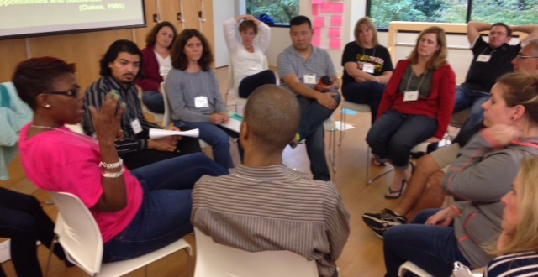
Goal of Leadership Teams Study Circles
To become a high-functioning team that has the trust, structures, and confidence to close the achievement gap and ensure that all students are successful.

Slide 11
Cultural
Shift
Outcomes
Change practices and policies
Engage the whole staff in the conversation and work
Examine beliefs, practices, and policies that are barriers to success
Hear from different stakeholders and include these perspectives in planning
Develop the trust to engage in uncomfortable conversations

Slide 12
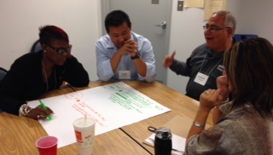
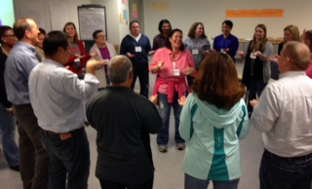
Our Approach
Build the capacity of leadership teams to:
Engage in honest and productive dialogue around race and equity
Hear a broad range of experiences and perspectives
Identify and examine institutional barriers (beliefs, practices, and policies)
Collaboratively work to eliminate the barriers

Slide 13
Start with a 2-day retreat.

Slide 14
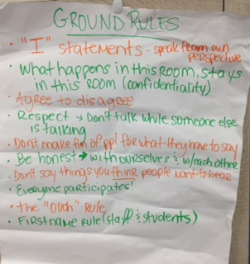
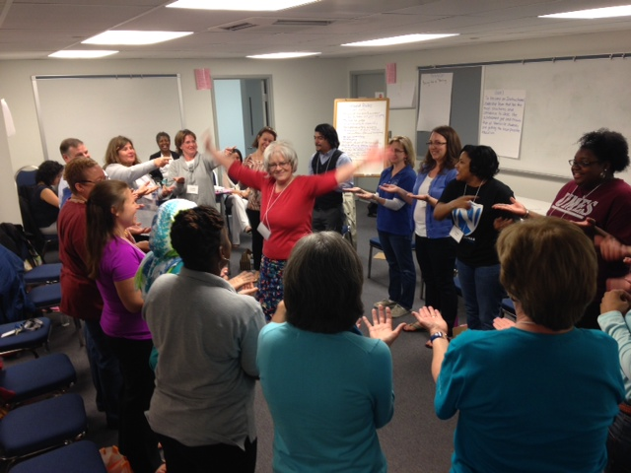
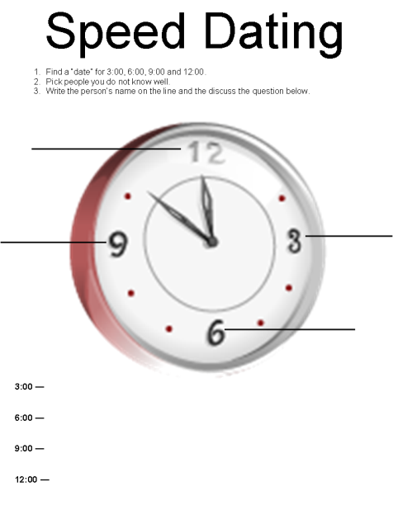
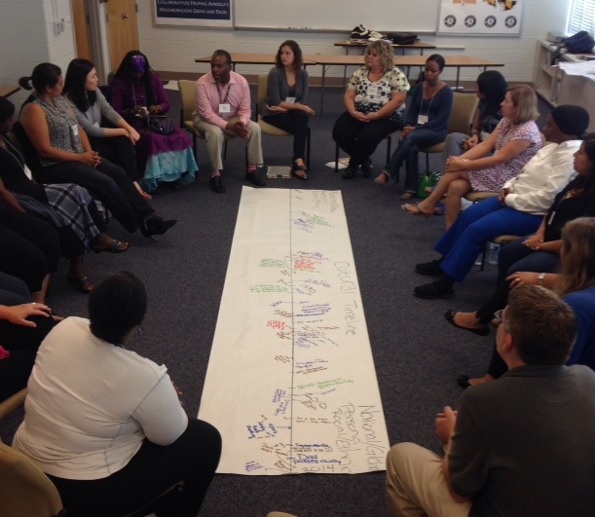
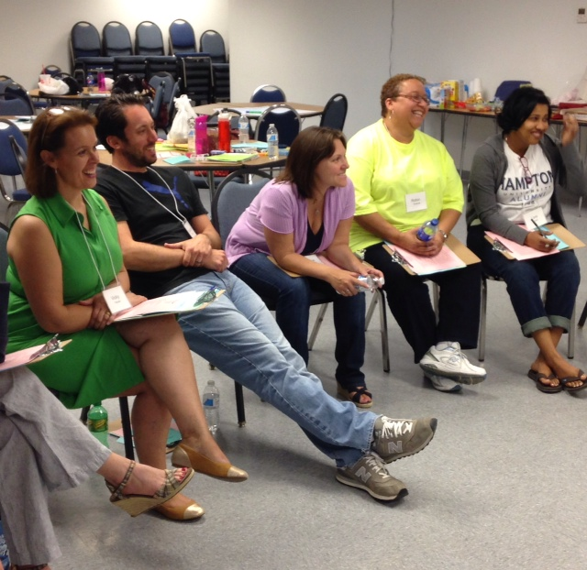
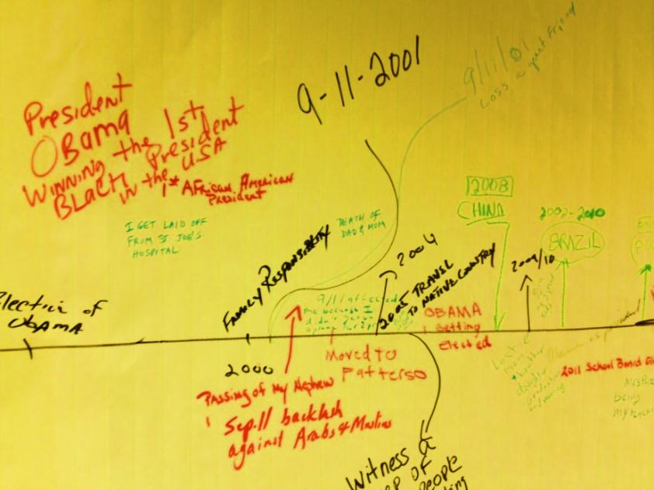
Session 1
Session 1
v
Create the trust and skills for honest dialogue.
Notes:
In session 1, we spend a lot of time building trust. The activities begin with developing ground rules, having some fun and then different activities to help share your own individual stories. These stories help when you get to the more challenging conversations later in the retreat.

Slide 15
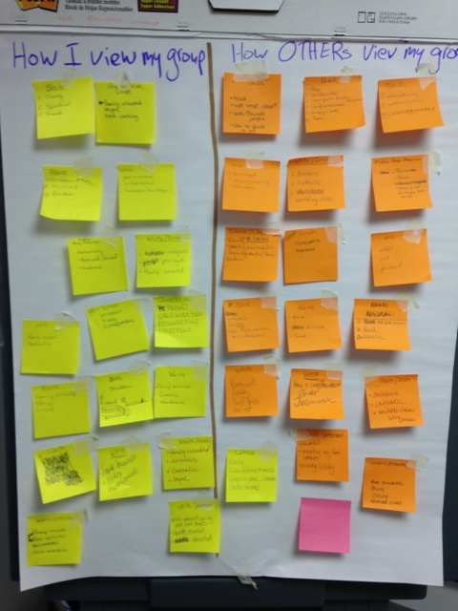
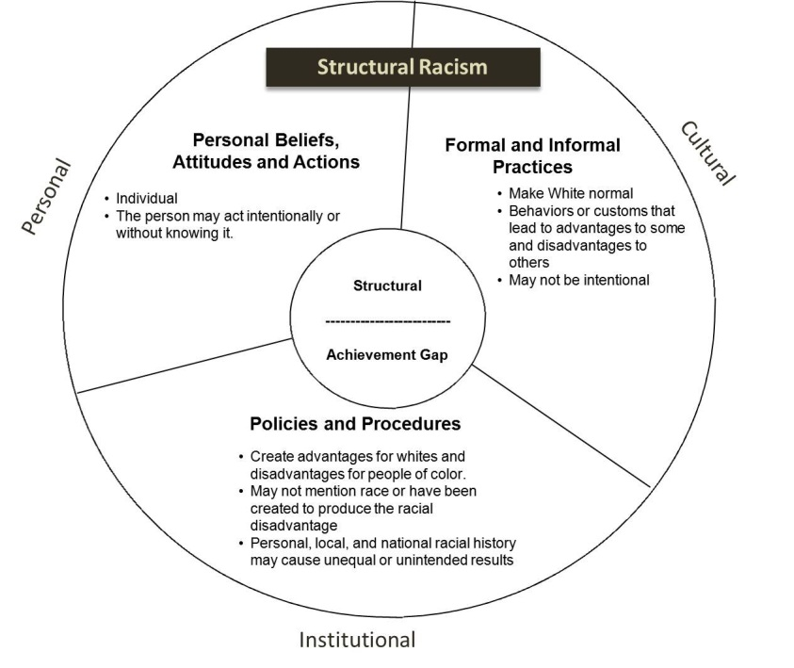
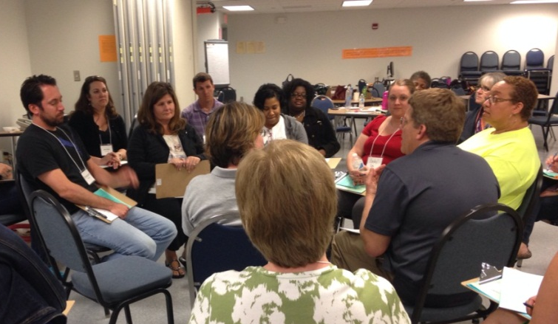
Session 2
Engage in honest dialogue about race and use a framework for understanding institutional barriers.
Notes:
In session 2, we build on the trust developed in session 1 to begin practicing having conversations about race and achievement. We start out light and build up. For example, we may do an activity around stereotypes and then talk about differences based on skin color. We may then show you how you can have honest and productive dialogues about how these issues impact student achievement.
At the end of the day, we show you a framework for looking at the beliefs, practices, and policies that may be impacting achievement at your school. This will help was we come back to work on action steps.

Slide 16
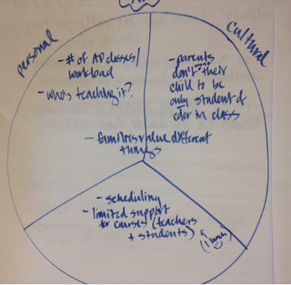
Ongoing Coaching Session during regular leadership meetings.
Develop and implement a plan for addressing institutional barriers.
Notes:
Toward the end of session 1, we also begin to tell the story of this school and of this Instructional Leadership Team, and work together to determine the vision for this Leadership Team.

Slide 17
Click to hear principals explain the impact on Study Circles on their leadership teams.
The video is 3 minutes. If it doesn’t open go to http://youtu.be/SWCUBaBX9g0

Slide 18
Outcomes from one school.
After the First Year working With the Study Circles Program

Slide 21
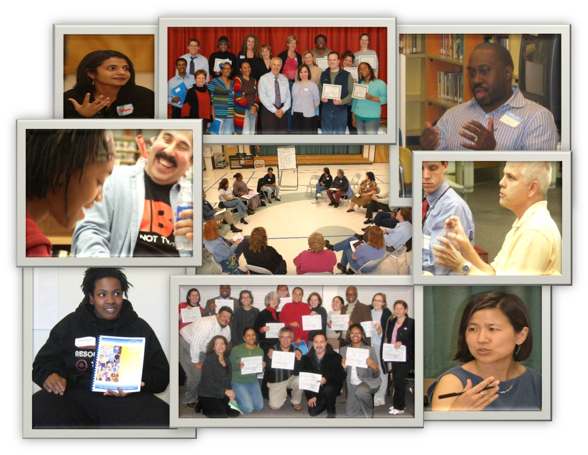
For More Information
WWW.MONTGOMERYSCHOOLSMD.ORG/DEPARTMENTS/STUDYCIRCLES
301-444-8630
Follow us on Twitter: @MCstudycircles
Notes:
Any questions?

