Slide 1
July 29, 2014
Joan Locastro and Kerri Mullins-Levine
Wheaton High School
UDL Strategies in LFI and SCB Classrooms

Slide 2

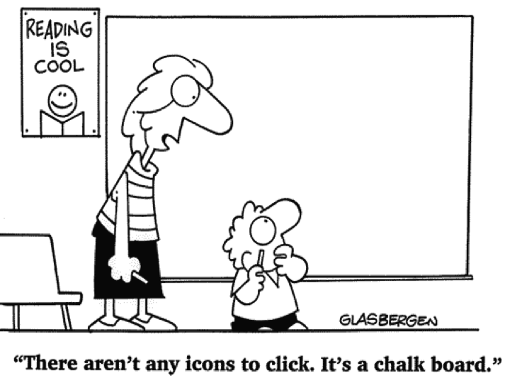
Introductions
What is your name?
Where do you teach? (grade level/program/subjects)
What is your experience with UDL?
Universal
Design
For Learning

Slide 3
Workshop Objectives
At the end of this workshop we will be able to:
Identify the components of student engagement
Describe what is Universal Design for Learning (UDL)
State the differences between UDL and differentiation of instruction
Identify the three main principles of UDL
Describe what UDL looks like in a LFI and SCB classroom
Identify and explore low and high tech resources
Begin to self-reflect on how to incorporate UDL strategies in the classroom

Slide 4
Agenda
10 minutes Introductions
5 minutes Workshop Objectives
25 minutes What is Student Engagement Jigsaw Activity
40 minutes UDL in LFI/SCB Classrooms
15 minutes BREAK
30 minutes Collaborative Knowledge Poster Activity
25 minutes LFI/SCB Material Share and Explore
25 minutes UDL Goal Setting and Planning
5 minutes Wrap-up and Course Evaluation

Slide 5

What is Student Engagement?
A Jigsaw Activity
Directions:
Find the poster that matches the number on your card.
As a group, you will have 8 minutes to discuss and answer the question on the chart paper.
Use the markers, post-it notes, etc and choose how to represent the groups answer.(ex. Make a list, chart, diagram, etc.)
Choose a spokesperson to share responses.
Notes:
Use post-it notes on table to write down comments and questions to put in BIN after discussion has ended on each slide.

Slide 6

What Does Student Engagement Look Like for LFI/SCB Students?
Behaviors we expect of LFI/SCB students:
Attending to learning tasks
Staying on task for predetermined period of time
Following directions
Physical (calm body/hands, attending to speaker)

Slide 7

What Does Student Engagement Look Like for LFI/SCB Students?
Behaviors we help students develop:
Increase independence to self-monitor on-task behaviors
Increase communication skills
Increase appropriate social skills (ie: taking turns without prompts)

Slide 8
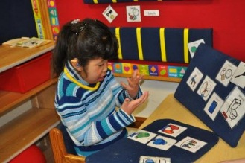
How Do We Know That
Our Students are Engaged?
Physically oriented towards the task
Responds to directions
Provides answers to questions
Completes tasks
Demonstrates motivation
Demonstrates positive demeanor

Slide 9

How Do We Design Instruction to Ensure Student Engagement?
Provide appropriate instructional materials for all students
Design interactive lessons/activities
Incorporate individual, small group, whole group lessons/activities
Provide consistent feedback
Scheduled routines/breaks
Provide opportunities for student choice

Slide 10

How Do We Work with
Para Educators to Ensure
Student Engagement?
Training
Develop a positive working relationship
Build upon para educator strengths
Communication
Develop a structured classroom with defined roles for para educators
Provide opportunities for para educator feedback

Slide 11

What are Barriers to Student Engagement in a LFI/SCB Classroom?
Communication
Behavioral challenges
Physical limitations
Issues related to attention
Issues related to health and/or medication
Issues related to staffing

Slide 12
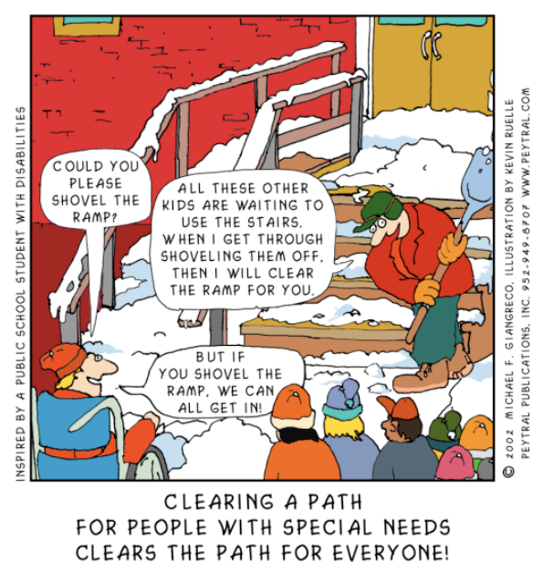
What is UDL?

Slide 13

Universal Design
provides equal access
to learning,
not simply equal access
to information.

Slide 14
Differences Between UDL and Differentiated Instruction
Differentiated Instruction | UDL
Responds to individual student needs | Anticipates range of all student needs
Responsive learning environment | Proactive and flexible learning environment
Student choice is sometimes provided | Student choice is always provided

Slide 15


Slide 16
Principle One:
Multiple Means of Representation
Flexibility in the ways information is presented in LFI and SCB classrooms is critical.
Mode of Representation | Examples
Say It | Discuss, Question, Read Aloud, Verbal Descriptions
Show It | Pictures, Graphics, White Board, ELMO, Video, Closed Caption, Promethean Board
Model It | Demonstrate, Coaching, Manipulatives, Role Play, Build/Construct
Media | Video, Audio, Computer, Other Technology
Notes:
Talk about graphics, spacing, and text

Slide 17
Principle Two:
Multiple Means of Expression
Provide different options for how LFI/SCB students respond or demonstrate knowledge and skills.
Tools for Expression | Examples
Low Tech | Picture Support, Graphic Organizers, Choice Boards, Scribe, Eye Gaze, Pencil Grip
High Tech | Computer Software (ex. Co-Writer, Inspiration, Screencast) Augmentative Communication Device (ex. GoTalk, BigMac Switch, iPad), Adapted Keyboard, Voice Activated Computer Software
Notes:
Rainforest Presentations

Slide 18
Principle Three:
Multiple Means of Engagement
Provide a variety of ways to engage students in learning.
Areas for Engagement | Examples
Instruction | Reinforcement, Redirection, Coaching, Prompting Strategies, Wait Times, Peer Support
Content | Highly Motivating Content and Context, Student Choice
Activities | Individual, Pairs, Small Groups, Large Groups

Slide 19

Everyday UDL in the SCB/LFI Classroom
Choices
Self-Management
Planning
Routines
Challenging Students
Student Challenges
Teacher Challenges

Slide 20

Choices
Providing for student choice throughout the school day creates a positive learning environment during academic instruction, community based instruction, job sites, and unstructured times.
Kind Manipulation
First/Then
Task/Activity
Student Work Product
Manipulatives
Seating Location
Notes:
KM- direct instruction, Task/Activity- High/Lo Tech, Student Work Product- types of projects, final work products, Manipulatives- digi/poker chips, Seating Location- Handerson, Zi

Slide 21

Self-Management
Providing direct instruction to teach students self-management skills will increase their engagement and independence while at school, home, work, and in their community.
Task Analysis
Group Work
Individual Work
Morning Routines
Lunch Time
Self-reflection
Problem Solving
Notes:
TA- KHS, Coffee, Worksites

Slide 22

Planning
Incorporating UDL principles when planning will reduce barriers in instruction and ensure that we provide appropriate accommodations, supports, and challenges for all students.
Frontloading
Instructional Packets
Instructional Activities
Choices
Notes:
Packets-variety, practice

Slide 23
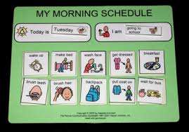
Routines
Once you have established routines, they require minimal time to implement, provide a predictable learning environment, and repetitive practice.
Arrival, Lunchtime, Dismissal
Homework
Beginning of Class period
  Question of the Day
  Spelling Tests
Instructional Routines
  Marzano
  Writing Four Square
  Independent Work Folders
  Data Sheets

Slide 24
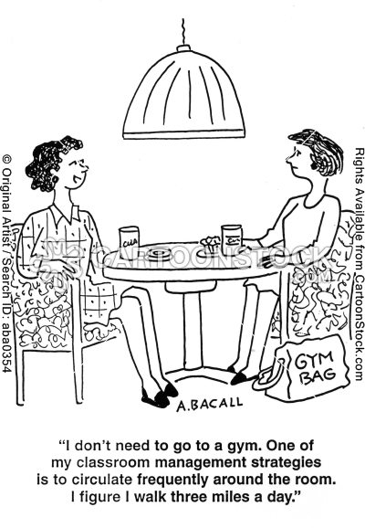
Challenging Students
Challenging behaviors will begin to decrease as more principles of UDL are incorporated into the classroom.
Choices
Individualized Work Schedules
Seating options
One-to-One Time
Simplifying and Reducing
Group “Leader”
Roles in Classroom
Behavior Management Charts
Notes:
Michael Nevia

Slide 25

Student Challenges
Students in the LFI and SCB Programs need support in many different areas.
Physical
  Bathroom
  Feeding
  Mobility
Cognitive
  Identifying personal preferences
  Making choices
Emotional
  Identifying feelings
  Identifying and demonstrating appropriate response

Slide 26

Teacher Challenges
LFI and SCB Programs present unique challenges for teachers.
Staffing
  Hours Provided vs. Student Needs
  Training
  Buy-In
Materials
  High School Level- same students for 6-8 years
  Extreme Range of Levels
  Limited opportunities to share materials
Related Service Providers
  Multiple Providers
  Schedules
Limited Opportunities for Professional Conversation
  Single Sites
  Limited Professional Development
Advocating for Our Students and Programs

Slide 27

Break

Slide 28

Collaborative Knowledge
Poster Activity
Directions:
Choose a poster. Please try to keep groups to no more than 5 people.
Without discussing, use the post-it notes to write one thing you currently do in your classroom that relates to the poster topic. You can write more than one note. If what you do is already written, place a check mark on that post-it note.
You will have 2 minutes at each poster. When time is up, you will rotate to the next poster as a group.
When you return to your original poster, you will have 5 minutes as a group to discuss the strategies on the poster and to pick 3 to share with the whole group.
Choose a spokesperson who will share with the group when we come together.
Notes:
30 minutes
Timer, music, post-it notes

Slide 29

LFI/SCB High Tech Resources
Photo Story
  Fish Dissection
Screencast
  Fealbert http://screencast-o-matic.com/watch/c2hoYtnaiI
  Kayla
  Irene
Hi!
Notes:
15 min share high/lo and look-fors

Slide 30

LFI/SCB Lo Tech Materials
Packets
  Rainforest
  Prince and the Pauper
  Mammals
Community Instruction
  Dress for Success
Instructional Activities
  Egg Drop
  Tinker Toys

Slide 31
UDL Look-Fors
School |  |  |  | Lesson Focus |  |  | Date of Observation
Class/Content |  |  |  | Grade
Look Fors |  |  |  |  |  |  | Observation/Notes
1. | Student Choices: Students are provided choices in how they gain information and show what they know to support and challenge diverse learning styles.
a. | Products - students are provided choices for responding and products that demonstrate their skill & knowledge (e.g. verbal, written, drawing, physical demonstration, technology)
b. | Tools – students are provided choices for types of tools to generate products that demonstrate their skill and knowledge (e.g. paper-pencil, computer, Promethean Board alternatives to handwriting, calculator)
c. | Stations/centers/groups - providing variety or choices in methods to learn information that tap into diverse learning styles (e.g. technology, readings at varied levels)
d. | Routines - students demonstrate familiarity and reasonable independence with expectations, procedures and routines related to choice and options in learning tools, materials and methods (e.g. transition to stations, use of technology)
2. | Flexibility in Teacher Presentations: Teacher presents information using multiple methods to complement text and verbal presentations in order to support and challenge diverse learning styles.
a. | Curriculum materials - presented in additional formats beyond viewable text and a teacher speaking (e.g., text in digital files that could be read aloud, online resources, audio, video, pictures, charts)
b. | Explanatory devices - teacher uses multiple types (e.g., concept maps, graphic organizers, demonstration, pictures, audio/video, written, diagrams, chart, models, manipulatives)
c. | Drawings or images - used in paper handouts, digital materials and presentations to complement text and a teacher speaking
d. | Reflection on Choices – materials or presentations provide a method for students to reflect on and/or plan for effective choices in learning and demonstrating knowledge

Slide 32

UDL Look-Fors
Can be used to measure school, department or team trends related to UDL implementation that could be observed if one walks into a lesson.
Intended to complement other ‘Look-Fors’ schools may use (e.g. Skillful Teaching).
Not intended to be a comprehensive list of effective instructional practices.
Not meant to suggest that all these should or could be observed in the same lesson.

Slide 33

Explore Materials
You have 10 minutes to look through the sample materials around the room and/or use the computer
to explore the HIAT website or research programs.
Notes:
10 minutes

Slide 34


Universal Design for Learning Checklist
A Self-Reflection Tool
Take 3 minutes to look through the packet. (Each principle
has multiple pages.)
  Pick one principle that you would like to spend time
  reflecting on.
Using the principle you chose, develop a goal to implement a
UDL strategy in your classroom by October 1^{st.}
Choose one of the following activities to further develop your goal:
  Lesson plan
  Action plan
  Further explore computer resources
  Further explore HIAT website
  http://www.montgomeryschoolsmd.org/departments/hiat/
  Not sure of a goal yet? You can further explore the UDL checklist.
You will have 15 minutes to work. Be ready to share your goal!
Notes:
20 minutes

Slide 35

Let’s Share!
You can choose to share your goal in two ways.
Text your goal to Poll Everywhere
http://www.polleverywhere.com/
Write your goal on a post-it note and place on the edge of Promethean Board.
Notes:
5 min

Slide 36

Notes:
5 min

