Slide 1
Special Education Advisory Committee
SEAC
February 25, 2021
Link to submit a question:
https://forms.gle/qGoxb897FPjqsZ9fA
Notes:
;

Slide 2
Agenda
Introductions from the Co-chairs
Public Testimony
Updates on re-entry
PPE and classroom set ups
Professional Development
Program and Principal Update

Slide 5
April 6 Return

Slide 6
Reassigning Virtual Students
1
MARCH 15
Class A
CURRENT:
Grade 2 Class A
Teacher
Logging in from home
2 Classrooms
Each room permits 12-15 bodies
24
Virtual Students
Staff
5
Virtual Students
19
In Person Students
➕
Staff
Teacher

Slide 7
Reassigning Virtual Students
1
MARCH 15
Class A
CURRENT:
Grade 12 Class A
Teacher
1 Classroom
Logging in from home
26
Virtual Students
Staff
3
Virtual Students
23
Virtual Students
➕
Teacher

Slide 8
Students Fully Included in General Education Classes
Each school is developing a plan based on the number of students coming back and remaining virtual.
Each school will be presenting a plan to the school community
Each school is responsible for making sure students who receive services will receive the on the IEP services during the school day

Slide 9
Related Services:
Service Delivery
Related services that are able to continue to be delivered virtually will continue to be delivered in that setting initially and revisited after student groups are phased back into in person settings
If a student’s related services goal(s) have been unable to be implemented during virtual instruction because they require a classroom setting or specialized equipment, that student’s related services will be provided in-person.
Critical needs (equipment fitting) which cannot be addressed through remote services may require periodic pull-out or plug-in services within cohort (not more than every two weeks)
Health and Safety
The service model should emphasize the greatest reduction in risk of transmission, potential primary contacts, and need for quarantine across multiple cohorts/schools if positive test while continuing to provide the service

Slide 10
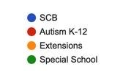
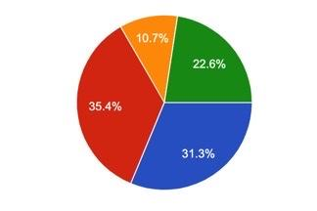
Professional Development
Staff attended trainings: Model Classrooms, PPE and, Addressing Challenging Behaviors (1,845 trained)

Slide 11
PPE for Students
Providing your student with a comfortable face mask will help prepare them for the return to in person learning
Schools have been supplied with various sizes of cloth and disposable face masks for students who need them
Specialized face masks, such as ClearMasks, will be provided to students with specific needs (e.g., articulation therapy, hearing needs, etc.)
Additional items such as student face shields will be provided on an as-needed basis

Slide 12
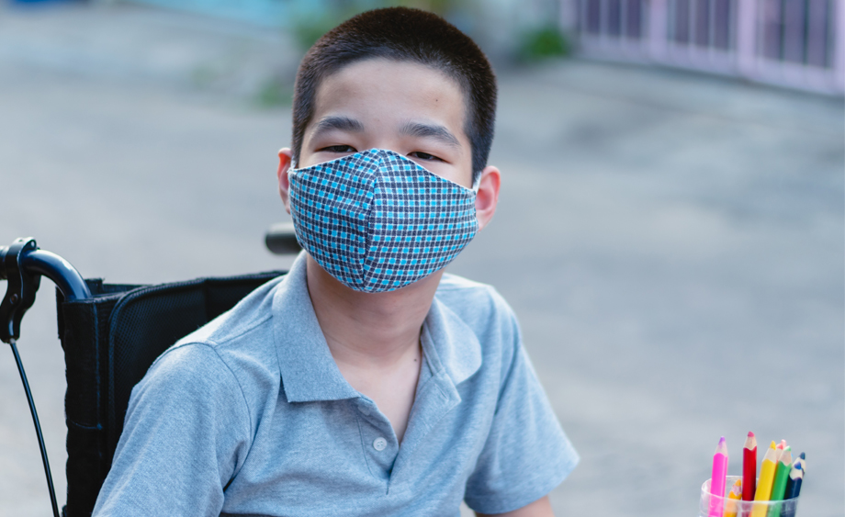
Special Education Transportation Professional Development
Professional Development for all bus
staff as students return to School

Slide 13
Services for Students with Autism
Autism Unit staff and School Teams have worked together to:
Ensure classrooms and virtual sections are staffed and provisioned to welcome our students back
Host parent evenings at each school to share photos of classes, answer questions, etc.
Hold after school teacher meetings where lessons regarding changes in schools, mask-wearing, etc. are provided to school teams
Identify areas of challenge and problem solve

Slide 14
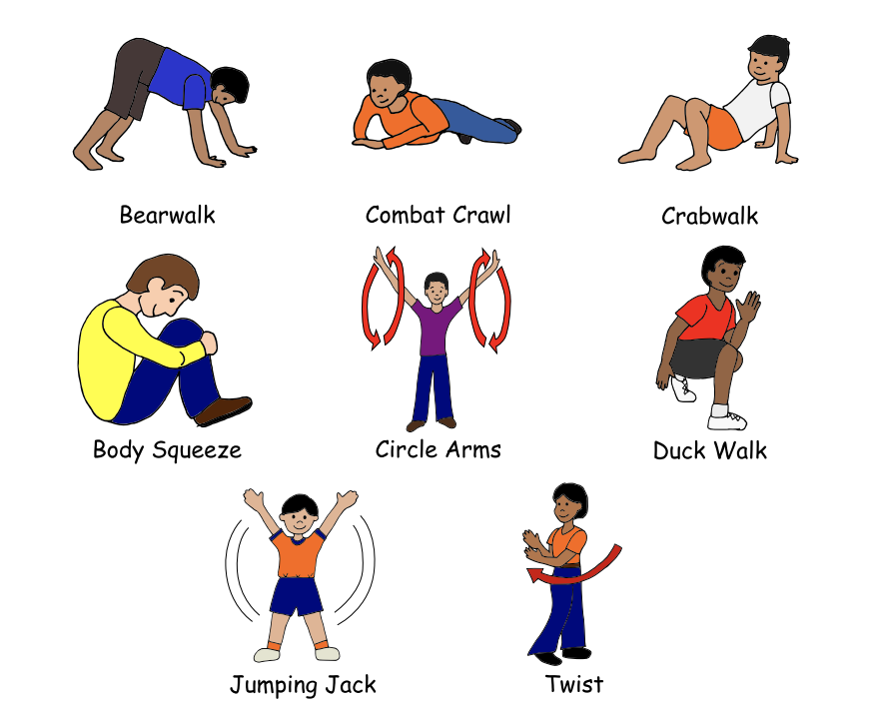
Sample from PD:
Proactive Strategies to Consider
Frequent opportunity for movement
Go outdoors if safe/able
Consider flexible seating
Ball chair, wobble chair, standing desk, therabands, etc...
Proximity: still useful even if not directly next to a child
Positioning teachers near classroom doors
During hall transitions, use staff to “surround” class
**Be mindful of shared materials and try to limit**

Slide 15
Sample from PD
Students not wearing masks
Proactive Strategies:
Preferential seating,
Pairing most valuable reinforcers with mask wearing.
Social distancing, personalized materials,
Differential reinforcement for mask wearing,
Videos, social narratives,
Systematic instruction, tolerance training,
Alternative masks-neck gaiters, bandanas, face shields, etc.
Responsive Strategies:
Ongoing instruction and training,
Environmental barriers
Resources: Health and Safety
Health and safety lessons including mask wearing

Slide 16
Extensions
School teams have been hosting virtual back to school meetings with families and providing virtual tours for new students.
Staff have been reimagining and rearranging their classrooms with health and safety guidelines in place.
School teams have been collaborating with building administration on schedules, additional space and staffing
Teachers, paraeducators and support staff have participated in the professional development
Model Classroom Guidance
Managing Challenging Behaviors
PPE for Close Contact Services
Tools for Reducing Risk Behavior
Nonviolent Crisis Intervention

Slide 17
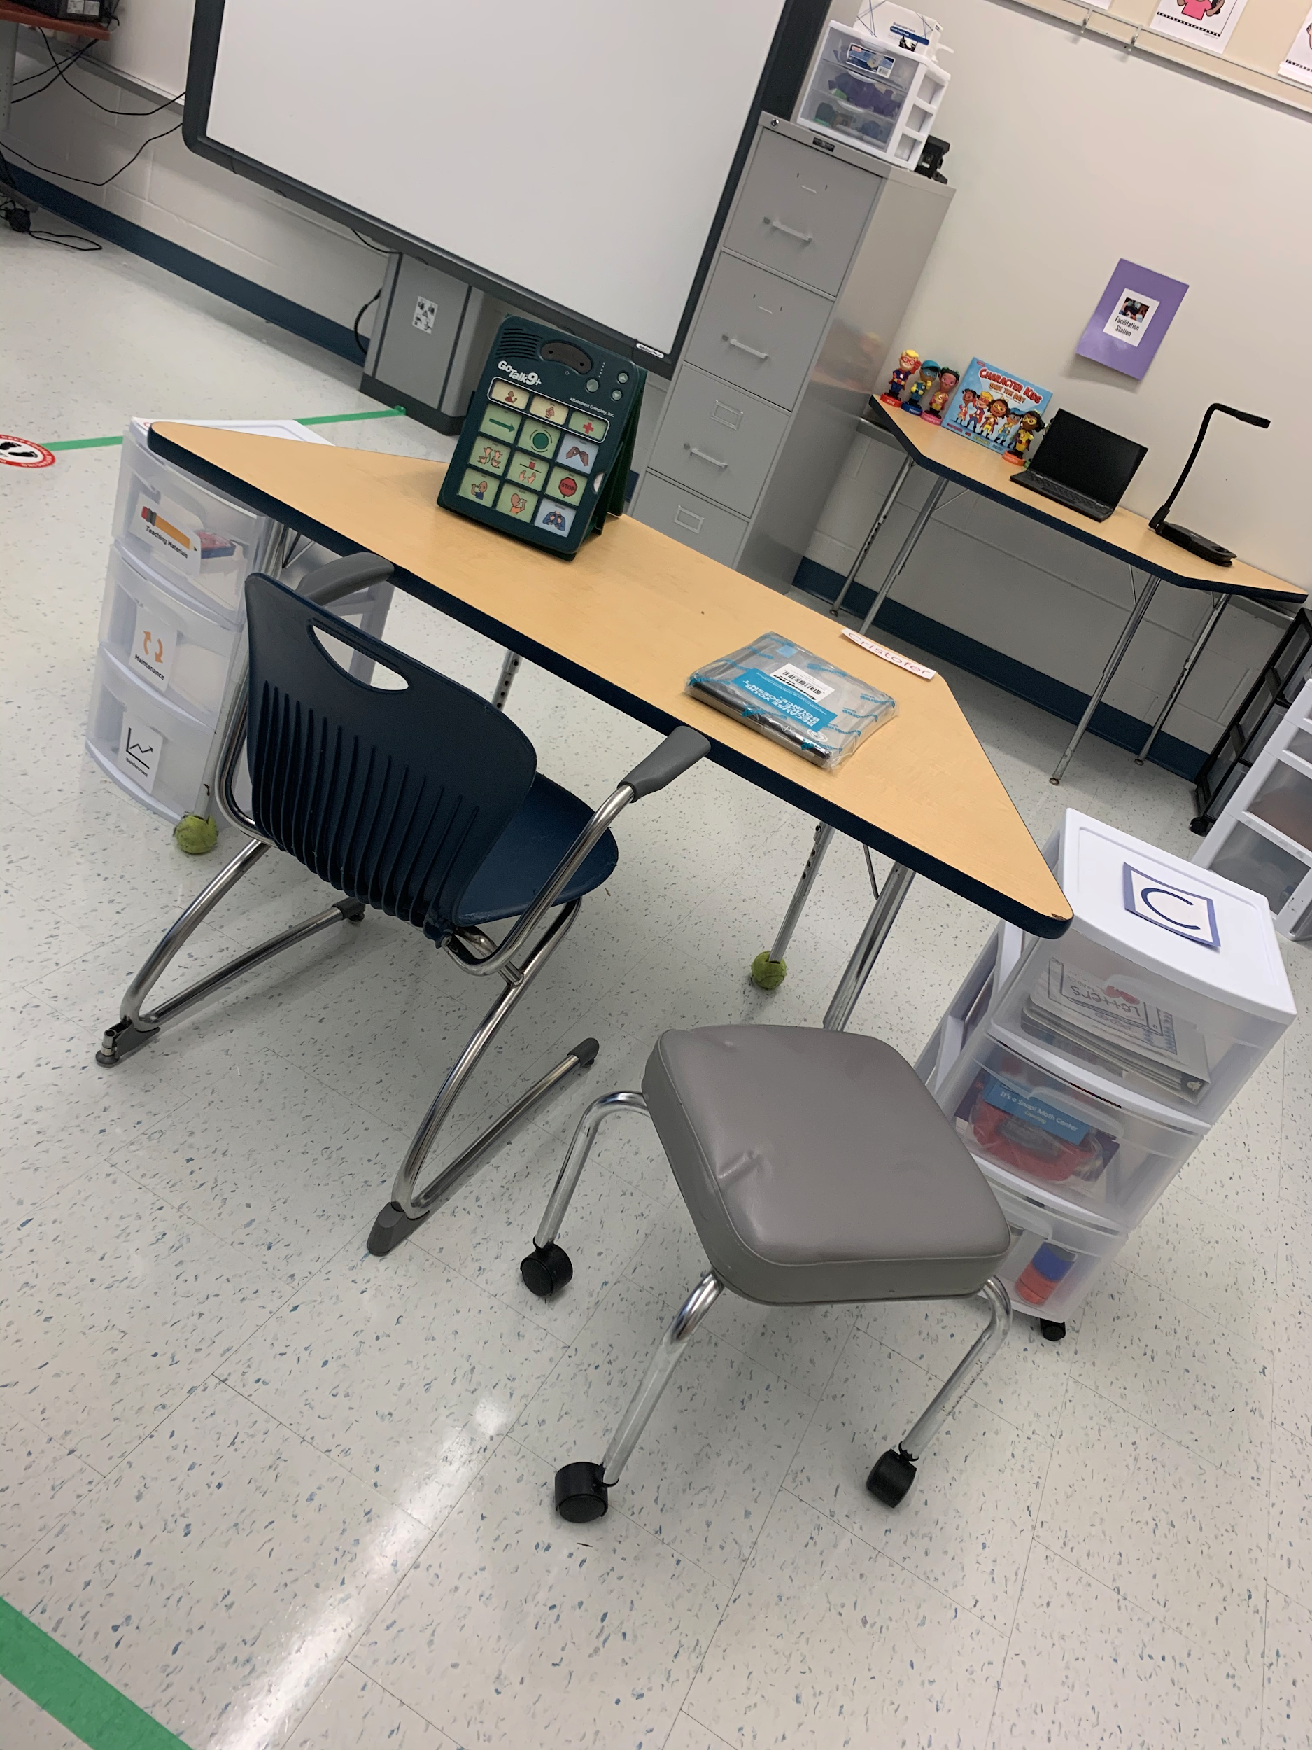
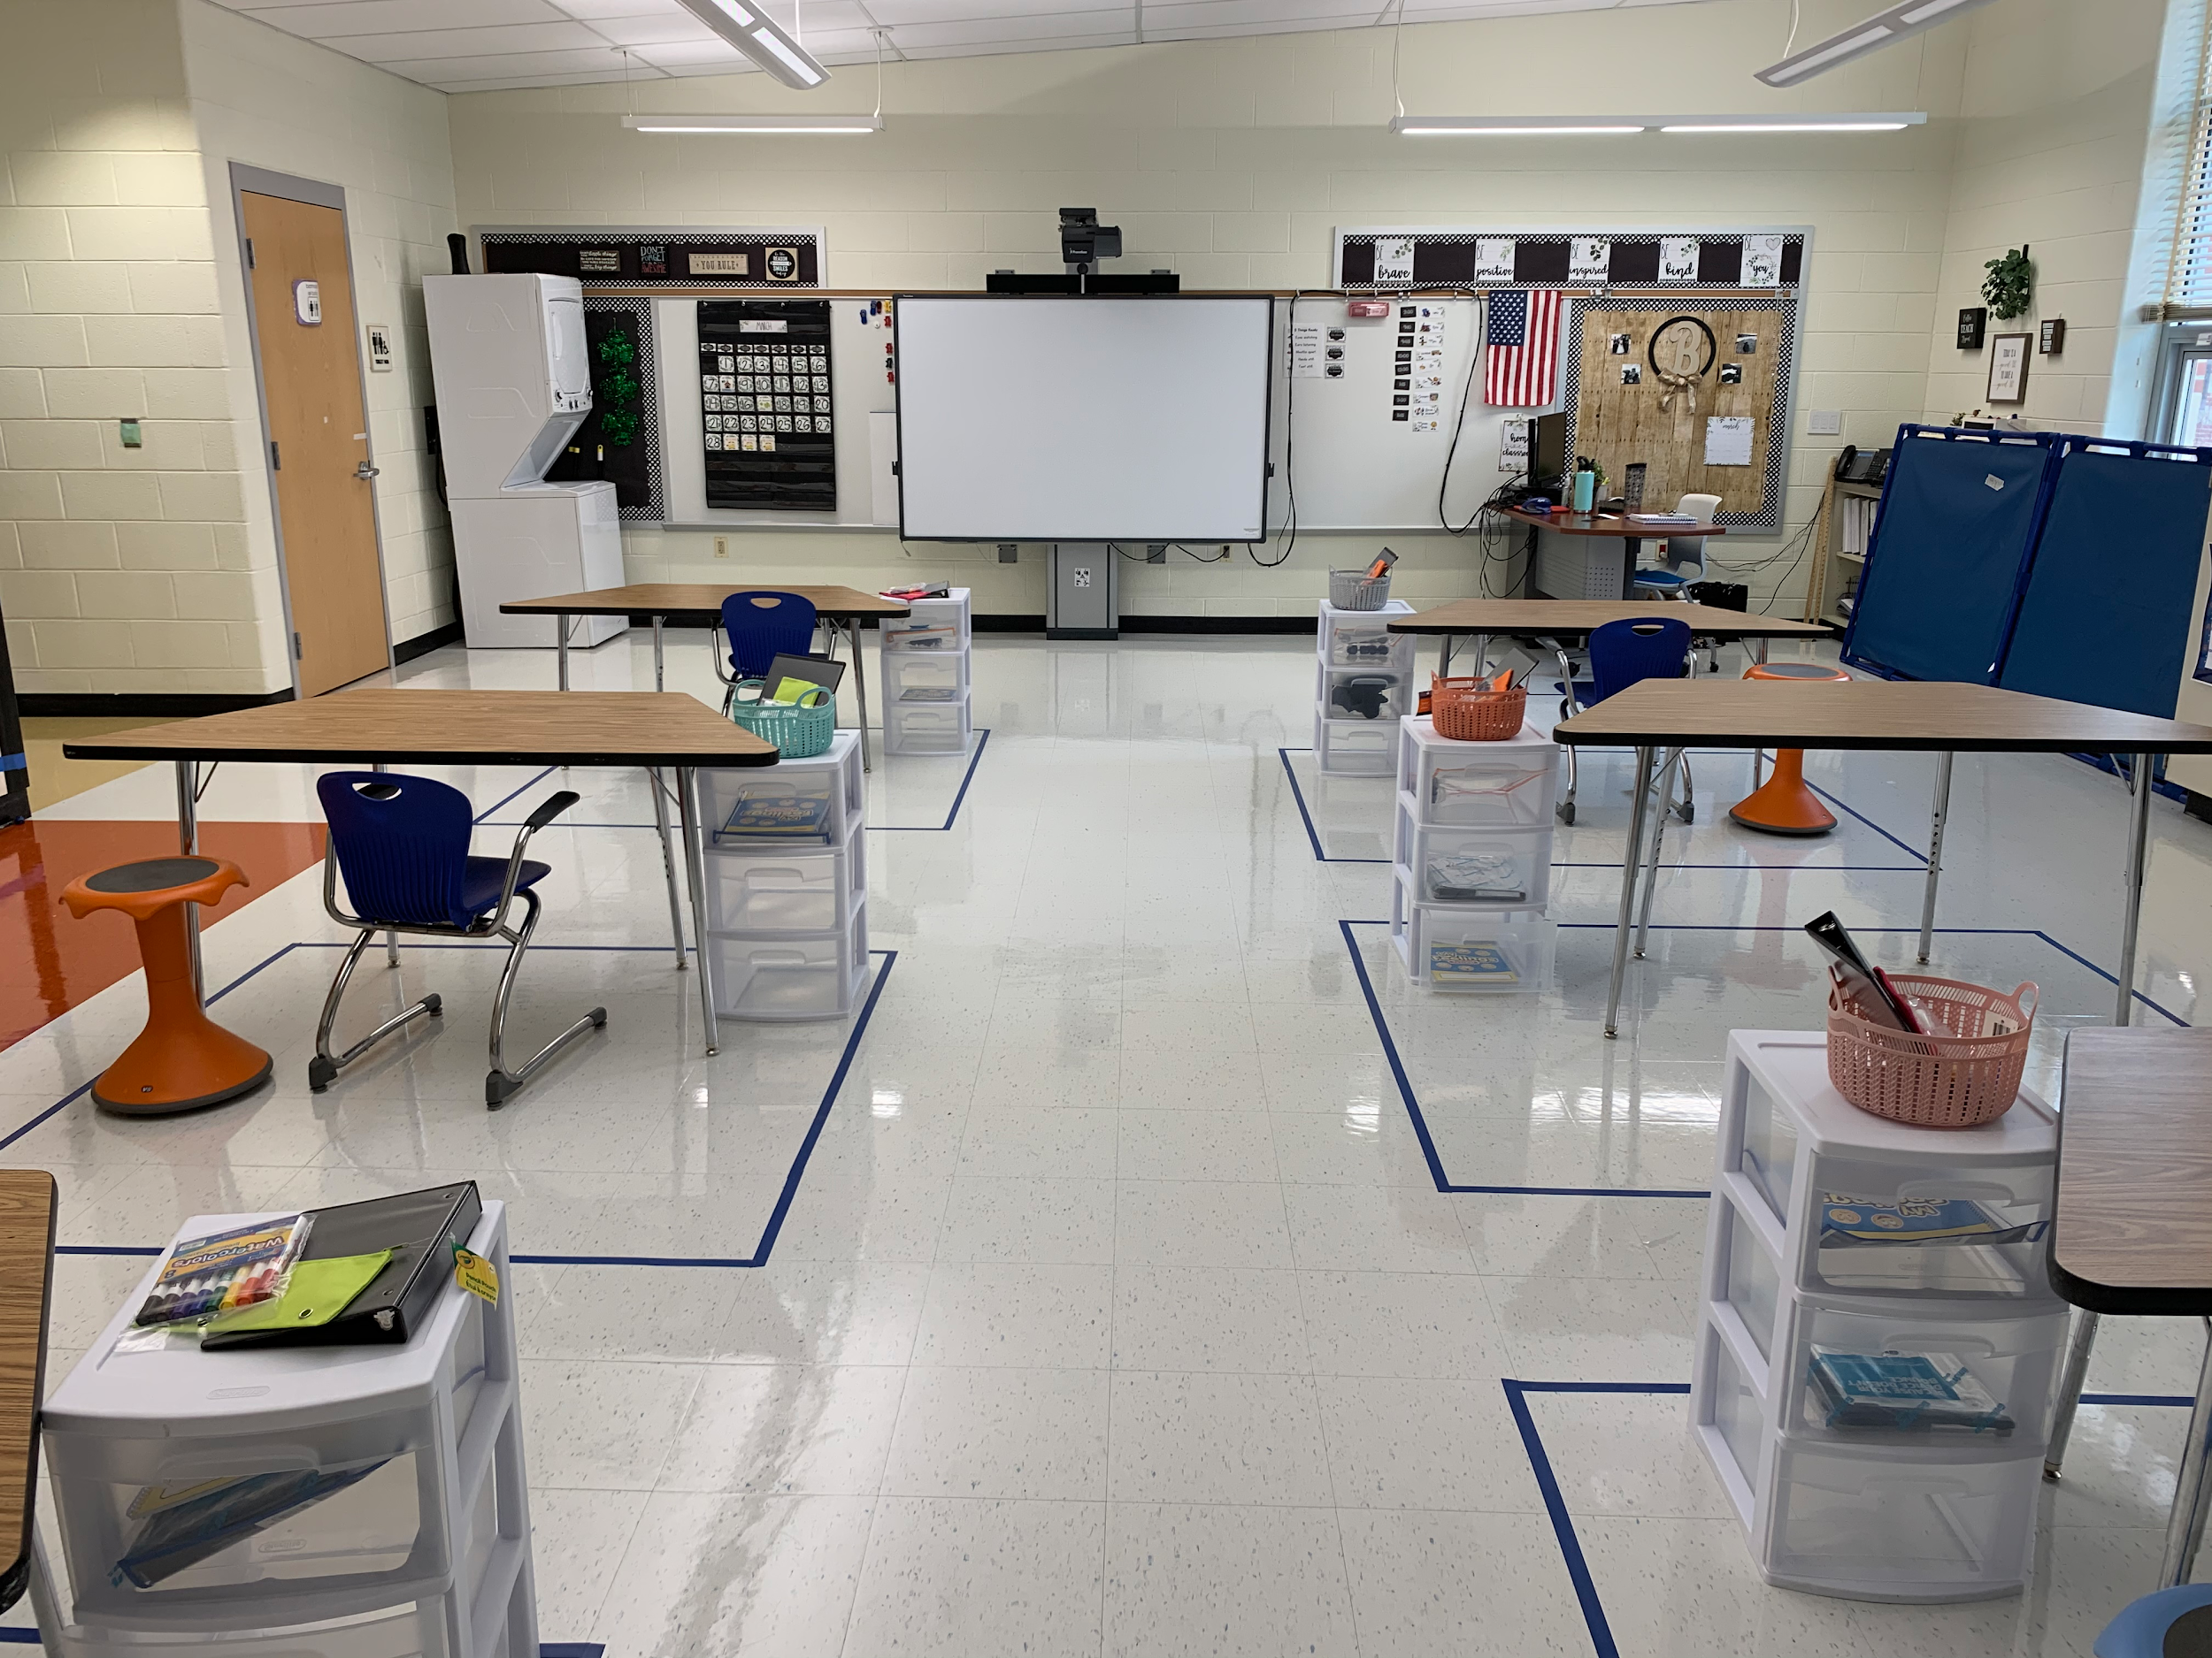
Extensions

Slide 18
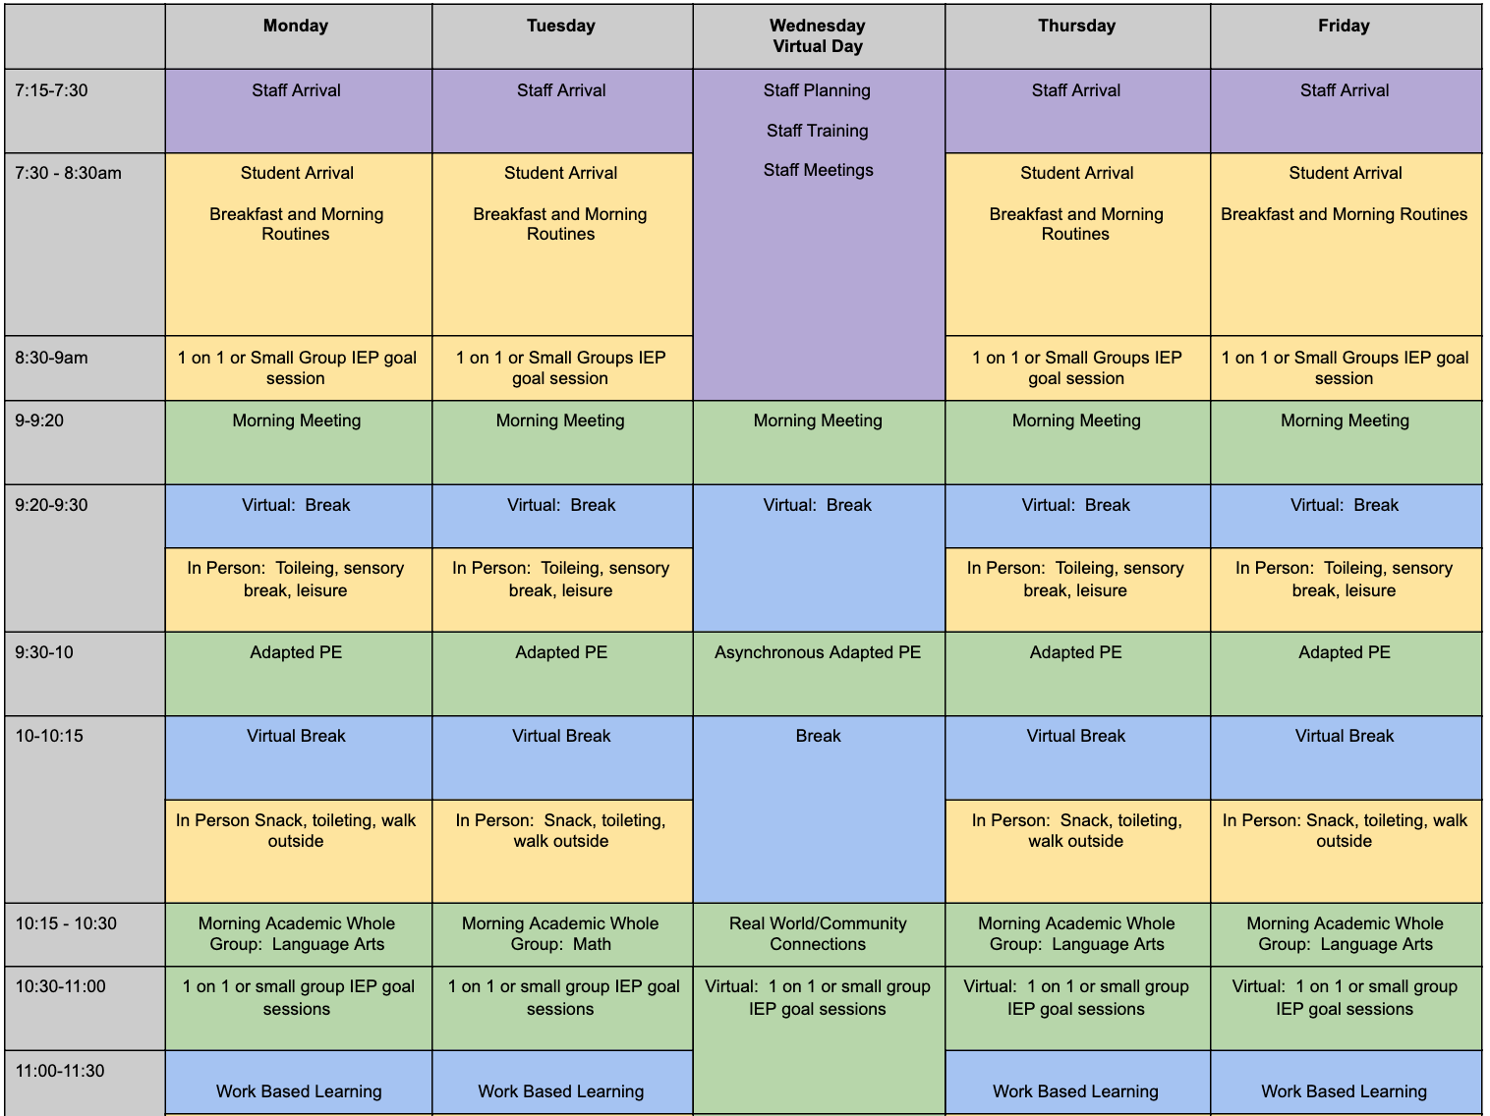
Sample High School Schedule
In-Person
Virtual & In-Person

Slide 19
Area Supervisors
Dr. Brunson
Dr. McKinnon
Ms. Smith

Slide 20
Special Schools
Carl Sandburg Learning Center

Slide 21
Special Schools
Rock Terrace School

Slide 22
Stephen Knolls School
March 1 In-Person March 15 In-Person
3 ES students - 1 class 9 PEP students - 3 classes
1 MS student - 1 class
Enhanced PPE on site, including: face shields, closed goggles, disposable masks, gloves, disposable gowns, KN-95 masks.
Staff have been reimagining and rearranging their classrooms with health and safety guidelines in place.
School teams have been collaborating with building administration on schedules, additional space and staffing.
Teachers, paraeducators and support staff have participated in the professional development.
Teachers and administration have been working with transportation on bus schedules.
Teachers and administration have been working with the PEP office on including students from other PEP sites.

Slide 23
Longview
Longview Hybrid Planning Information

Slide 24
Questions
Link to submit a question:
https://forms.gle/qGoxb897FPjqsZ9fA

