Slide 1
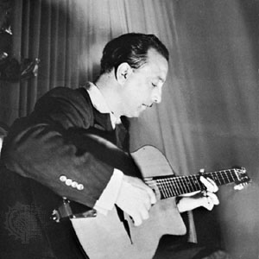
Django Reinhardt 1910-1953
Style: Gypsy Jazz
Most noted for changing the role of guitar in jazz.
Songs: Djangology, Swing 39
Other Contributions:
Melodic solos
Quintette du Hot Club de France
Mr. Eisenberg
Reinhardt, Django." Compton's by Britannica. Encyclopædia Britannica Online School Edition. Encyclopædia Britannica, Inc., 2012. Web. 3 Dec. 2012
"Django Reinhardt." 2012. The Biography Channel website. Dec 03 2012, 01:56

Slide 2
Name year of birth – year of death
Insert picture here
Style of music
Most noted for
2 Song Titles
Other Contributions
Student name
Citation Information

