Slide 1
Young Geographers
Project
Young Geographers
Project

Slide 2
Young
Geographers
United States of America Images

Slide 3
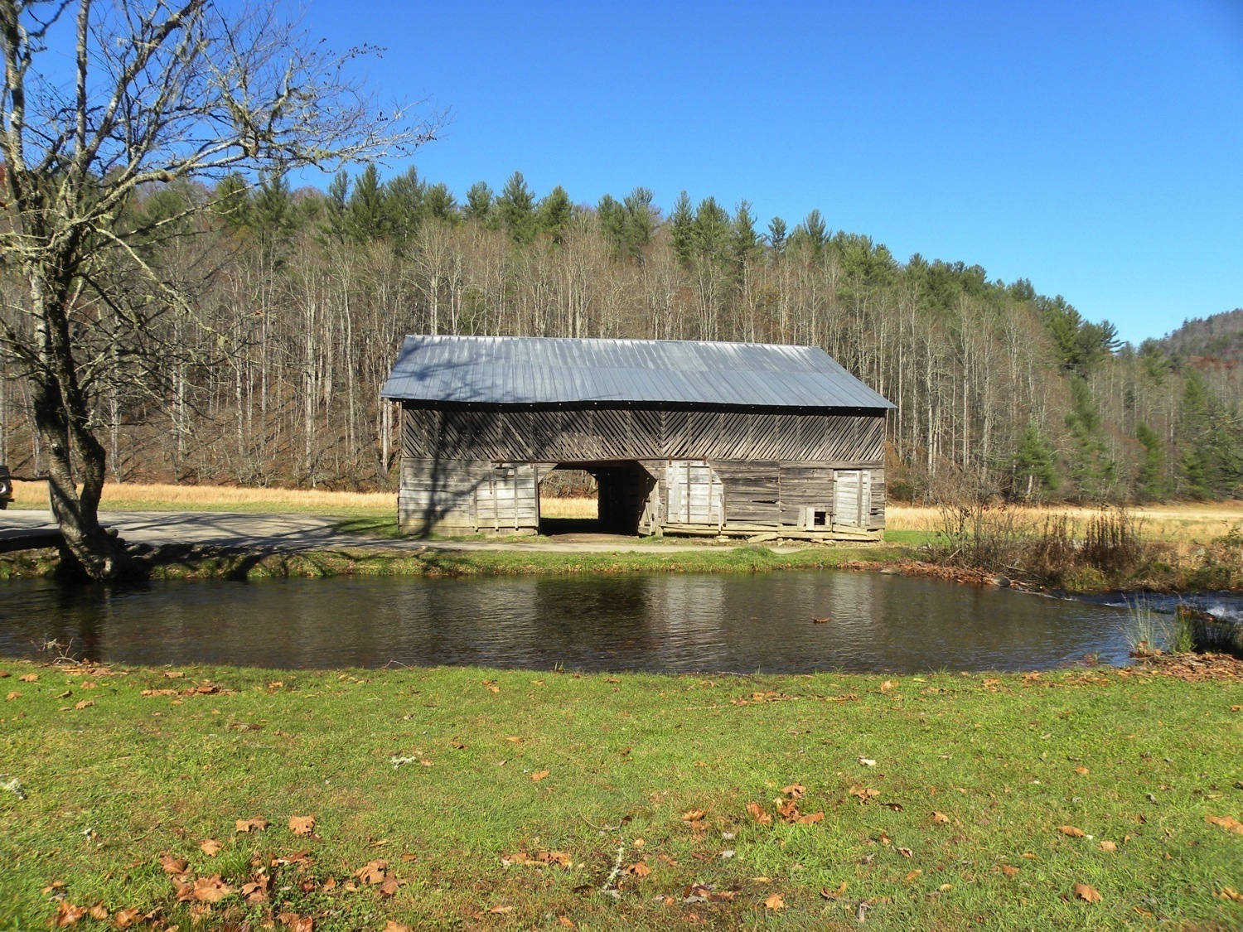
Notes:
Barn and creek – Great Smokey Mountains North Carolina
Photo credit: Brenda D. Anderson

Slide 4
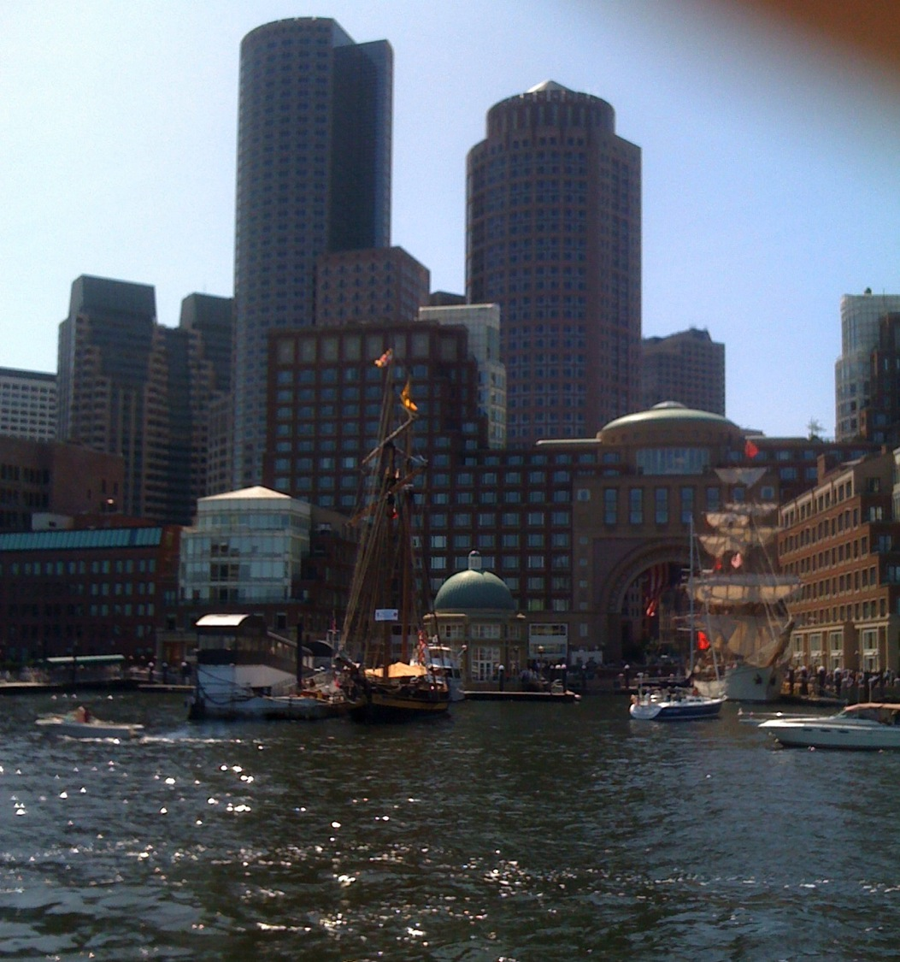
Notes:
Boston, MA skyline from Charles River
Photo credit: Brenda D. Anderson

Slide 5
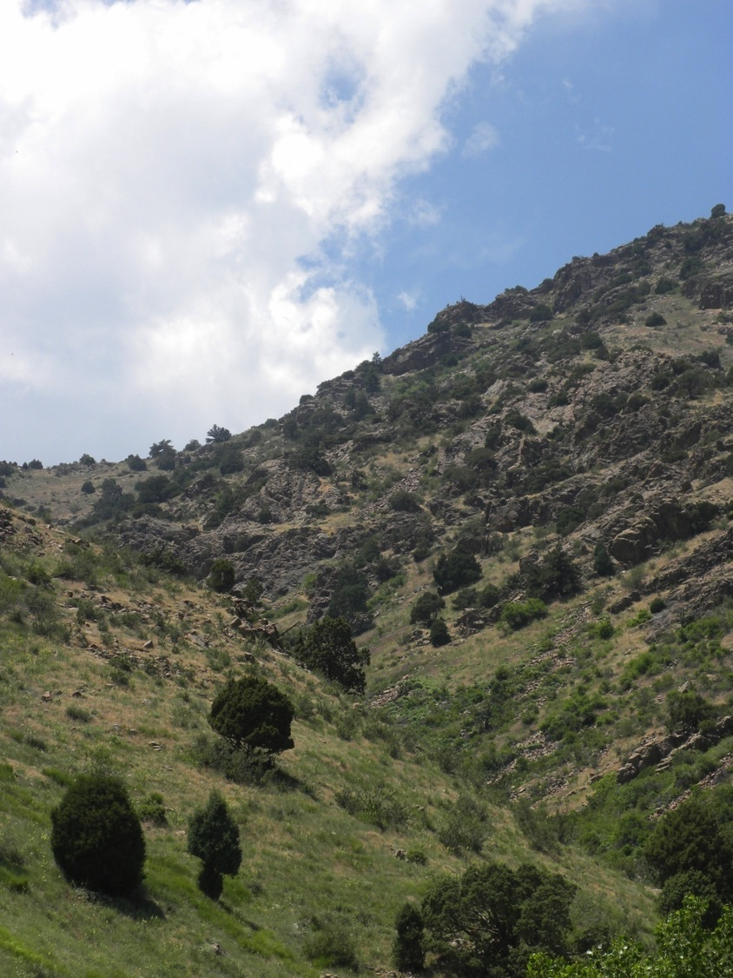
Notes:
Colorado hills
Photo credit: Brenda D. Anderson

Slide 6
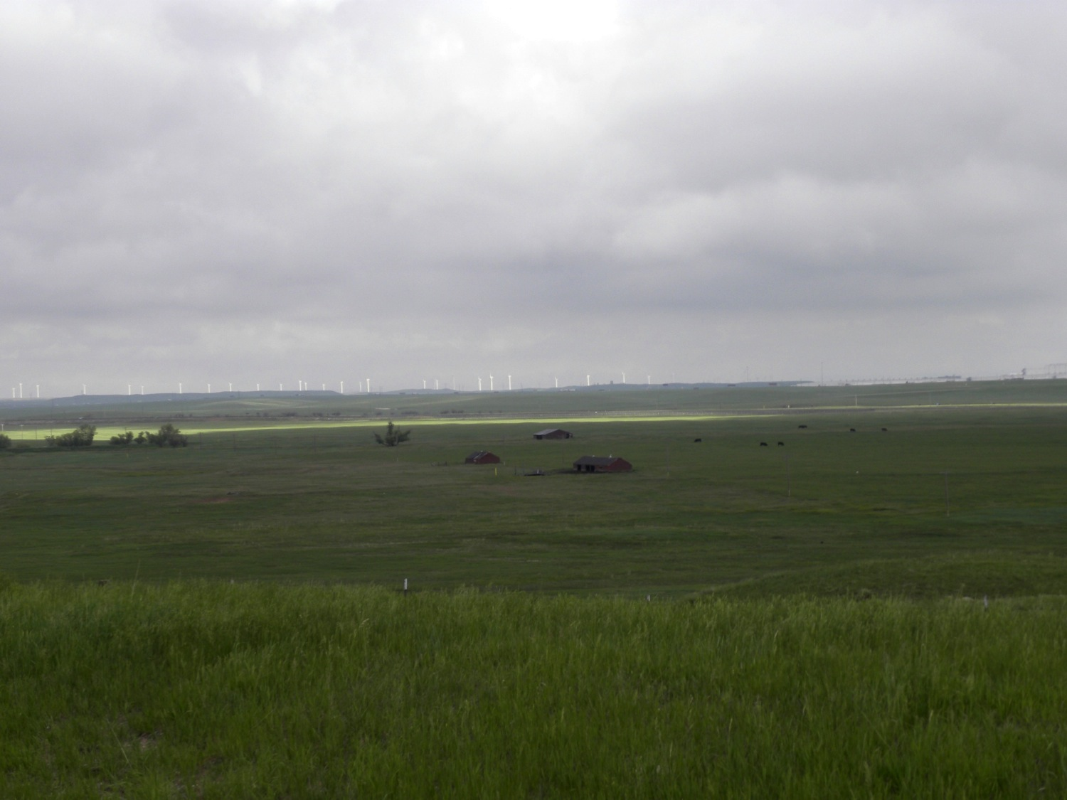
Notes:
Colorado fields and windmills
Photo credit: Brenda D. Anderson

Slide 7
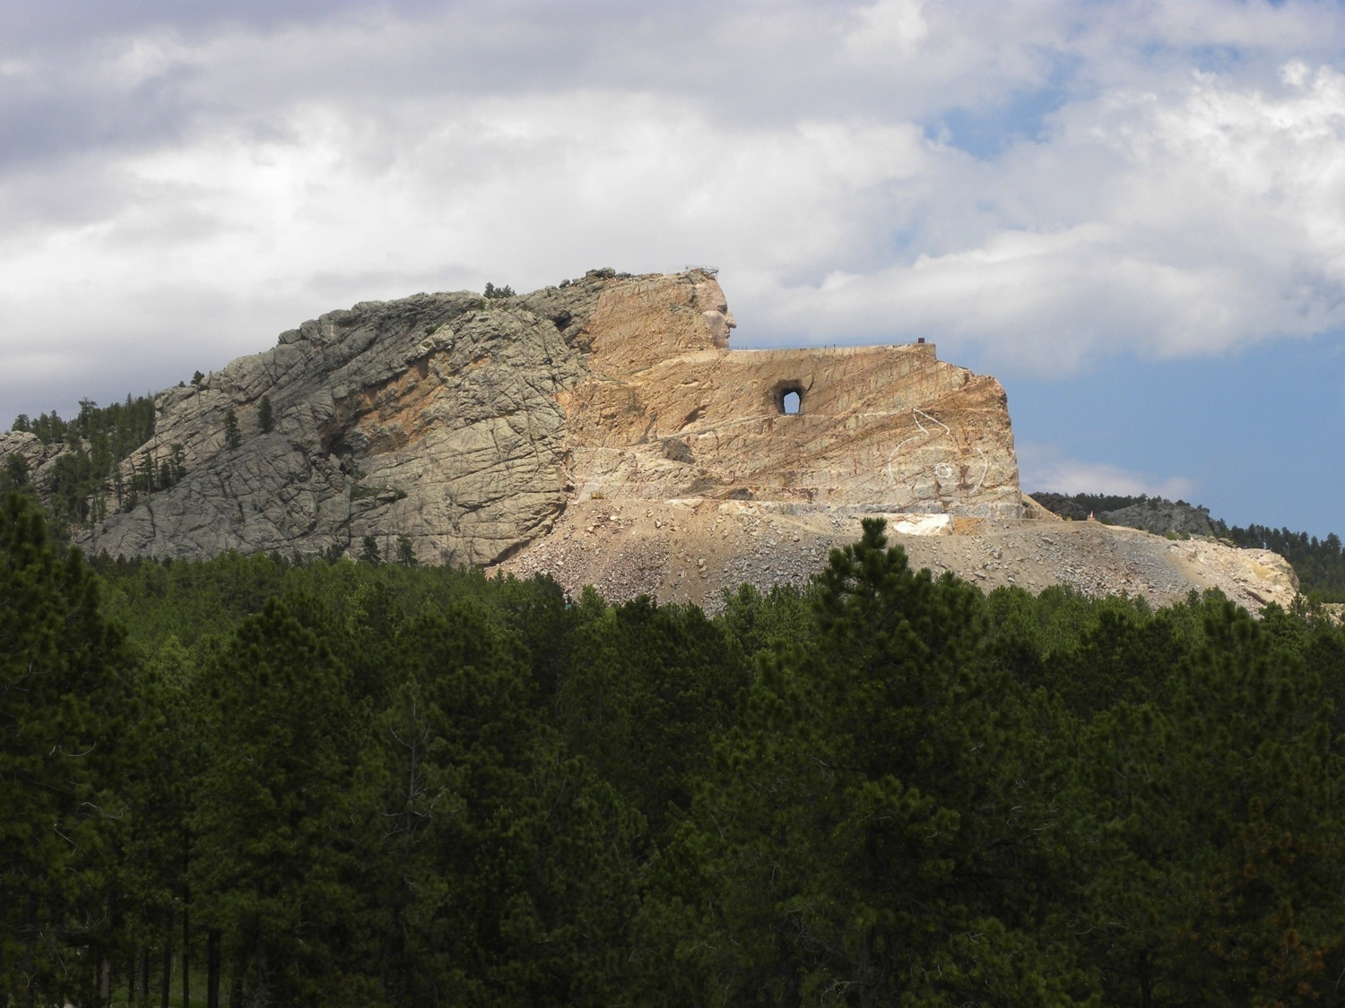
Notes:
Crazy Horse Memorial, Rock formation
Photo credit: Brenda D. Anderson

Slide 8
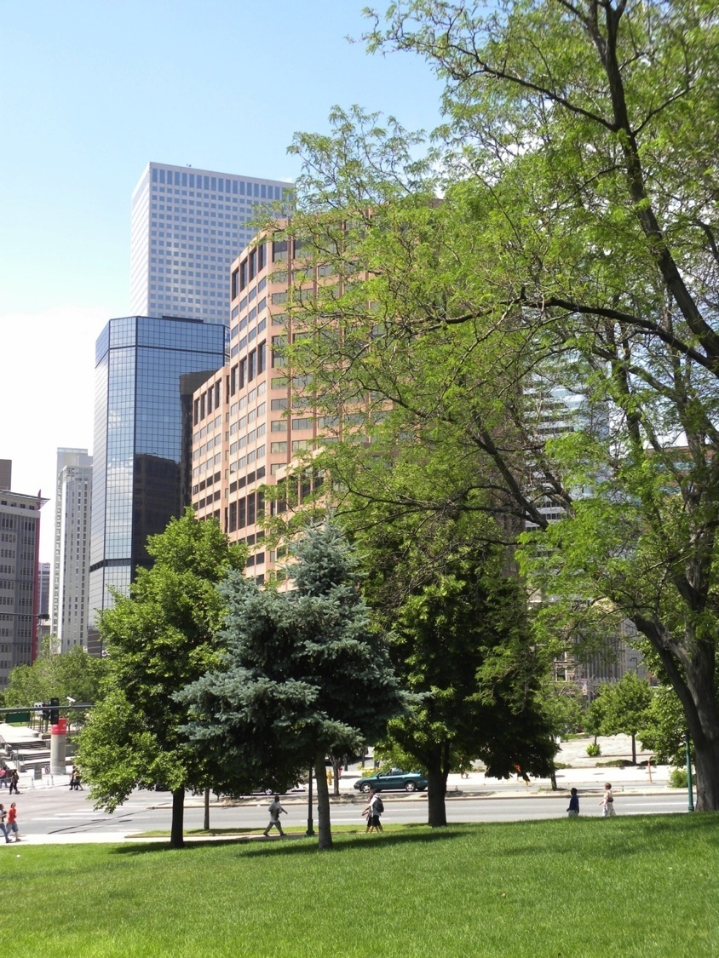
Notes:
Denver Colorado, cityscape
Photo credit: Brenda D. Anderson

Slide 9
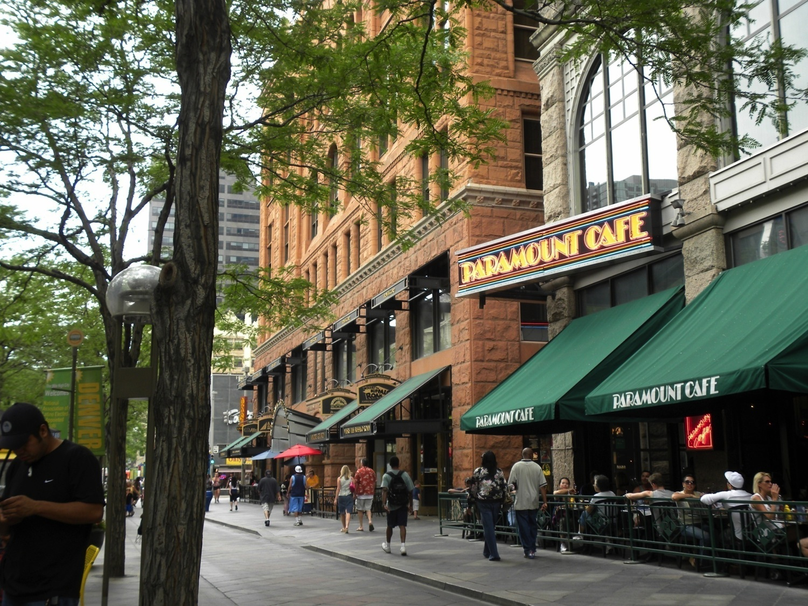
Notes:
Denver, CO cityscape
Photo credit: Brenda D. Anderson

Slide 10
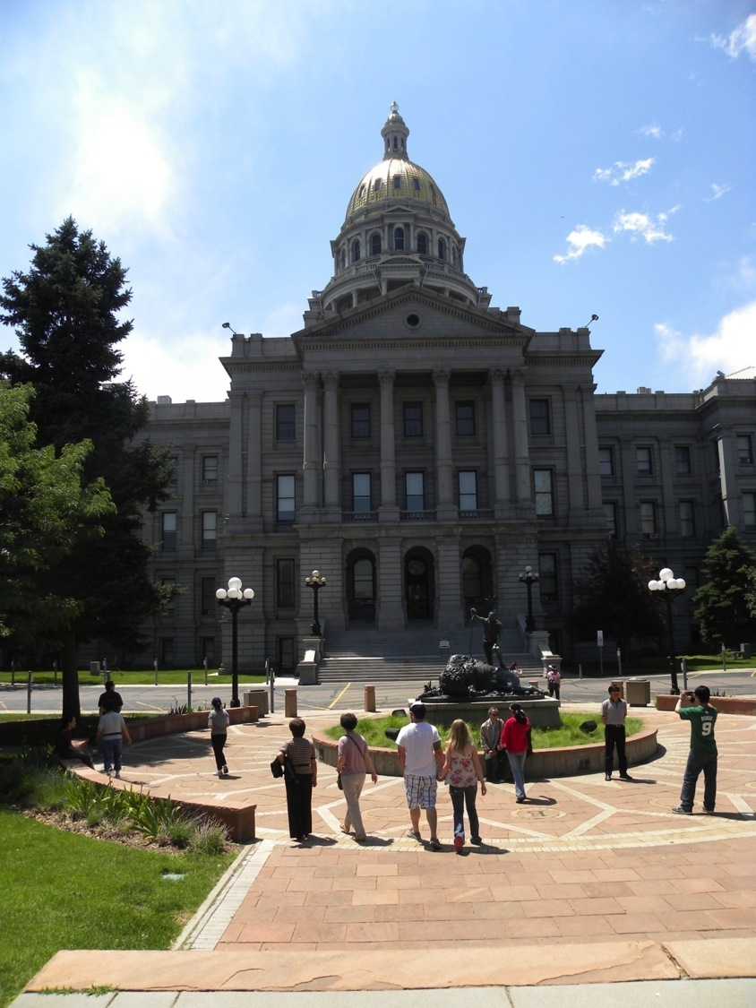
Notes:
Denver, CO state house
Photo credit: Brenda D. Anderson

Slide 11
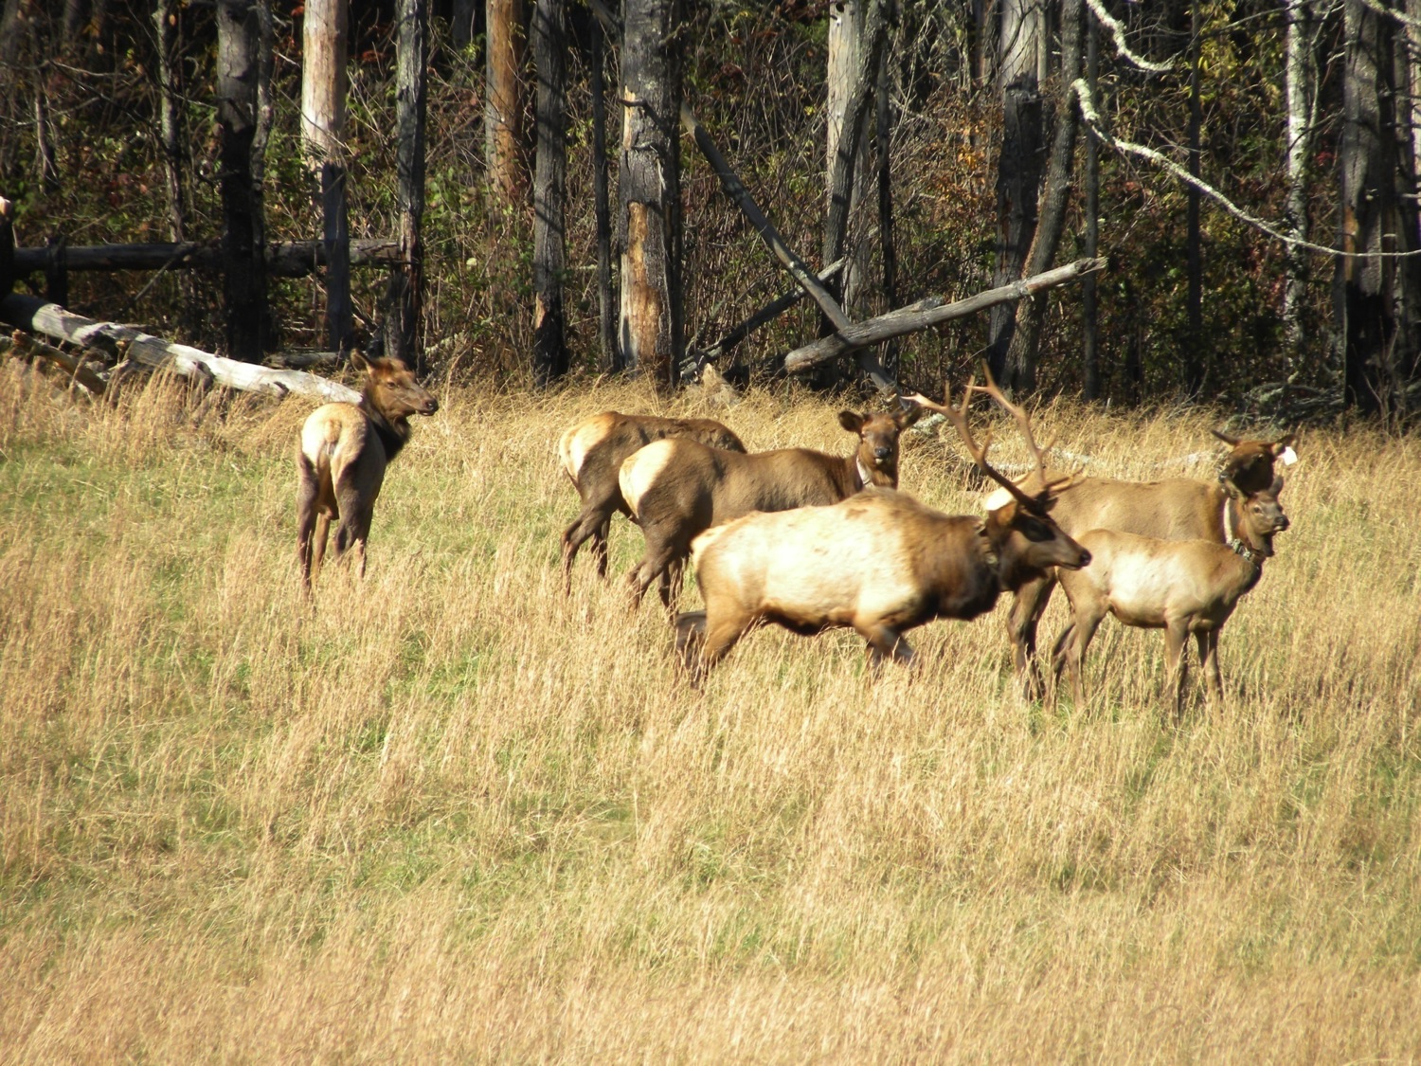
Notes:
Elk herd, Great Smoky Mountains
Photo credit: Brenda D. Anderson

Slide 12
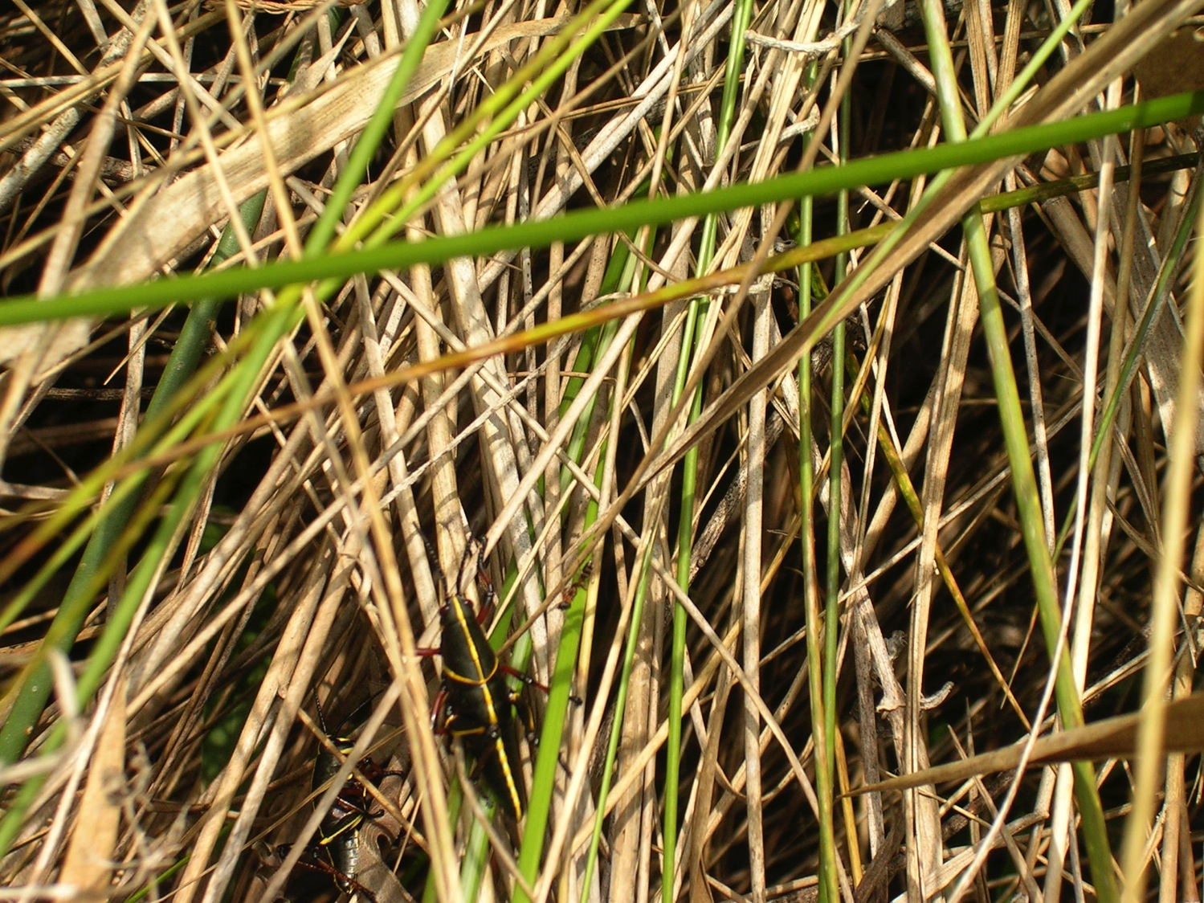
Notes:
Florida, marsh grasses and insects
Photo credit: Brenda D. Anderson

Slide 13
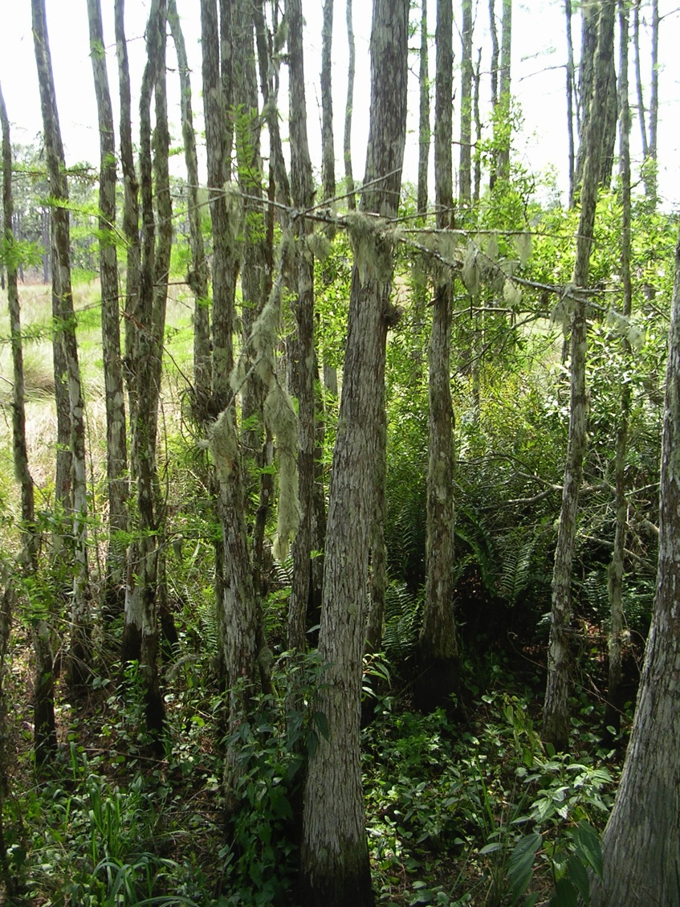
Notes:
Florida, Spanish moss
Photo credit: Brenda D. Anderson

Slide 14
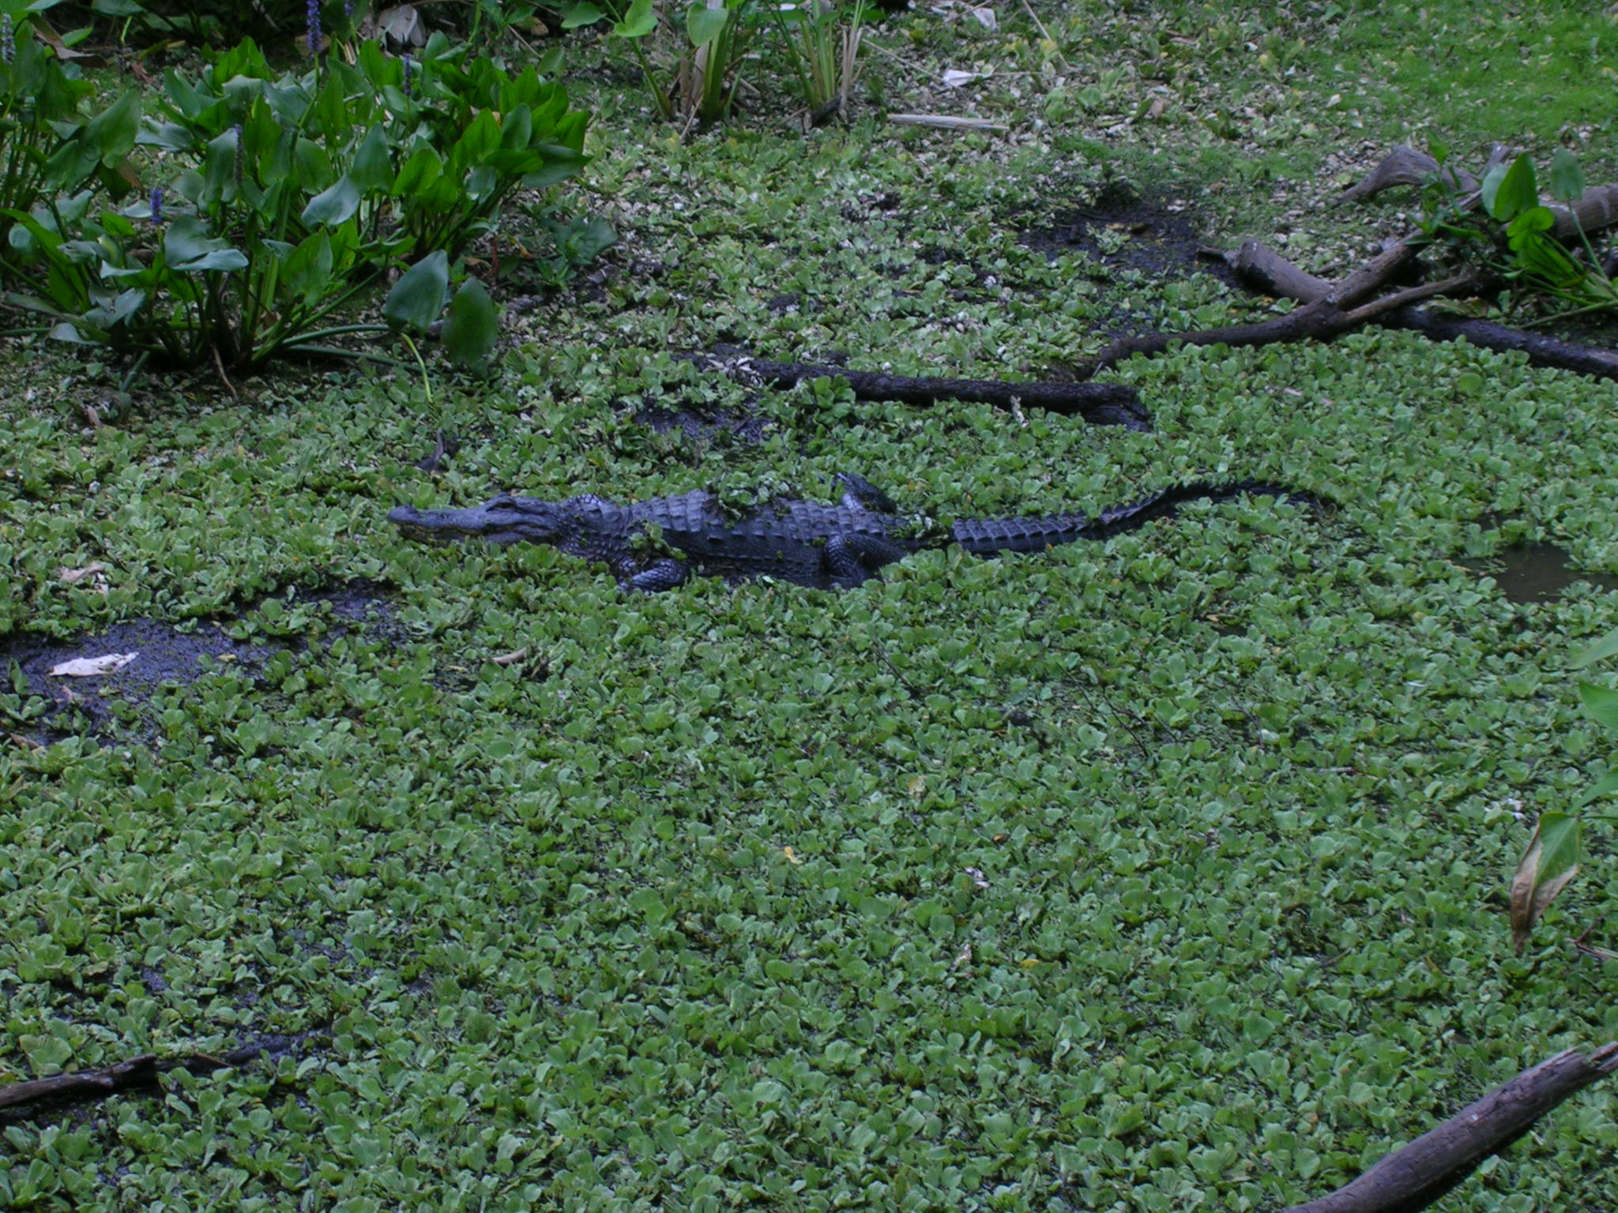
Notes:
Florida swamp with alligator
Photo credit: Brenda D. Anderson

Slide 15
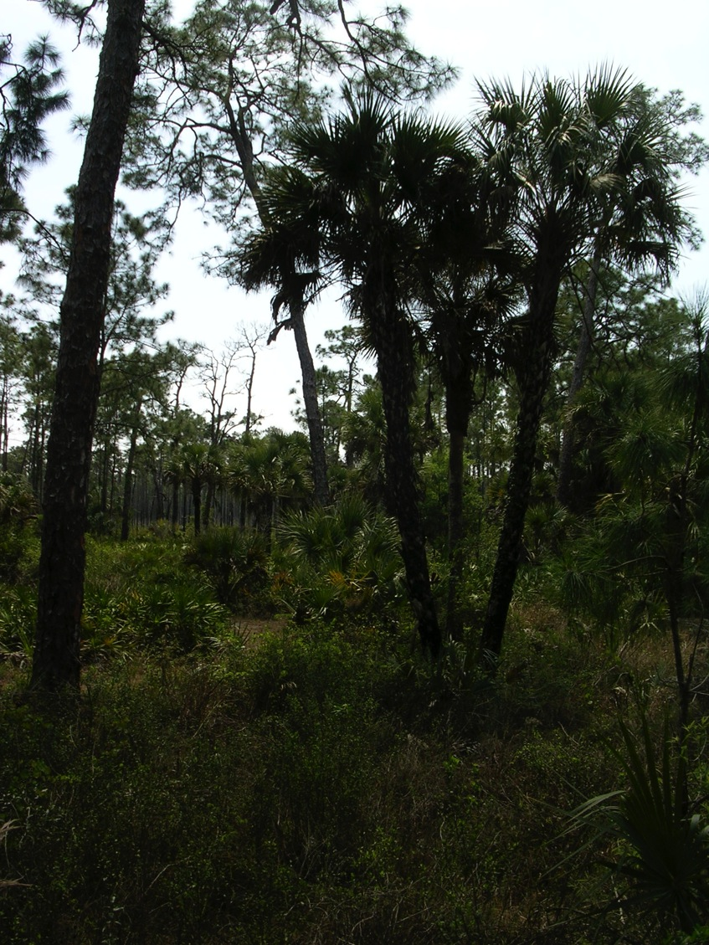
Notes:
Florida west coast vegetation
Photo credit: Brenda D. Anderson

Slide 16
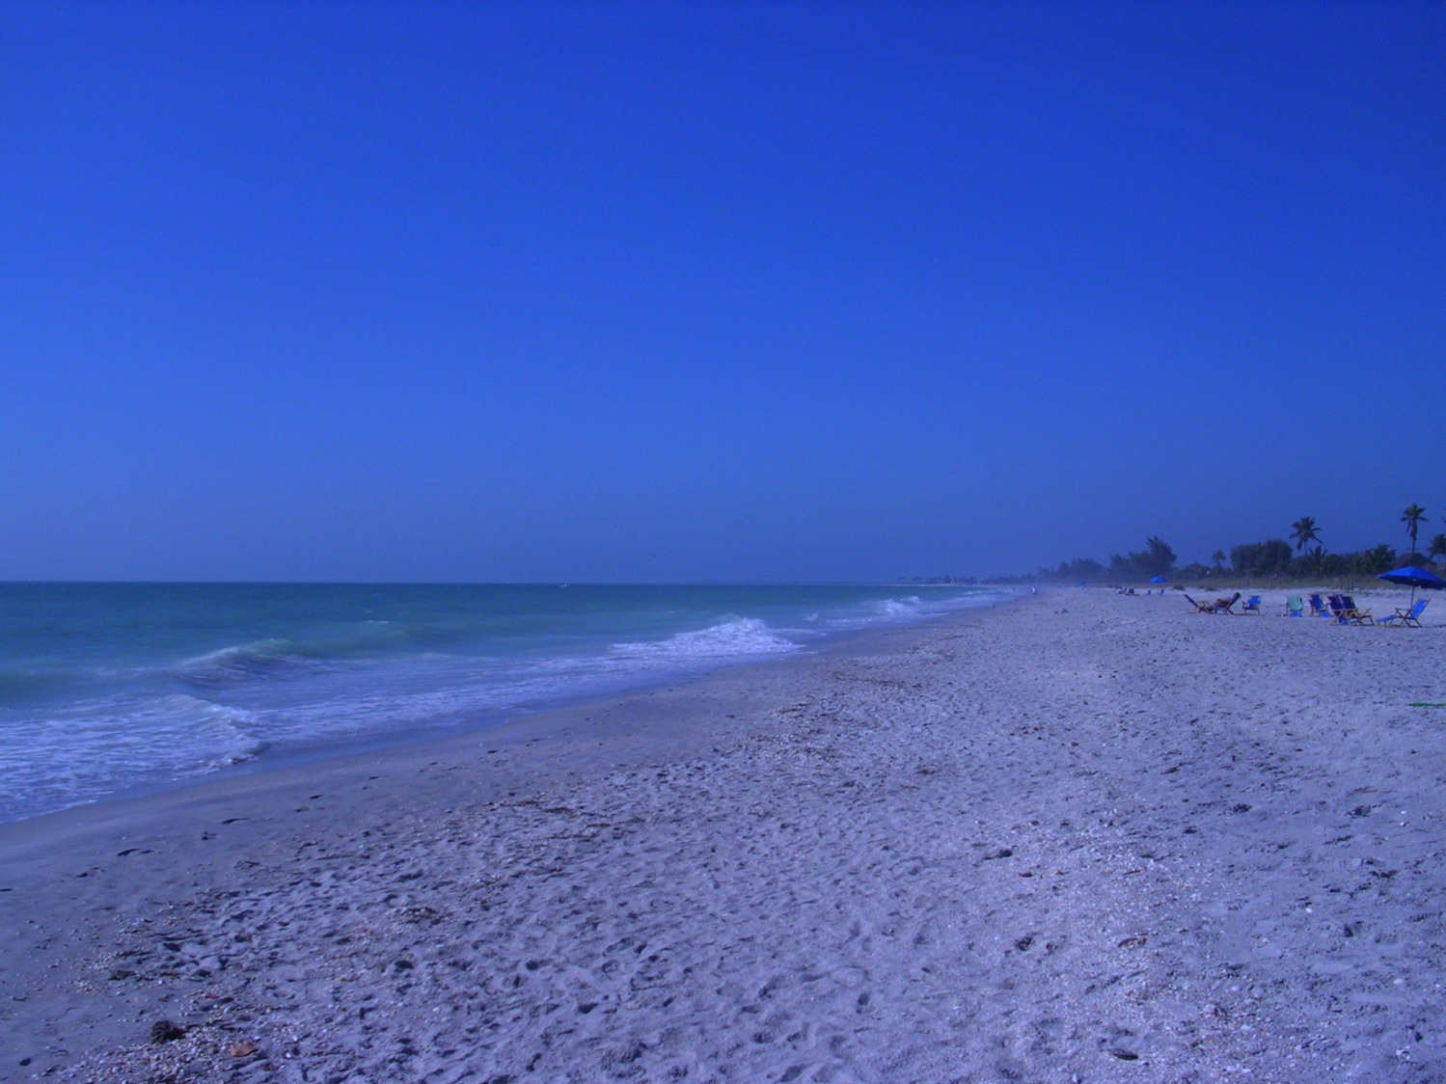
Notes:
Florida West Coast beach
Photo credit: Brenda D. Anderson

Slide 17
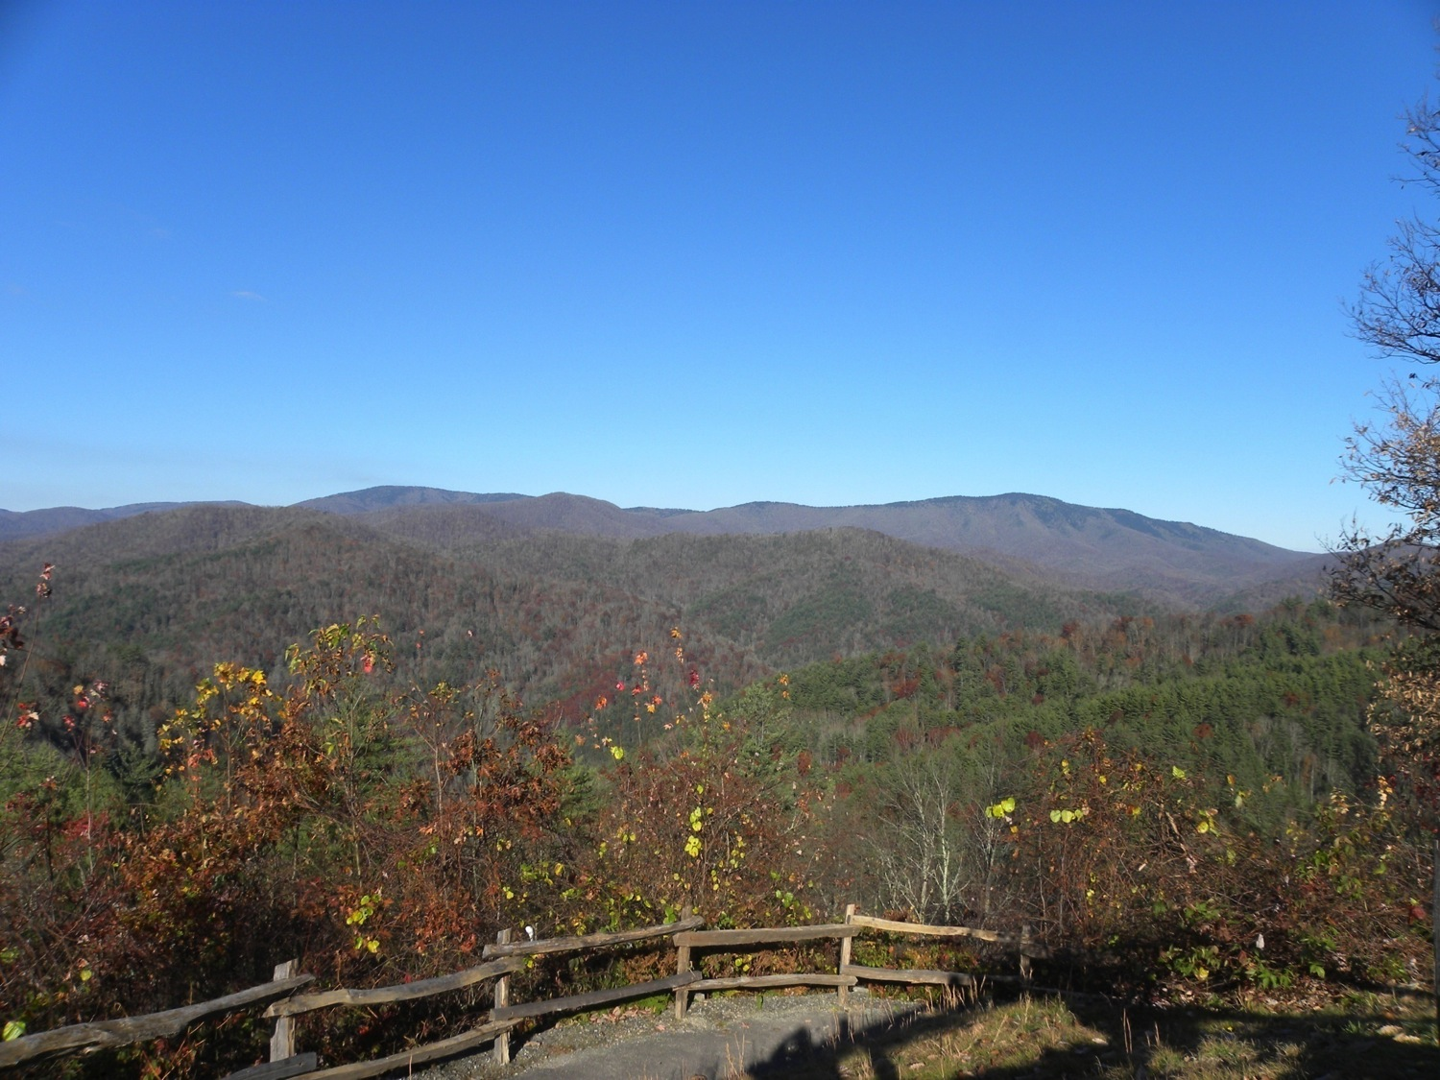
Notes:
Great Smokey Mountains
Photo credit: Brenda D. Anderson

Slide 18
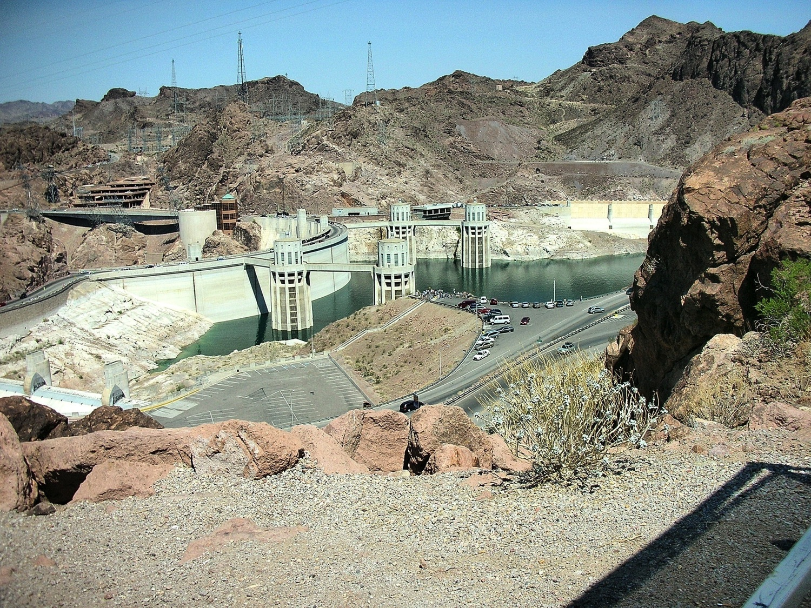
Notes:
Hoover Dam
Photo credit: Brenda D. Anderson

Slide 19
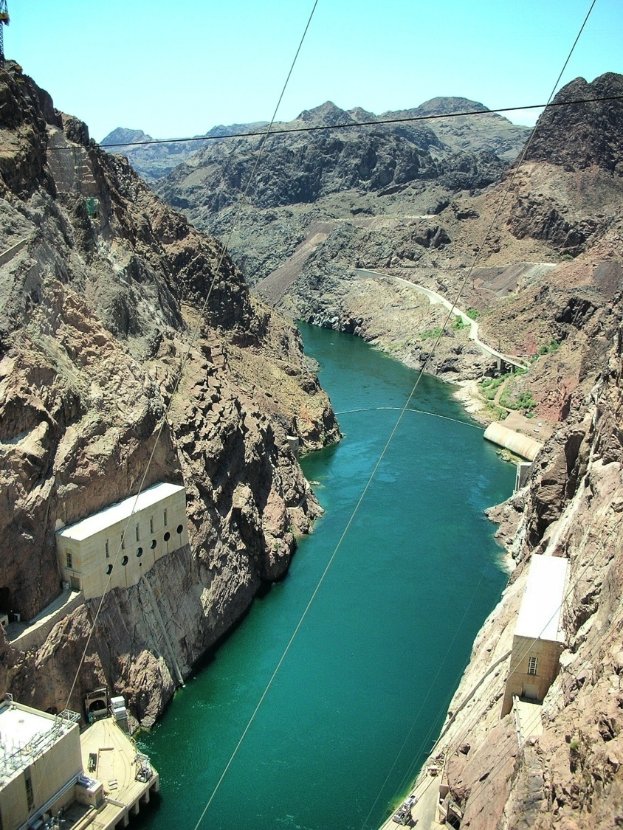
Notes:
Hoover Dam, Colorado River
Photo credit: Brenda D. Anderson

Slide 20
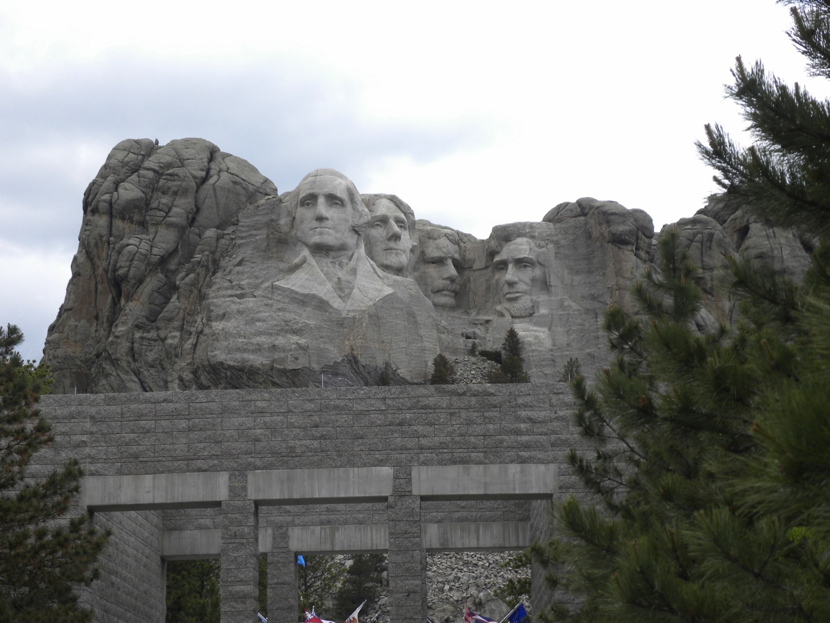
Notes:
Mount Rushmore
Photo credit: Brenda D. Anderson

Slide 21
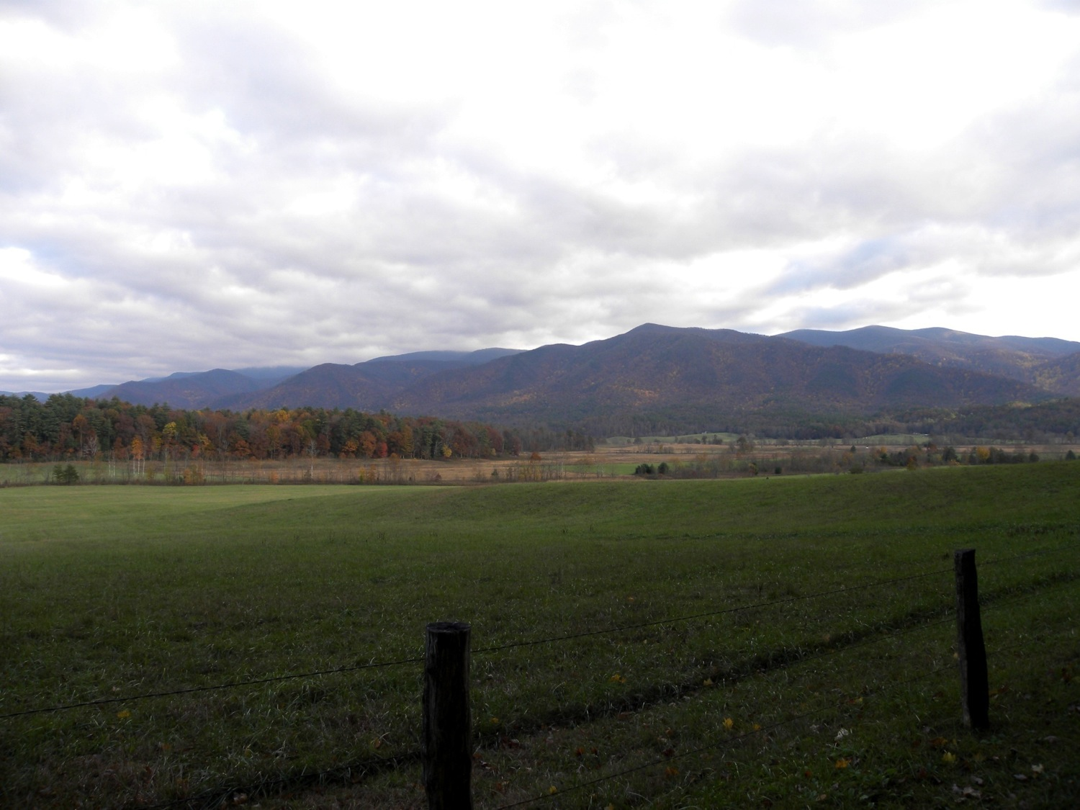
Notes:
North Carolina, meadow and Great Smoky Mountains
Photo credit: Brenda D. Anderson

Slide 22
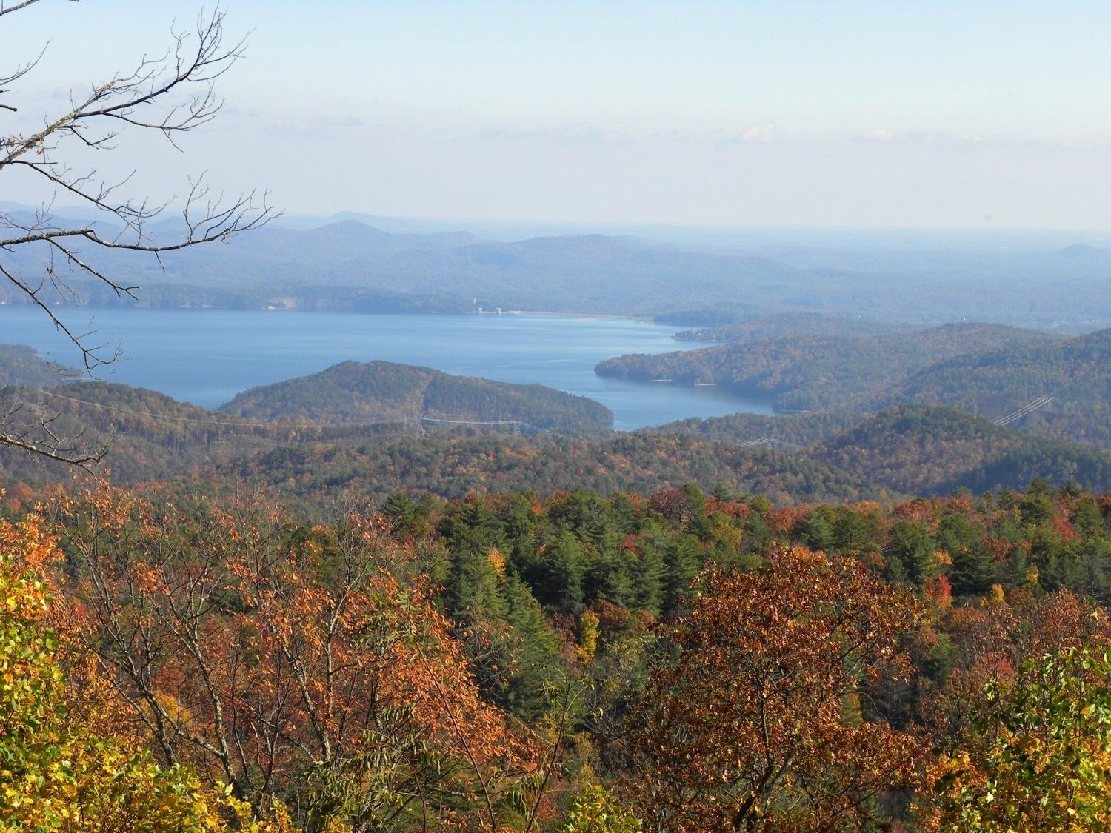
Notes:
North Carolina, lake
Photo credit: Brenda D. Anderson

Slide 23
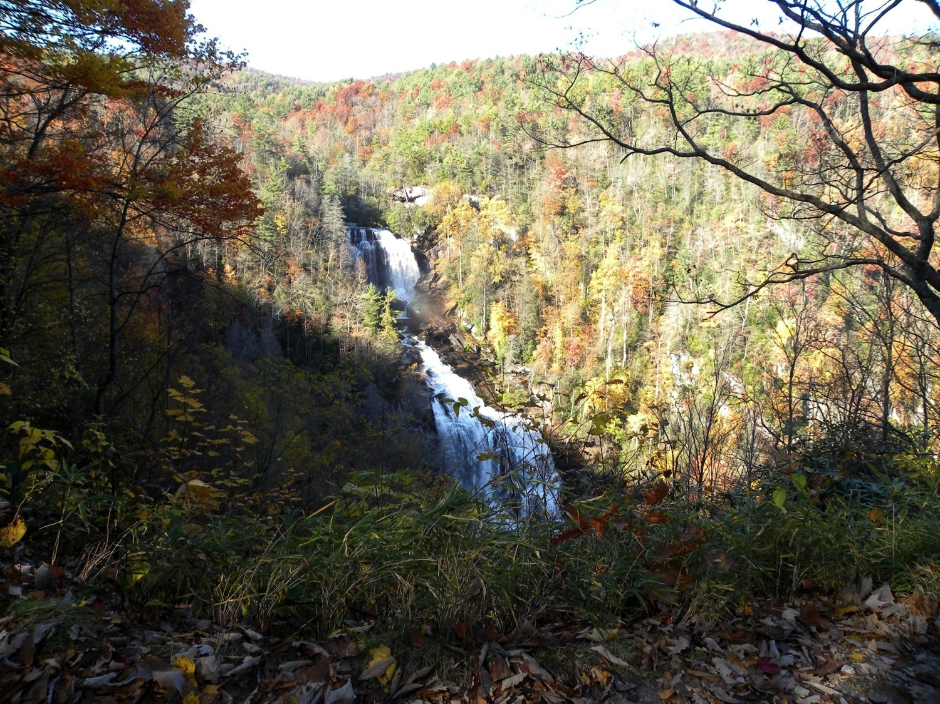
Notes:
North Carolina, waterfall
Photo credit: Brenda D. Anderson

Slide 24
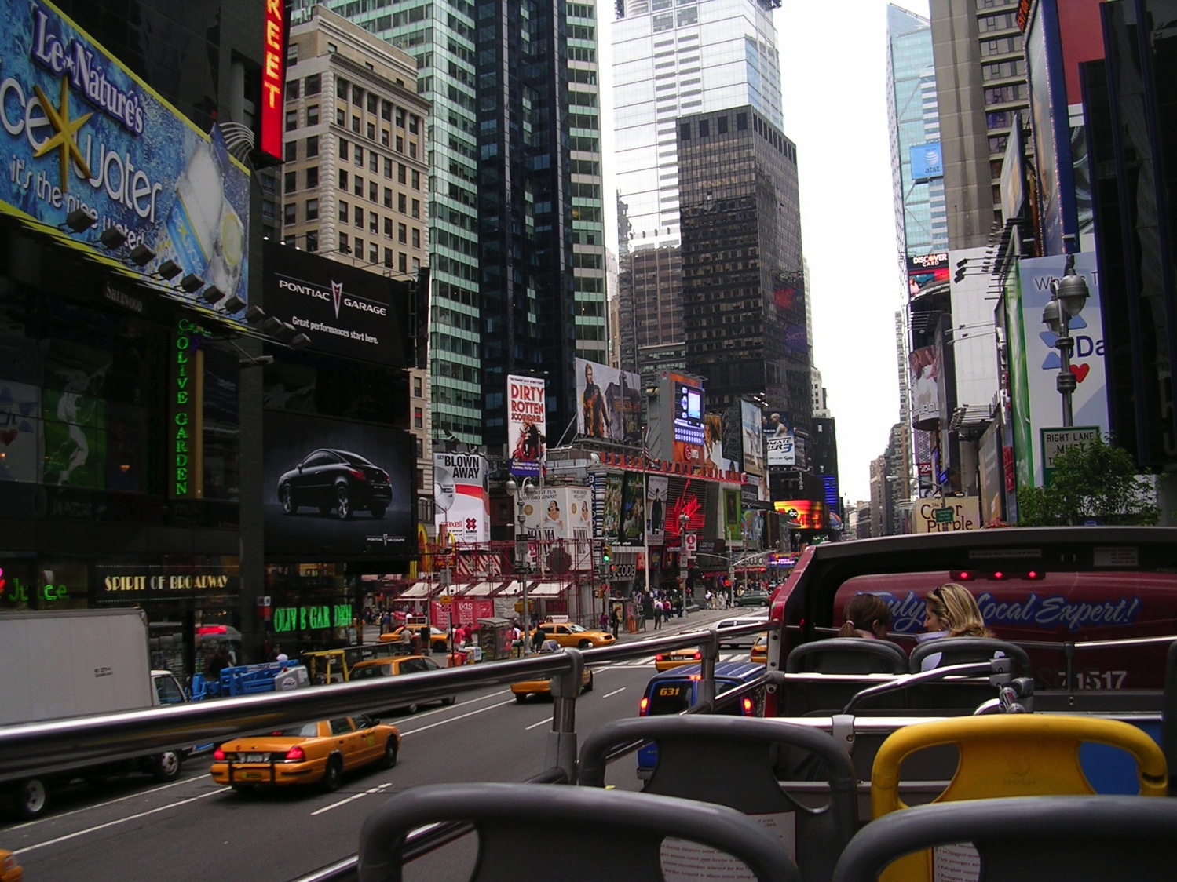
Notes:
New York City, Broadway
Photo credit: Brenda D. Anderson

Slide 25
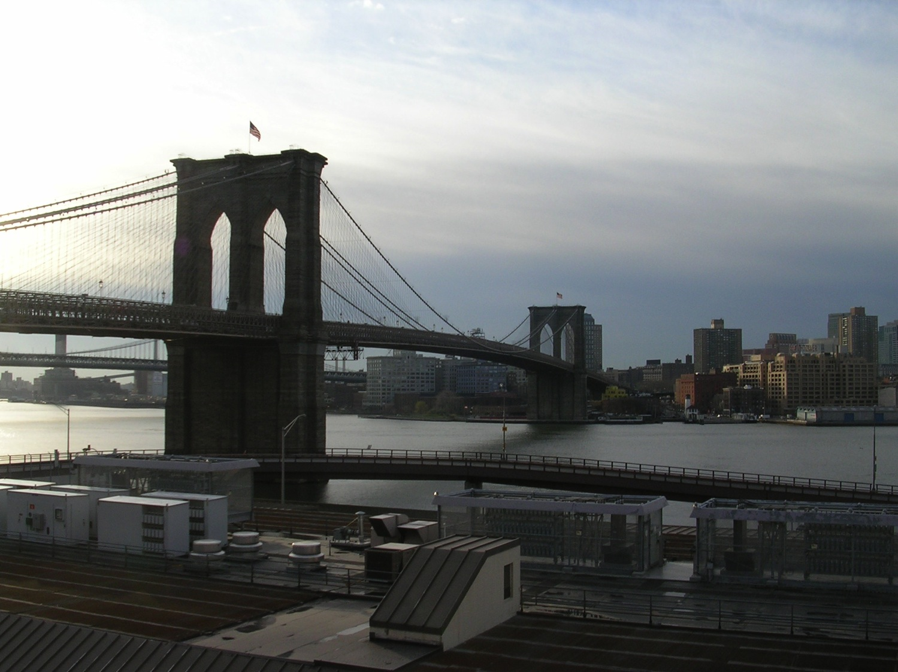
Notes:
Brooklyn Bridge, East River looking over to Brooklyn
Photo credit: Brenda D. Anderson

Slide 26
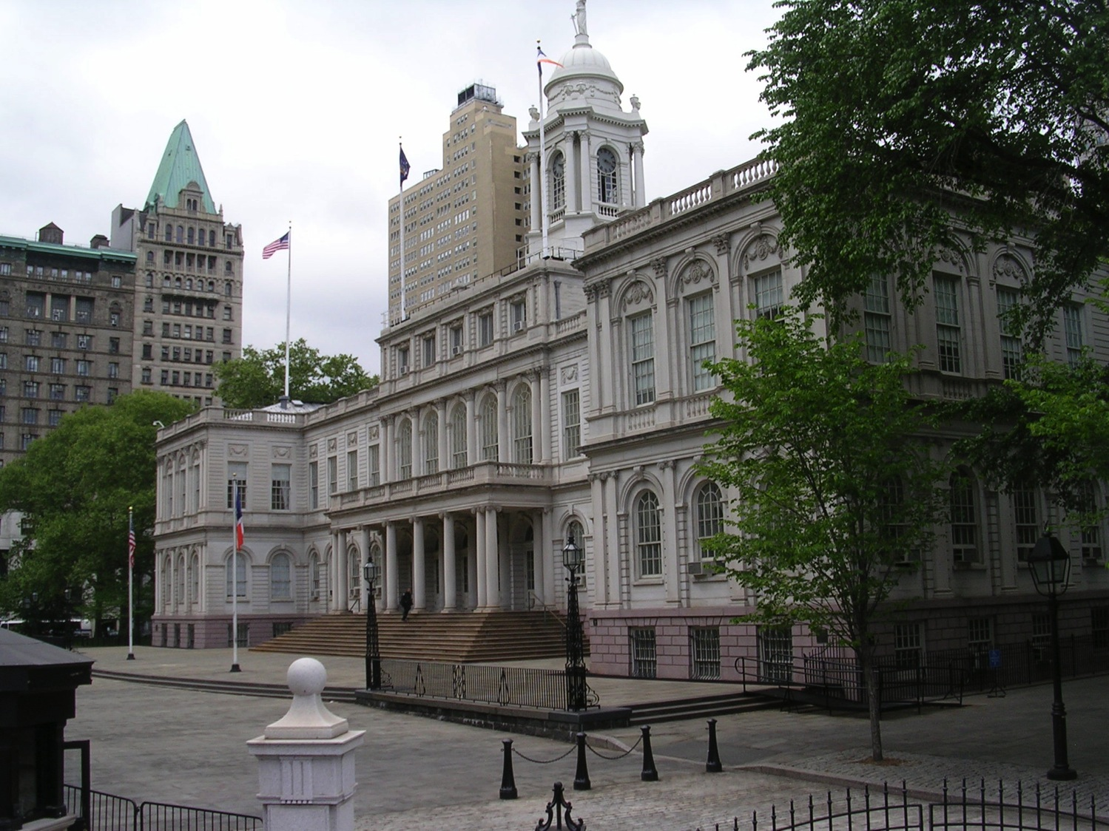
Notes:
New York City, government building
Photo credit: Brenda D. Anderson

Slide 27
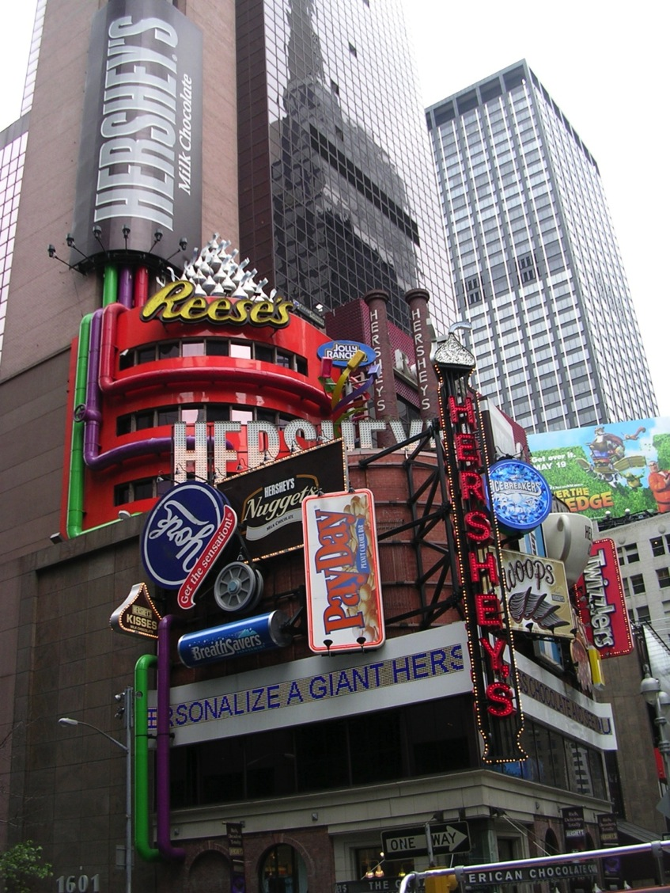
Notes:
Hershey’s Building, Time Square, New York City
Photo credit: Brenda D. Anderson

Slide 28
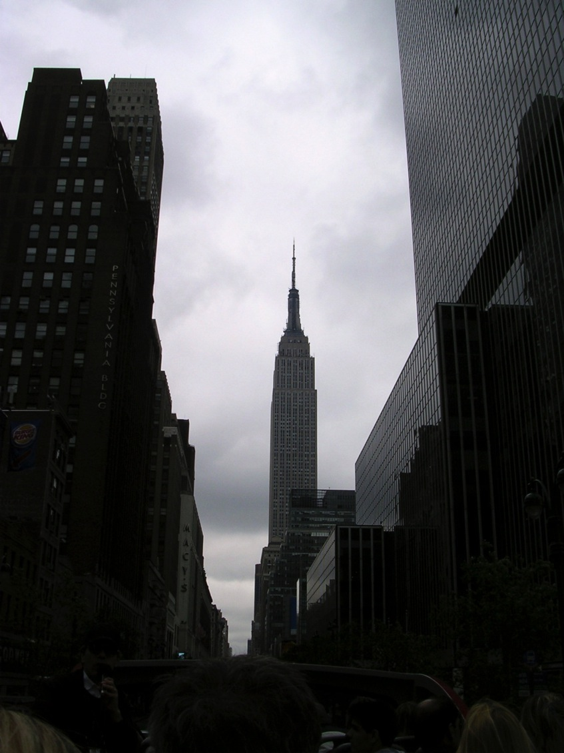
Notes:
New York City, Empire State Building
Photo credit: Brenda D. Anderson

Slide 29
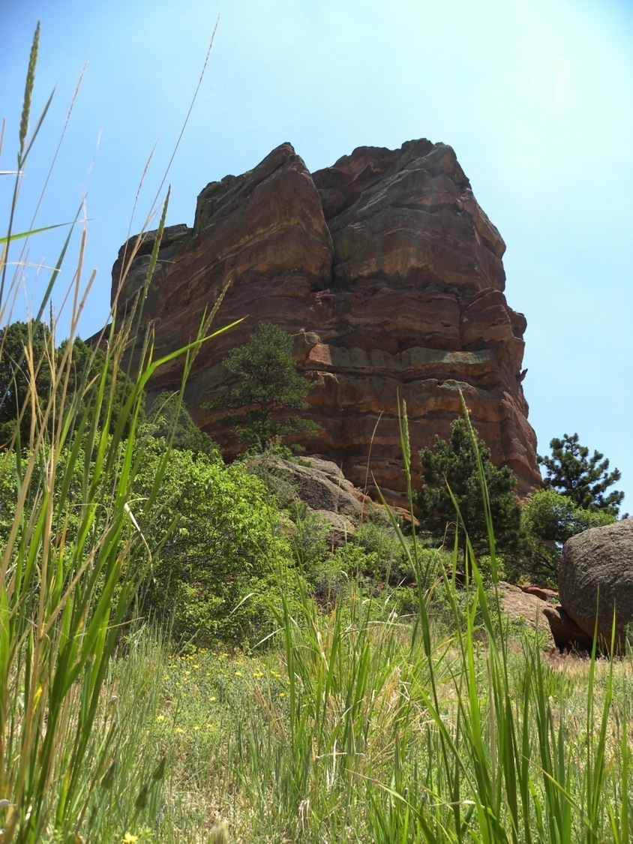
Notes:
Red Rock Canyon, Colorado
Photo credit: Brenda D. Anderson

Slide 30
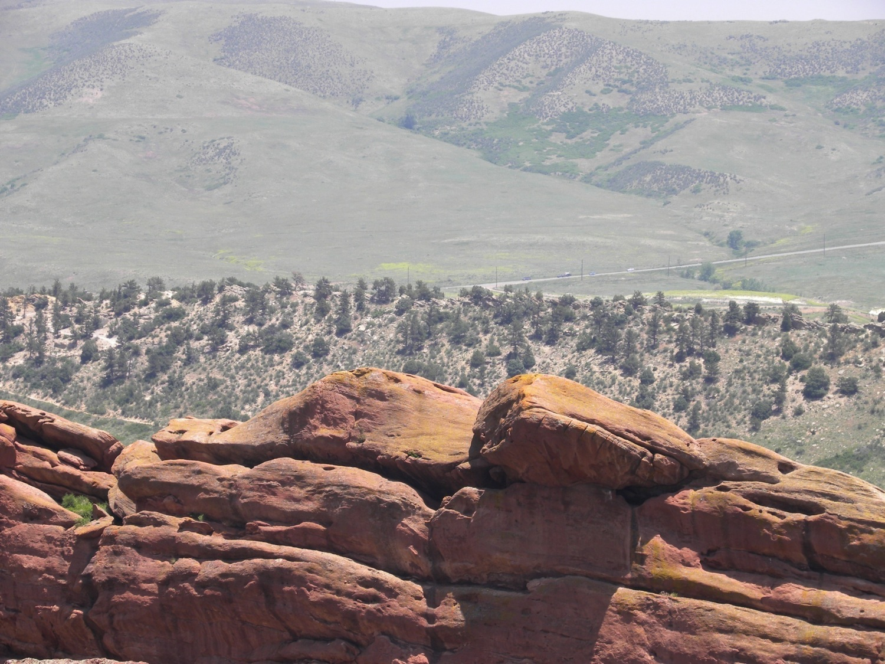
Notes:
Colorado, rocks, mountains, road
Photo credit: Brenda D. Anderson

Slide 31
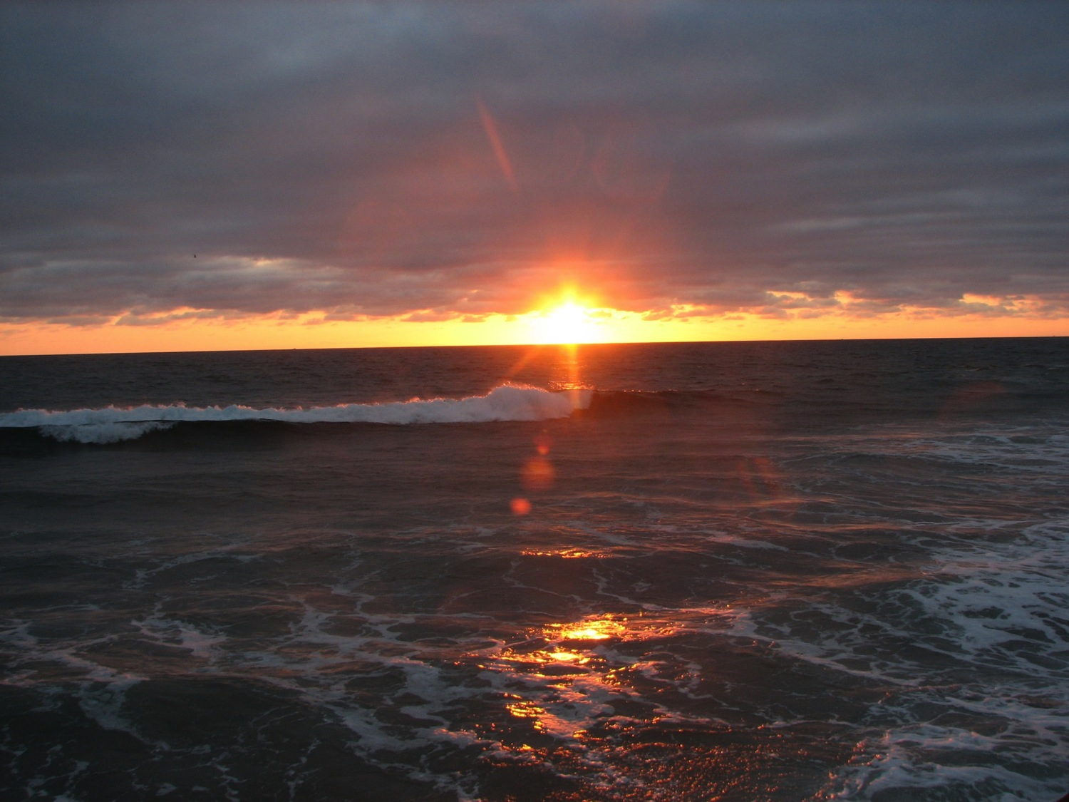
Notes:
Atlantic Ocean, Maine
Photo credit: Brenda D. Anderson

Slide 32
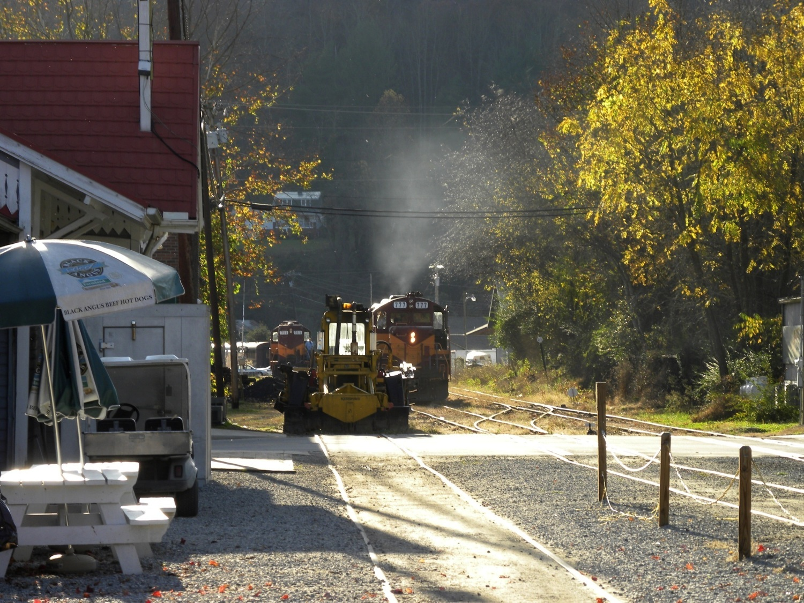
Notes:
North Carolina, train on track
Photo credit: Brenda D. Anderson

Slide 33
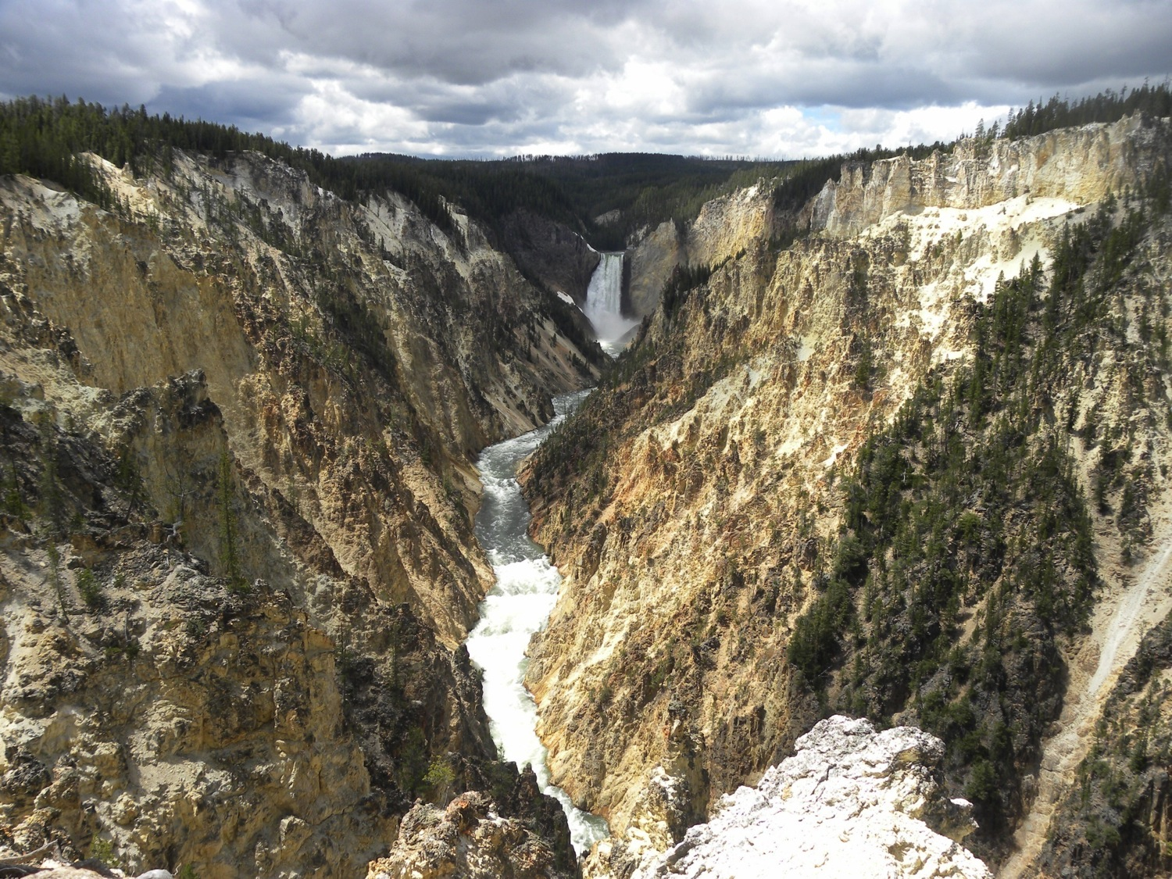
Notes:
Yellowstone National Park, waterfall, canyon
Photo credit: Brenda D. Anderson

Slide 34
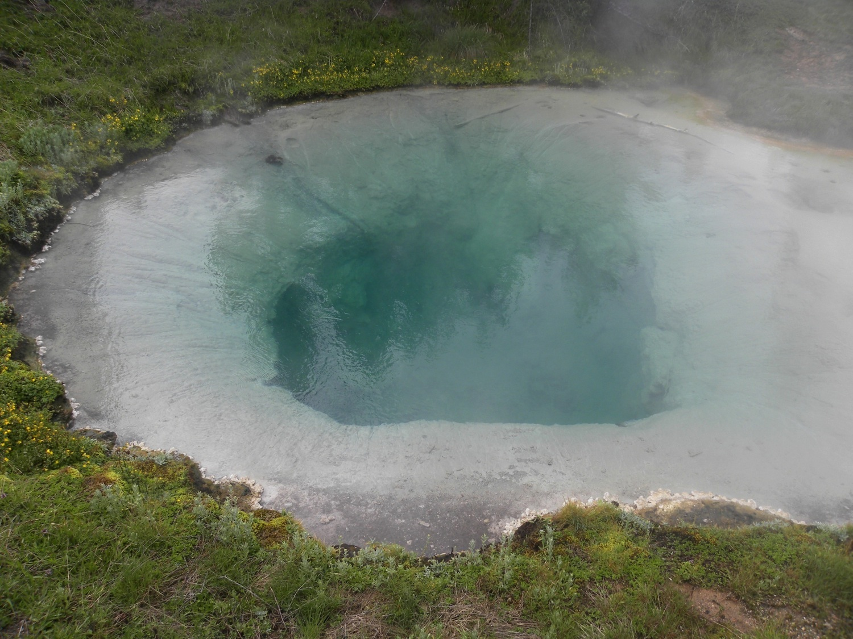
Notes:
Yellowstone, hot sulfur pot
Photo credit: Brenda D. Anderson

Slide 35
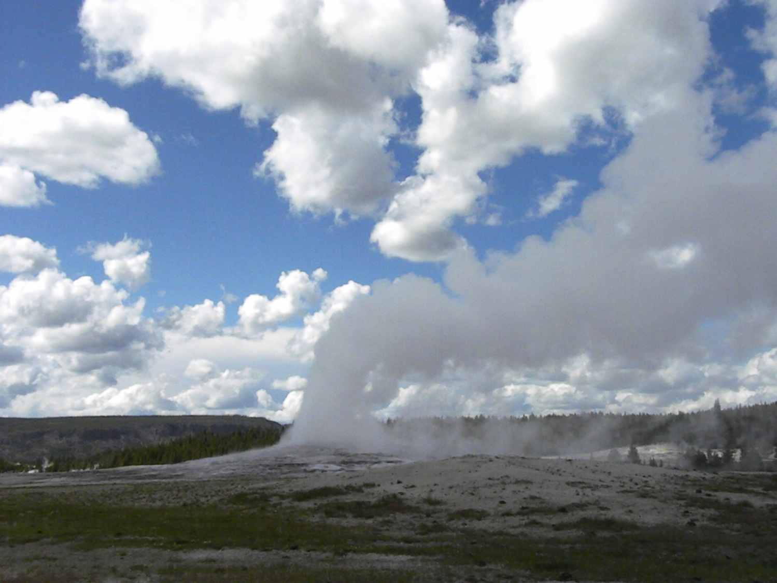
Notes:
Yellowstone National Park, Old Faithful geyser
Photo credit: Brenda D. Anderson

Slide 36
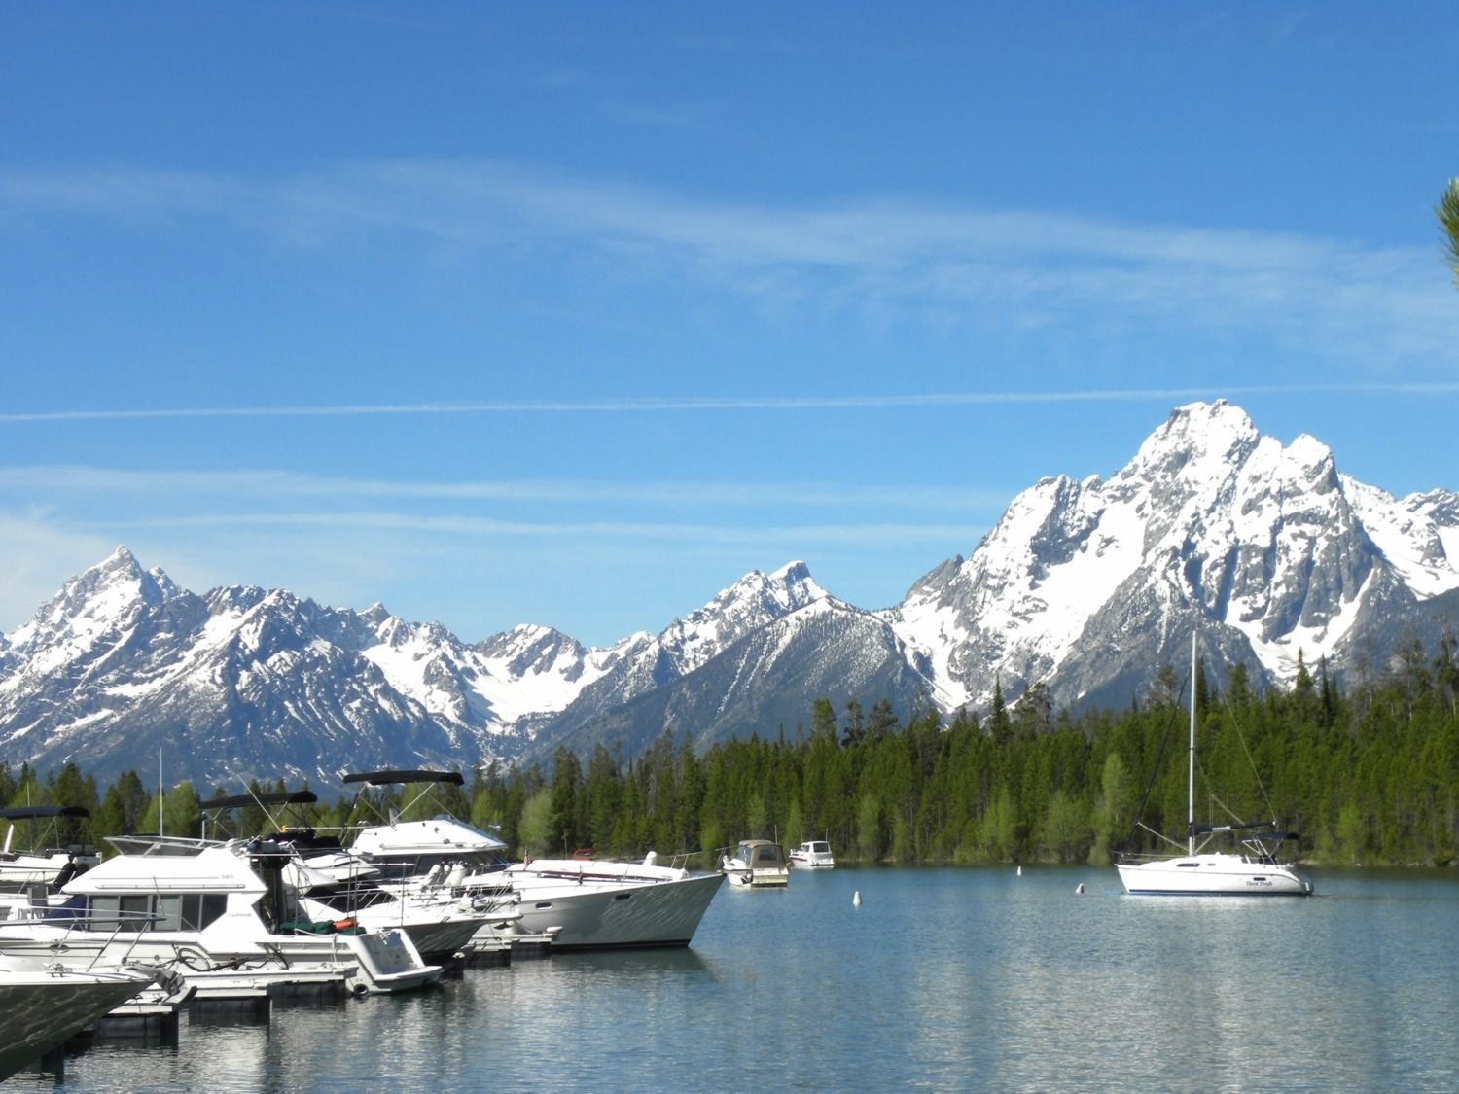
Notes:
Grand Teton Mountains
Photo credit: Brenda D. Anderson

Slide 37
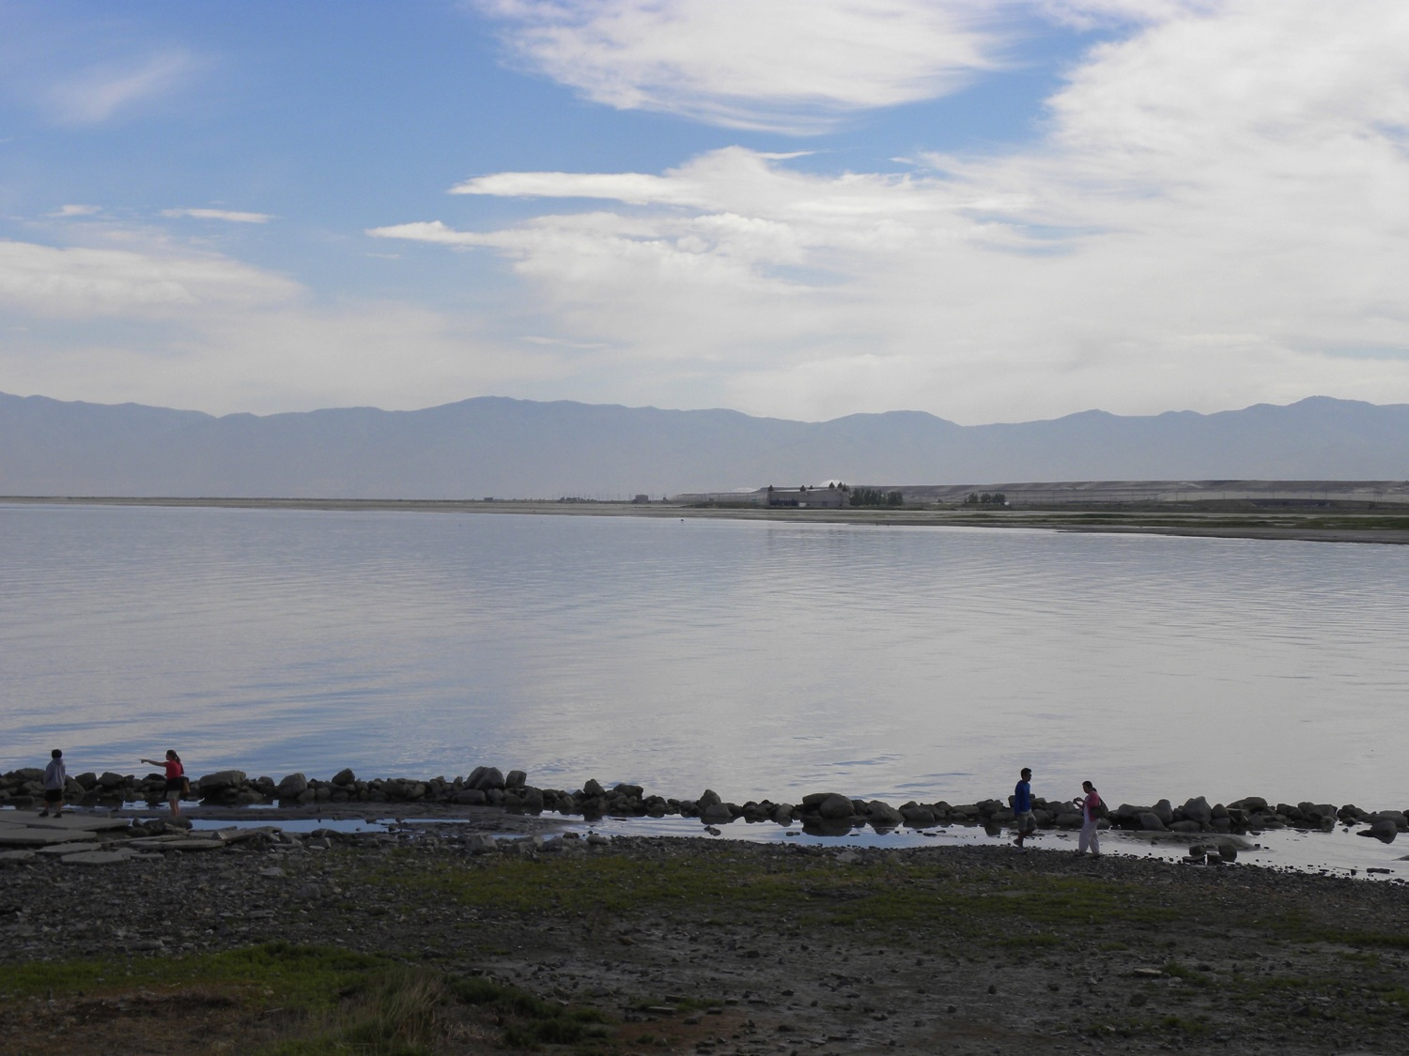
Notes:
Great Salt Lake, Utah
Photo credit: Brenda D. Anderson

Slide 38
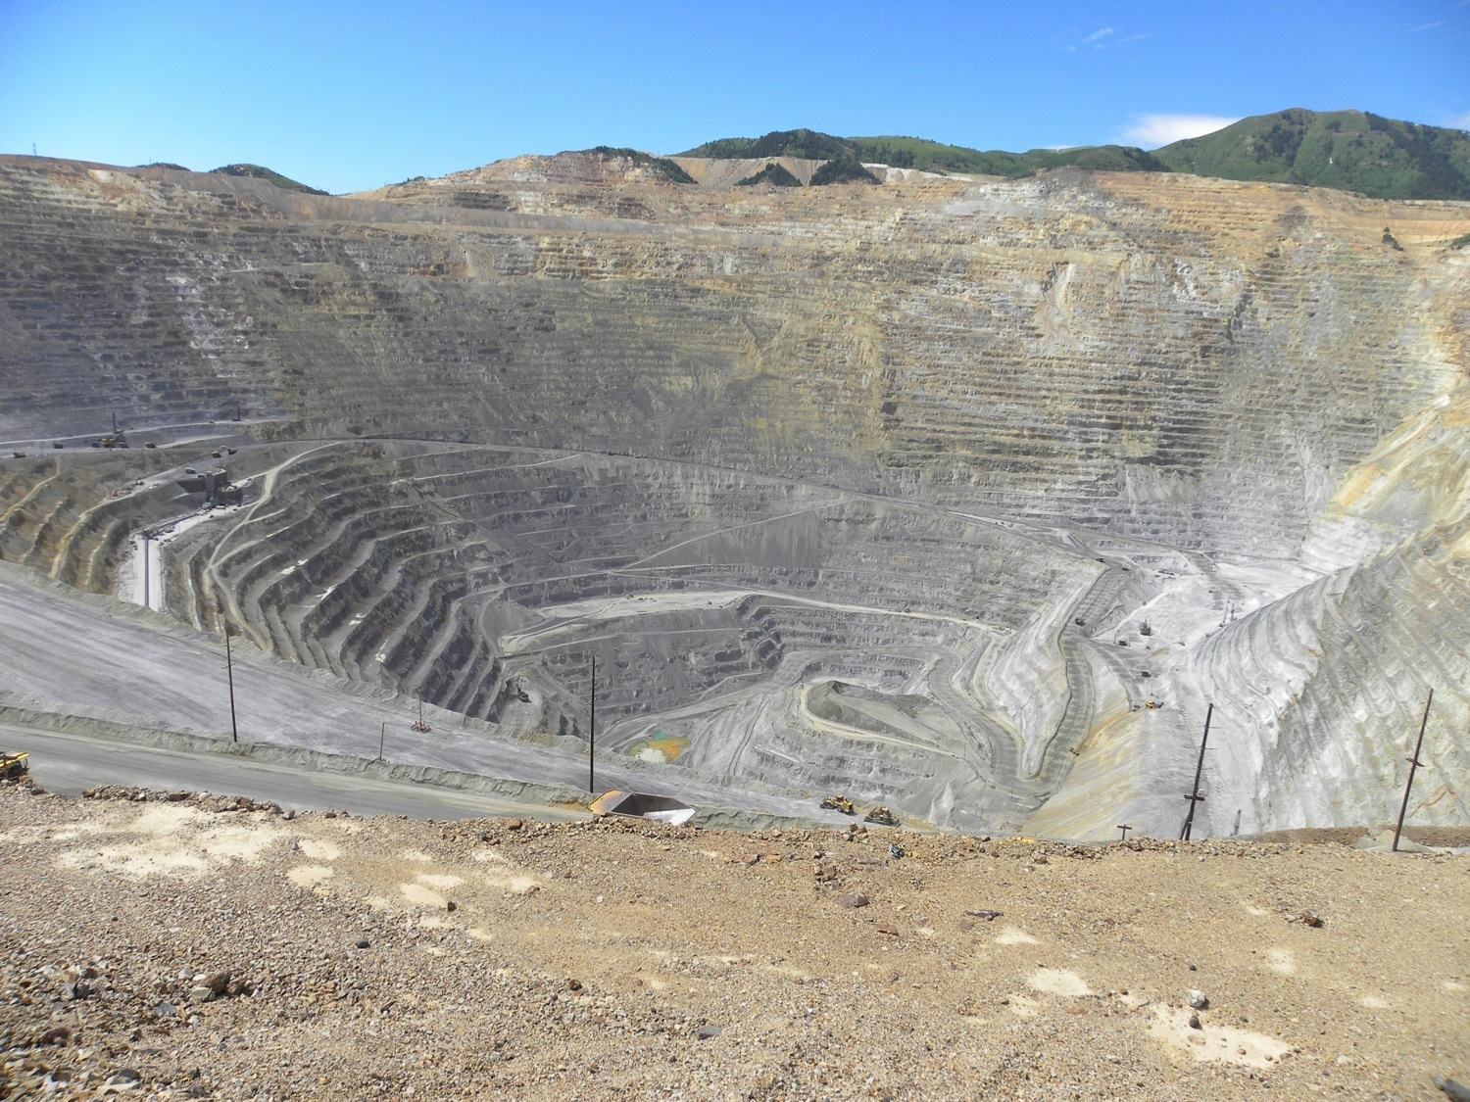
Notes:
Bingham Canyon Mine, copper mining
Photo credit: Brenda D. Anderson

Slide 39
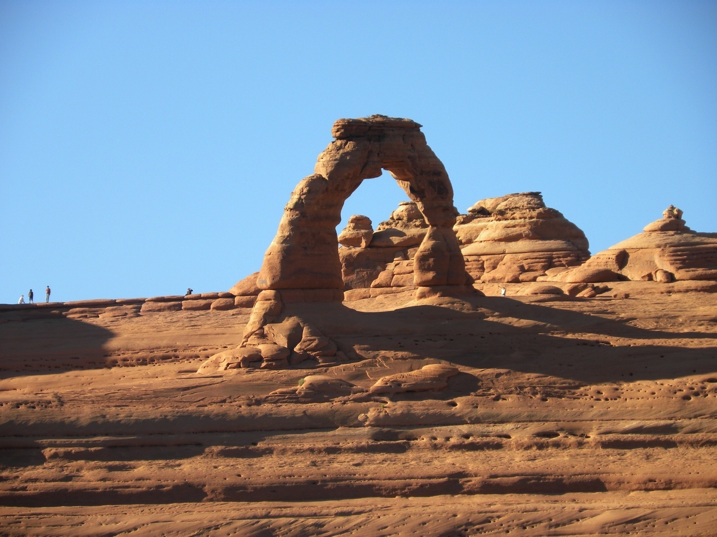
Notes:
Arches National Park
Photo credit: Brenda D. Anderson

Slide 40
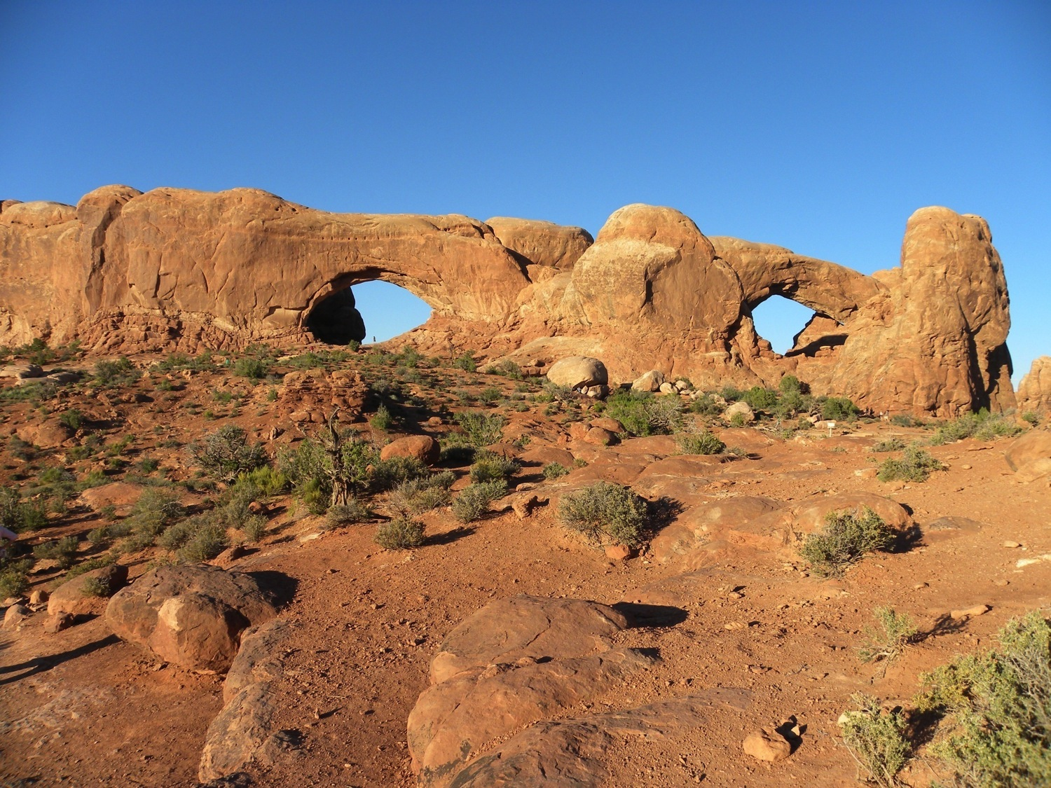
Notes:
Arches National Park
Photo credit: Brenda D. Anderson

Slide 41
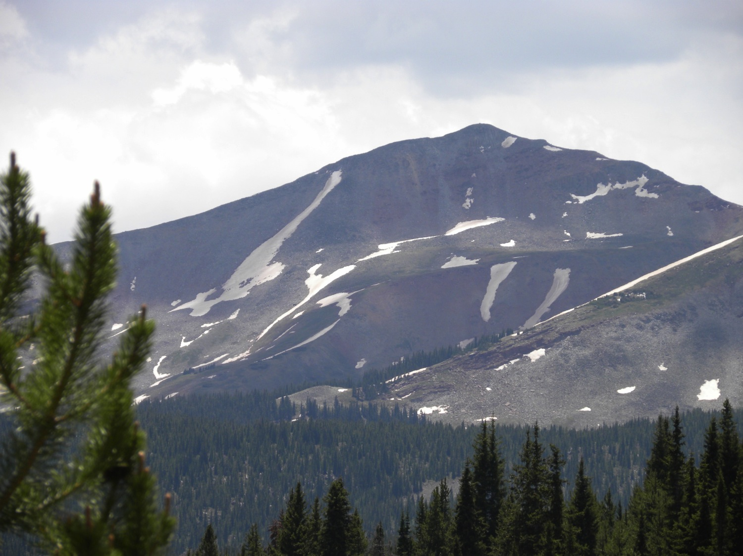
Notes:
Rocky Mountains, Colorado
Photo credit: Brenda D. Anderson

Slide 42
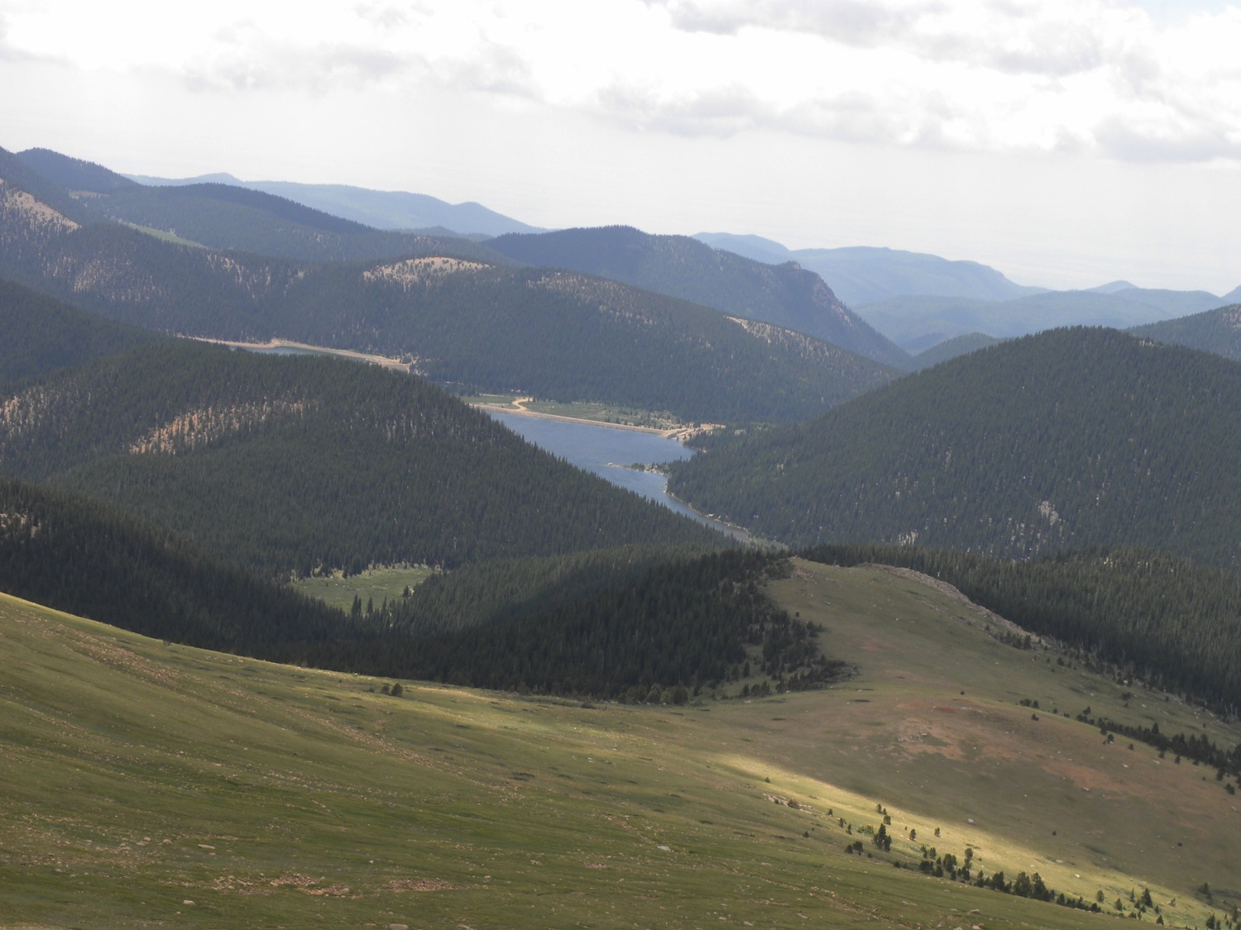
Notes:
Colorado from Pikes Peake
Photo credit: Brenda D. Anderson

Slide 43
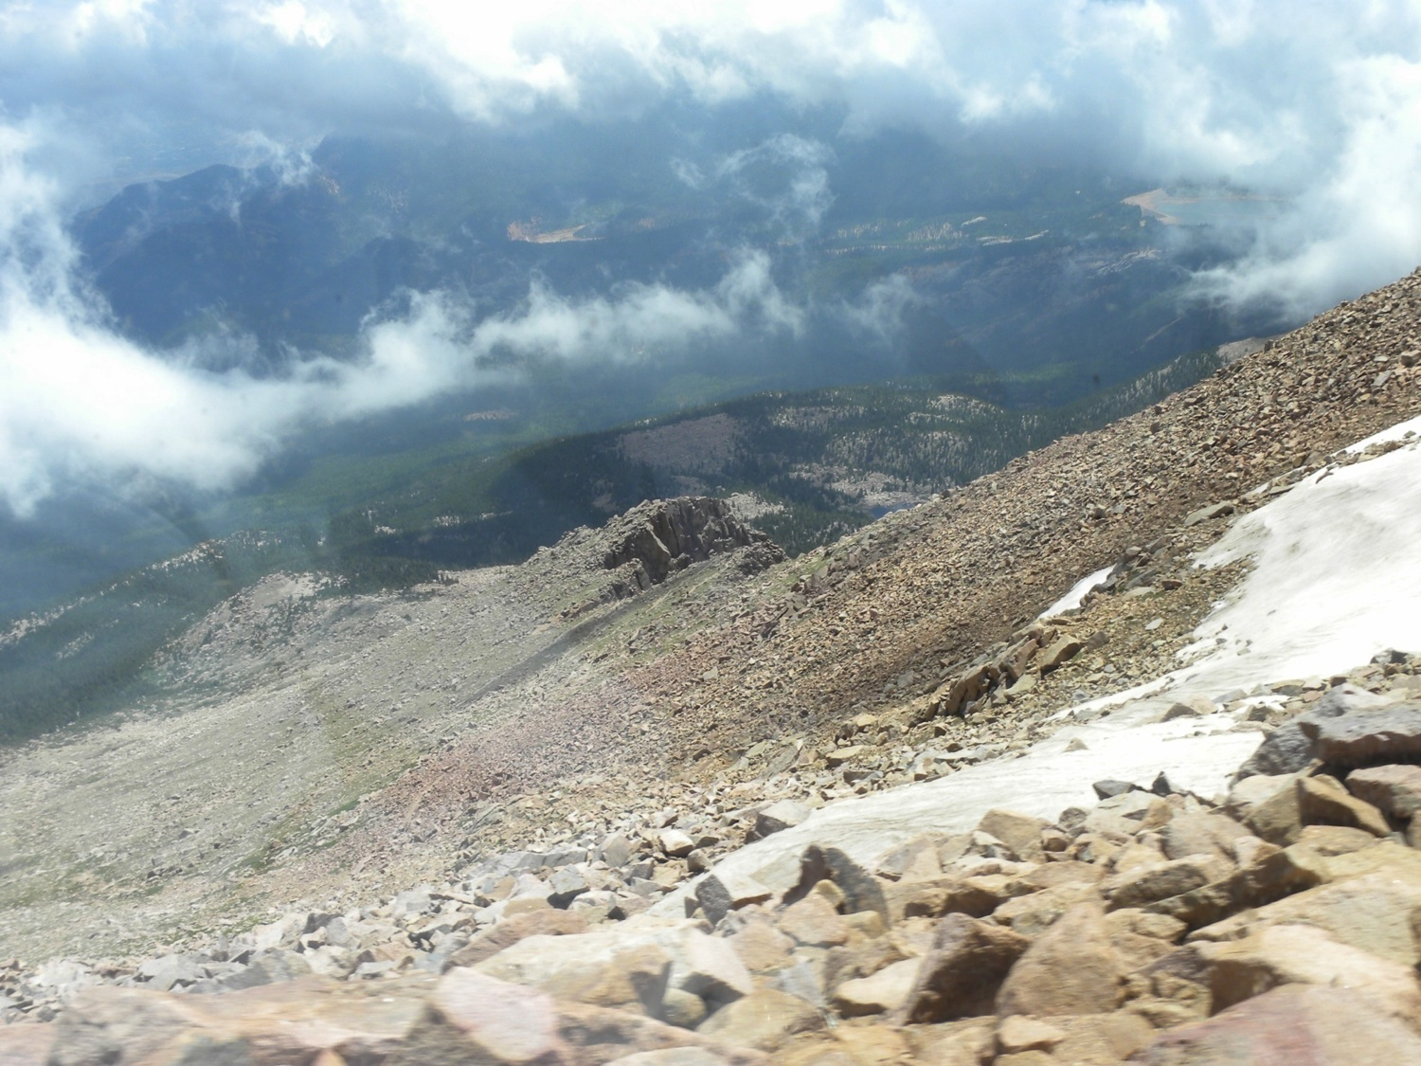
Notes:
Alpine tundra, Pikes Peake, Colorado
Photo credit: Brenda D. Anderson

Slide 44
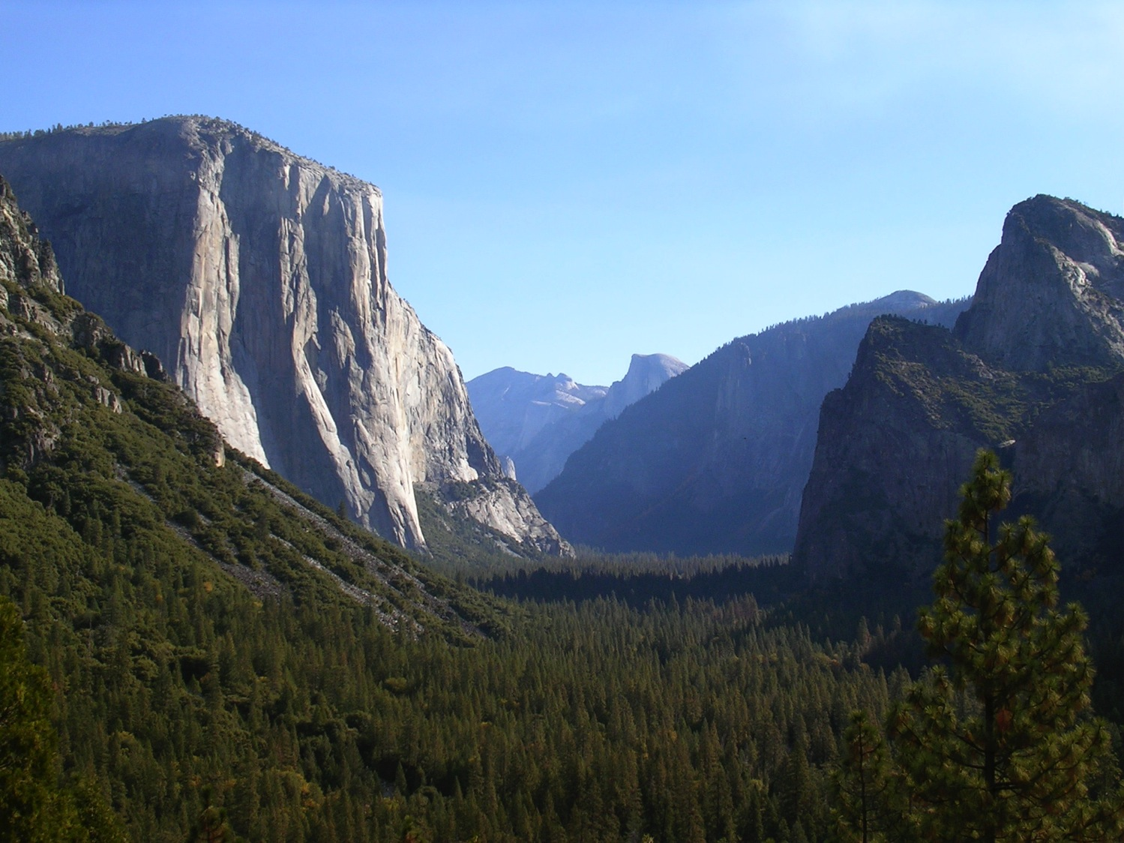
Notes:
Yosemite National Park
Photo credit: Brenda D. Anderson

Slide 45
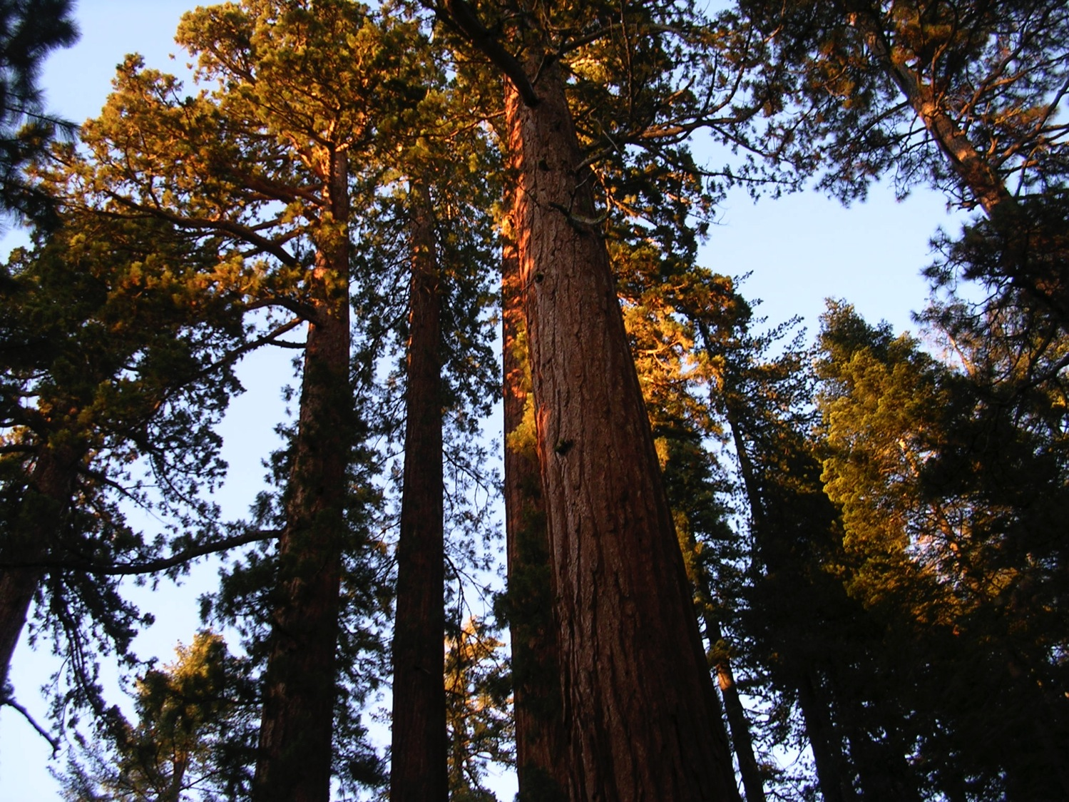
Notes:
Giant Sequoia trees, Sequoia National Park
Photo credit: Brenda D. Anderson

Slide 46
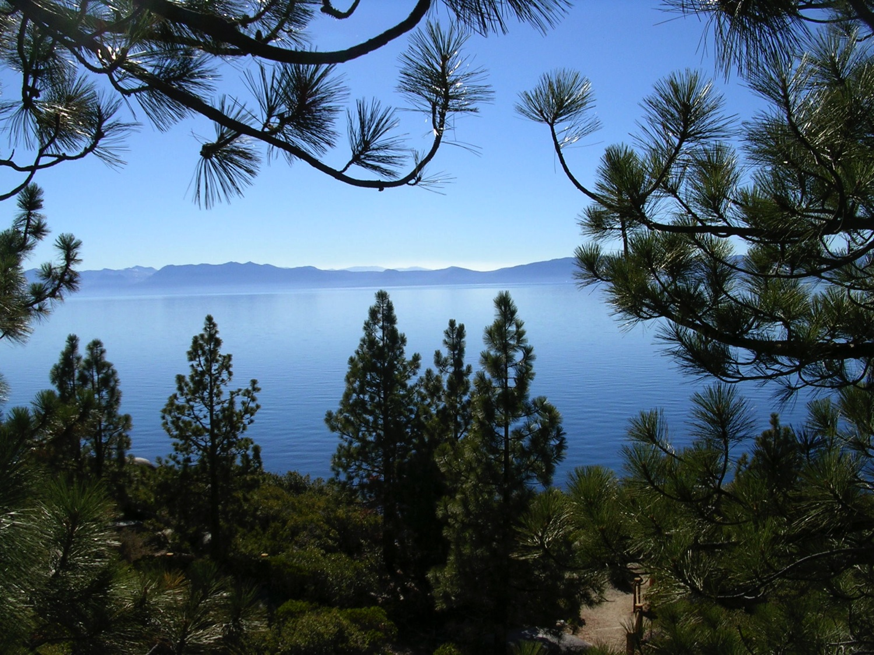
Notes:
Lake Tahoe
Photo credit: Brenda D. Anderson

Slide 47
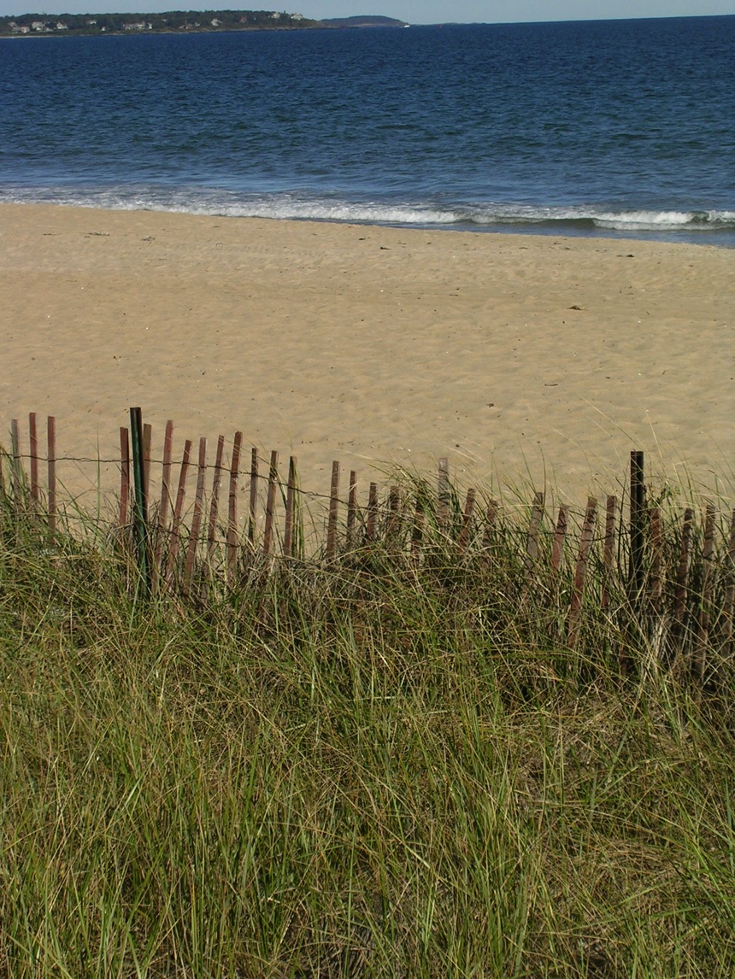
Notes:
Beach, New England
Photo credit: Brenda D. Anderson

Slide 48
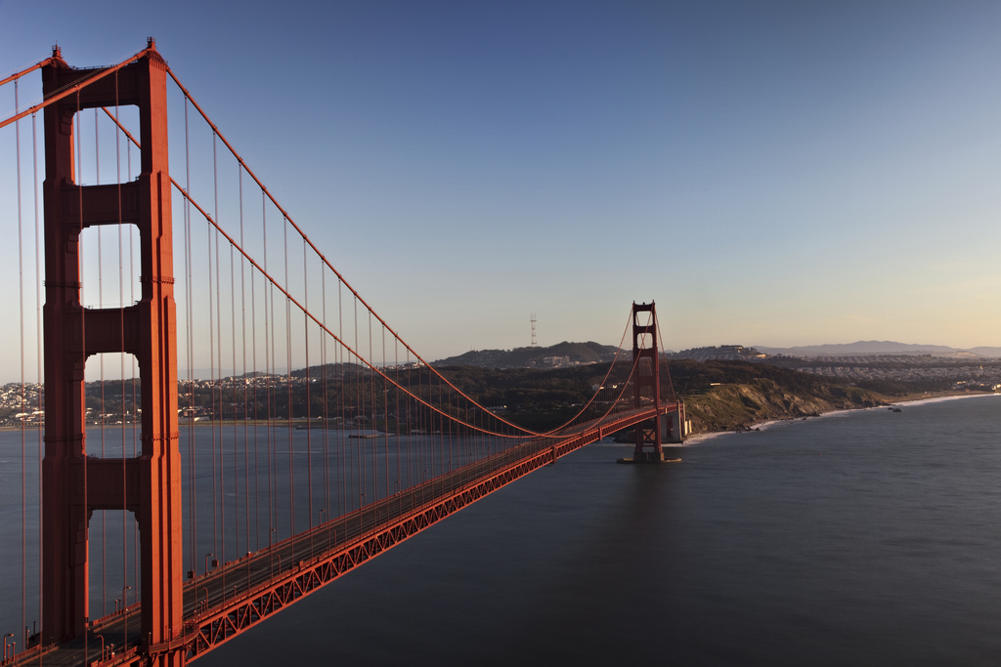
Notes:
Golden Gate Bridge
http://www.flickr.com/photos/kevcole/4436427104/

Slide 49
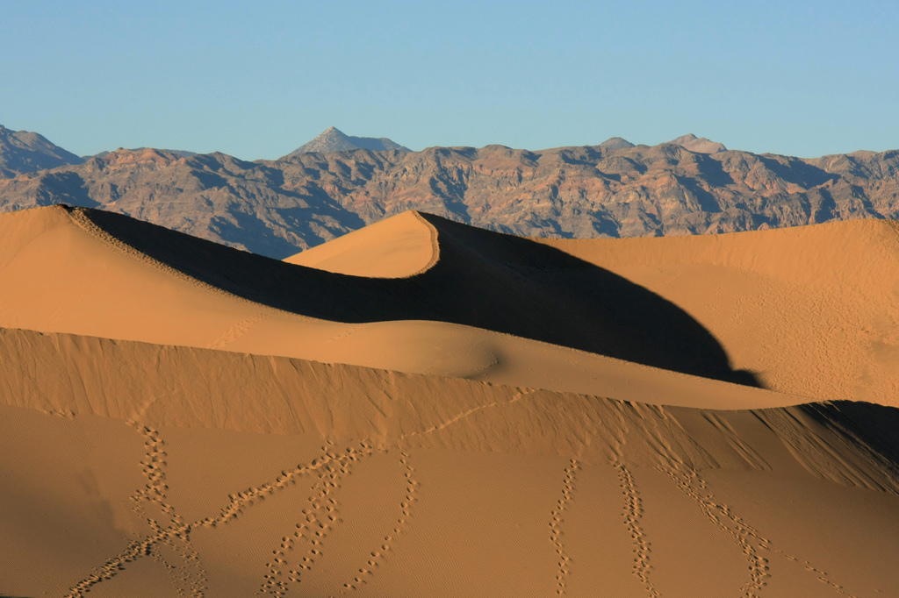
Notes:
Death Valley, CA sand dunes
http://www.flickr.com/photos/ssanyal/2146225430/

Slide 50
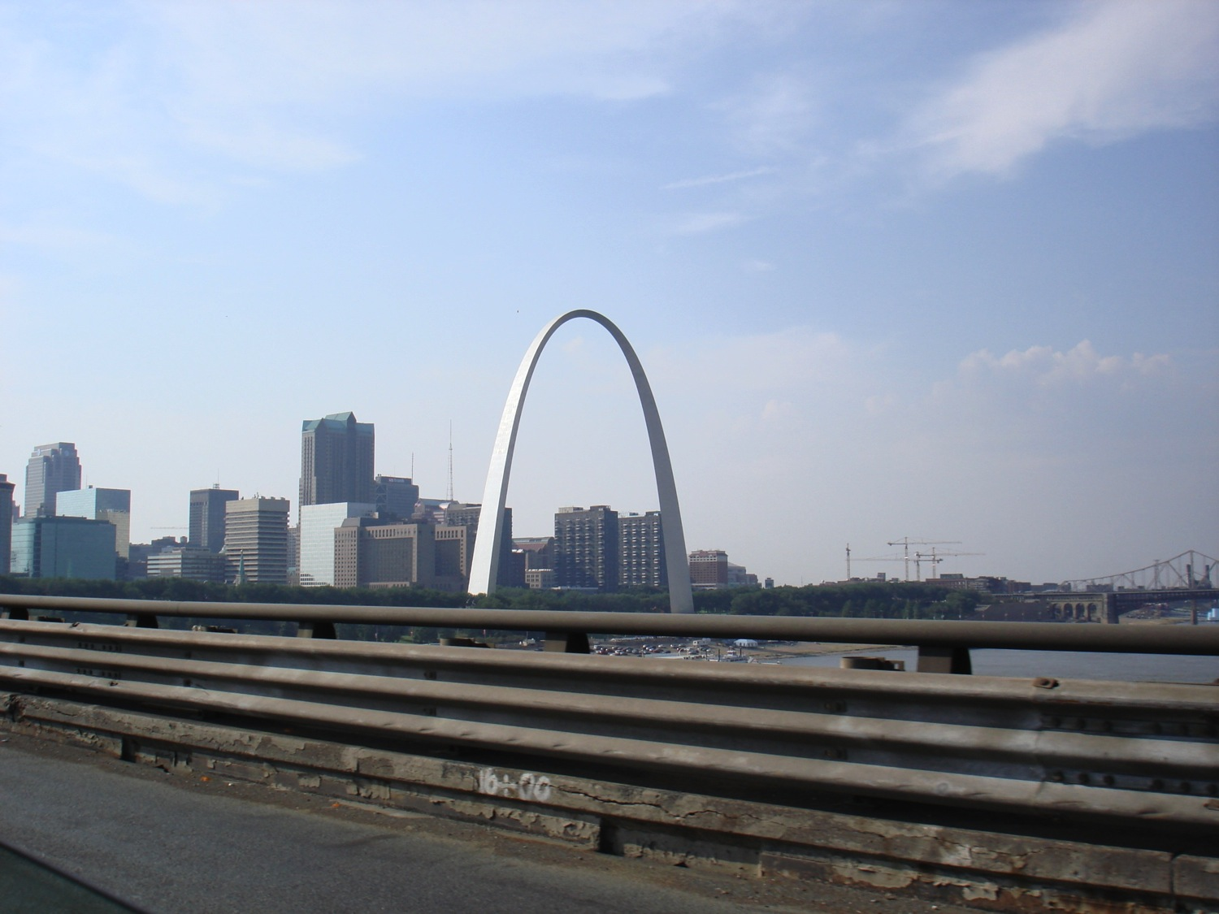
Notes:
St Louis Missouri
Photo credit: Brenda D Anderson

Slide 51
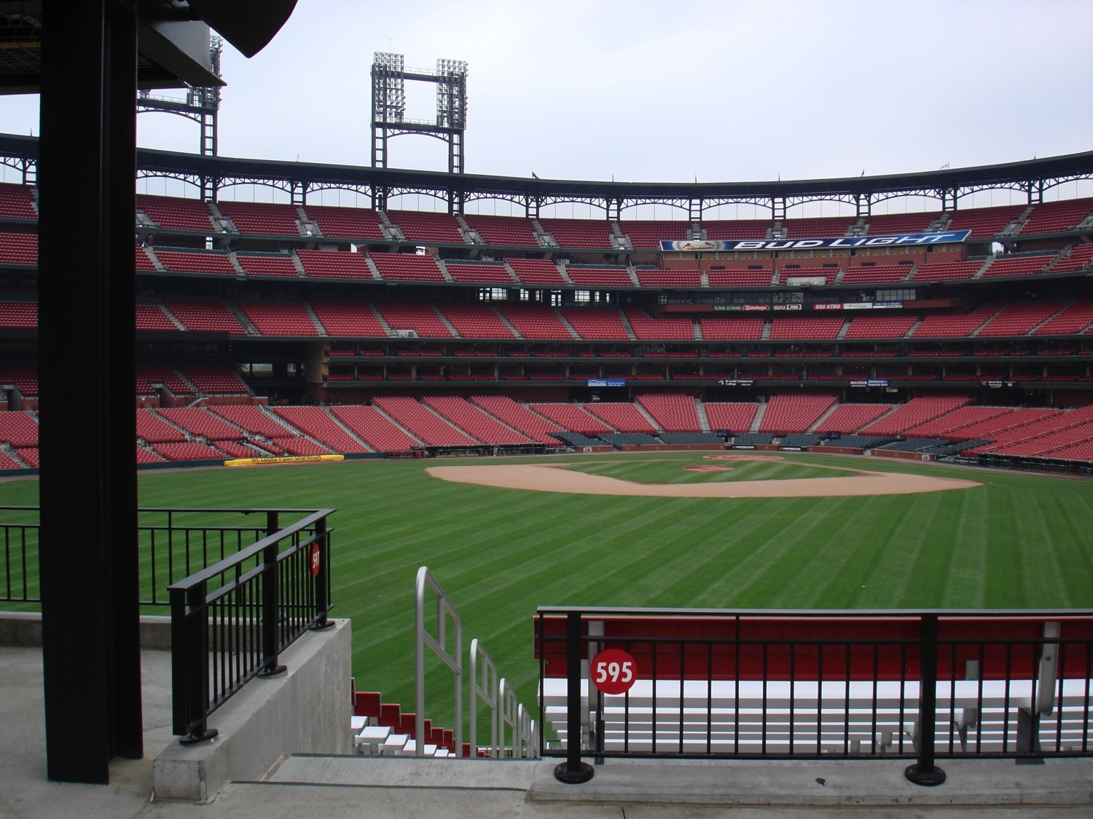
Notes:
Baseball stadium, St Louis Missouri
Photo credit: Brenda D. Anderson

Slide 52
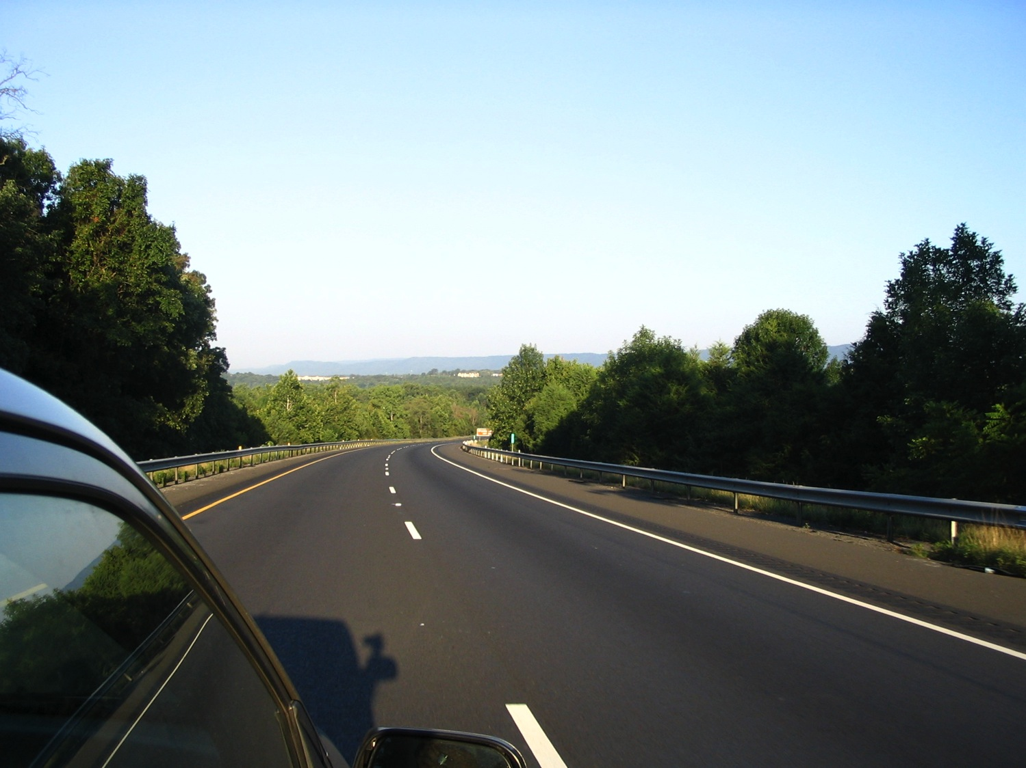
Notes:
Road
Photo credit: Brenda D. Anderson

