Slide 1
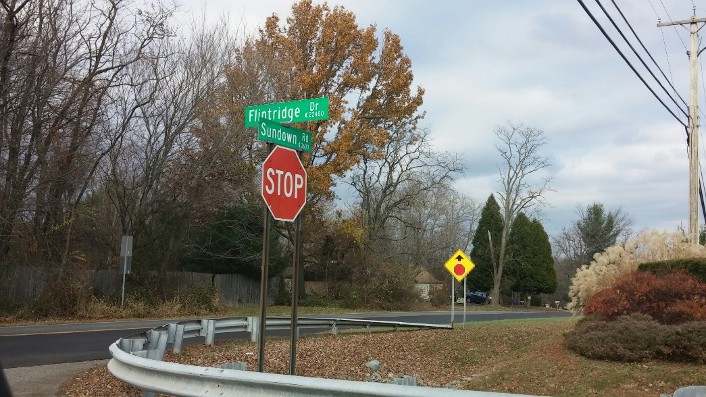
Unity Area Boundary Study
Community Meeting
January 18, 2017
www.montgomeryschoolsmd.org/departments/planning/unityarea.aspx

Slide 2
Agenda
Sign in – I will call on people in order
Ground Rules
Review Option

Slide 3
Ground Rules
Be true to the charge
Share openly
Participate enthusiastically
Give and receive constructive feedback
Appreciate everyone’s ideas
Suspend judgment
Limit discussions to the topic
Do homework and be prepared
Abide by decisions made by the facilitator
Cell phones—turn off, vibrate, or answer on first ring
Start and end meetings on time

Slide 5
Laytonsville ES Enrollment and Capacity (Maximum # of Seats=449)
 | 2017–18 | 2018–19 | 2019–20 | 2020–21 | 2021–22 | 2022–23
No Change
Number of Students | 370 | 376 | 313 | 382 | 374 | 390
% of Building Occupied | 82% | 84% | 70% | 85% | 83% | 87%
Available Seats | 79 | 73 | 136 | 67 | 75 | 59
With Change
Number of Students | 360 | 366 | 303 | 372 | 364 | 380
% of Building Occupied | 80% | 82% | 67% | 83% | 81% | 85%
Available Seats | 89 | 83 | 146 | 77 | 85 | 69

Slide 6
Greenwood ES Enrollment and Capacity (Maximum # of Seats=584)
 | 2017–18 | 2018–19 | 2019–20 | 2020–21 | 2021–22 | 2022–23
No Change
Number of Students | 462 | 450 | 443 | 450 | 447 | 432
% of Building Occupied | 79% | 77% | 76% | 77% | 77% | 74%
Available Seats | 122 | 134 | 141 | 134 | 137 | 152
With Change
Number of Students | 472 | 460 | 453 | 460 | 457 | 442
% of Building Occupied | 81% | 79% | 79% | 79% | 78% | 76%
Available Seats | 112 | 124 | 131 | 124 | 127 | 142

Slide 7
Effect on Demographics
School | % Afr. Amer. | % Asian | % Hispanic |  | % White | % 2 or More | % FARMS | % ESOL
No Change
Laytonsville ES | 15.7% | 7.1% | 20.9% |  | 47.9% | 8.4% | 20.8% | 5.2%
With Change
Laytonsville ES | 16.0% | 7.2% |  | 21.1% | 47.5% | 8.3% | 21.4% | 5.6%
No Change
Greenwood ES | 10.4% | 7.8% |  | 7.8% | 66.7% | 7.4% | 9.1% | <5.0%
With Change
Greenwood ES | 10.3% | 7.7% |  | 7.9% | 66.7% | 7.5% | 8.9% | <5.0%

Slide 8
Gaithersburg MS Enrollment and Capacity (Maximum # of Seats=962)
 | 2017–18 | 2018–19 | 2019–20 | 2020–21 | 2021–22 | 2022–23
No Change
Number of Students | 816 | 857 | 865 | 901 | 959 | 957
% of Building Occupied | 85% | 89% | 90% | 94% | 100% | 99%
Available Seats | 146 | 105 | 97 | 61 | 3 | 5
With Change
Number of Students | 806 | 847 | 855 | 891 | 949 | 947
% of Building Occupied | 84% | 88% | 89% | 93% | 99% | 98%
Available Seats | 156 | 115 | 107 | 71 | 13 | 15

Slide 9
Rosa Parks MS Enrollment and Capacity (Maximum # of Seats=978)
 | 2017–18 | 2018–19 | 2019–20 | 2020–21 | 2021–22 | 2022–23
No Change
Number of Students | 862 | 836 | 851 | 830 | 824 | 812
% of Building Occupied | 88% | 85% | 87% | 85% | 84% | 83%
Available Seats | 116 | 142 | 127 | 148 | 154 | 166
With Change
Number of Students | 872 | 846 | 861 | 840 | 834 | 822
% of Building Occupied | 89% | 87% | 88% | 86% | 85% | 84%
Available Seats | 106 | 132 | 117 | 138 | 144 | 156

Slide 10
Effect on Demographics
School | % Afr. Amer. | % Asian | % Hispanic |  | % White | % 2 or More | % FARMS | % ESOL
No Change
Gaithersburg MS | 23.3% | 7.5% | 46.3% |  | 21.0% | <5% | 44.4% | 13.0%
With Change
Gaithersburg MS | 21.5% | 7.6% |  | 46.6% | 20.4% | <5% | 44.9% | 13.1%
No Change
Rosa Parks MS | 12.0% | 10.2% |  | 11.5% | 61.7% | <5% | 10.9% | <5.0%
With Change
Rosa Parks MS | 11.8% | 10.1% |  | 11.6% | 61.8% | <5% | 10.0% | <5.0%

Slide 11
Gaithersburg HS Enrollment and Capacity (Maximum # of Seats=2407)
 | 2017–18 | 2018–19 | 2019–20 | 2020–21 | 2021–22 | 2022–23
No Change
Number of Students | 2480 | 2496 | 2524 | 2539 | 2590 | 2736
% of Building Occupied | 103% | 104% | 105% | 105% | 108% | 114%
Available Seats | -73 | -89 | -117 | -132 | -183 | -329
With Change
Number of Students | 2475 | 2491 | 2519 | 2534 | 2585 | 2731
% of Building Occupied | 103% | 103% | 105% | 105% | 107% | 113%
Available Seats | -68 | -84 | -112 | -127 | -178 | -324

Slide 12
Sherwood HS Enrollment and Capacity (Maximum # of Seats=2183)
 | 2017–18 | 2018–19 | 2019–20 | 2020–21 | 2021–22 | 2022–23
No Change
Number of Students | 1933 | 1989 | 1981 | 2012 | 1984 | 1959
% of Building Occupied | 89% | 91% | 91% | 92% | 91% | 90%
Available Seats | 250 | 194 | 202 | 171 | 199 | 224
With Change
Number of Students | 1938 | 1994 | 1986 | 2017 | 1989 | 1964
% of Building Occupied | 89% | 91% | 91% | 92% | 91% | 90%
Available Seats | 245 | 189 | 197 | 166 | 194 | 219

Slide 13
Effect on Demographics
School | % Afr. Amer. | % Asian | % Hispanic |  | % White | % 2 or More | % FARMS | % ESOL
No Change
Gaithersburg HS | 24.8% | 7.6% | 49.1% |  | 15.4% | <5.0% | 41.3% | 19.9%
With Change
Gaithersburg HS | 24.8% | 7.6% |  | 49.1% | 15.2% | <5.0% | 41.3% | 19.9%
No Change
Sherwood HS | 17.1% | 11.5% |  | 18.2% | 49.2% | <5.0% | 5.2% | <5.0%
With Change
Sherwood HS | 17.1% | 11.5% |  | 18.1% | 49.3% | <5.0% | 5.2% | <5.0%

Slide 14
Next Steps
PTAs and organizations should hold meetings to gather input about option
Committee members will share the input at the next meeting
Committee members should fill out evaluation forms for next meeting
PTAs should prepare position papers for next meeting

Slide 15
Website
All materials will be posted on the following website:
http://www.montgomeryschoolsmd.org/departments/planning/unityarea.aspx

